Slide 1
Internship & Career Fair Prep Workshop

Slide 2
What is a CAREER FAIR?

Slide 3
A career fair is a formal gathering of potential employers who want to meet prospective employees.

Slide 4
What We’ll Cover Today…
Why should you attend career fairs?
Why do employers attend career fairs?
The 6 R’s of career fair preparation
Career fairs on campus
How Career Services may be helpful to you
Notes:
I am going to walk you through 6 overarching tips for preparing for a career fair.

Slide 5
Why Should You Attend?
Get a job or internship!
Get a new job or internship!
Check out potential career
opportunities- ‘window shopping’
Learn more about companies
Network with recruiters
Notes:
There are many reasons for attending a career fair. In addition to finding out about job and internship opportunities it is a great chance to explore career opportunities and learn about companies. Many of the representatives at the career fair will be alumni of the University of Kentucky – so be on the lookout for blue “alumni” ribbons to alert you to this fact.

Slide 6
Why do Employers Attend?
Seek out new employees, co-ops, and interns
Meet students in person and make
contacts
Advertise and gain exposure
for their company
Notes:
The obvious reason that employers attend a career fair at UK is to hire. Employers also view a career fair as a great opportunity to meet students or alumni in person rather than relying solely on the information in a resume. Employers also attend for Public Relations purposes and may not be actively hiring. You will want to use this opportunity to build your network!

Slide 7
The 6 R’s of career fair preparation

Slide 8
Research Employers via…
Wildcat CareerLink
OR
UK Career Fair+ app

Slide 9
Research Employers via Wildcat CareerLink
Visit gatton.uky.edu/career/ OR www.uky.edu/careercenter
View internship, co-op and job postings
Postings sent to UK (Wildcat CareerLink Jobs)
NACElink Network
Access employer contacts from employer database
Apply for on-campus interviews
Get details about job fairs
Access FREE resources such as InterviewStream®, CareerInsider by Vault® and Career Shift®
Notes:
In addition to the showcase, you will want to take advantage of Wildcat CareerLink. You can upload your resume to Wildcat CareerLink and apply for specific jobs and internships. WCL will aid in your research efforts if you take advantage of the Employer database of contact information. Let me know you what that looks like.

Slide 10
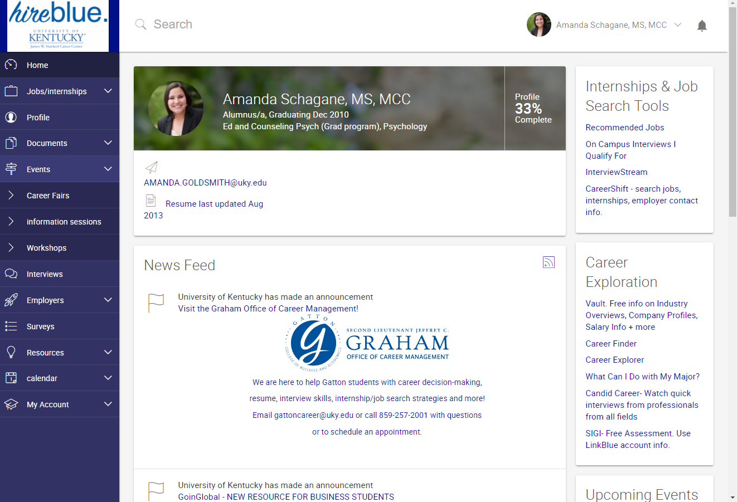
Wildcat CareerLink
Notes:
Wildcat CareerLink is a wealth of information. Go to the Events tab and then Career Fairs to see past career fairs and upcoming ones. This is where you can access the companies attending as well as the majors that they are seeking and whether the type of job that they are targeting whether full-time, or internships.
STOP PPT and demo WCL from log in. Mention all features of WCL, InterviewStream, CareerInsider by Vault and CareerShift.

Slide 11
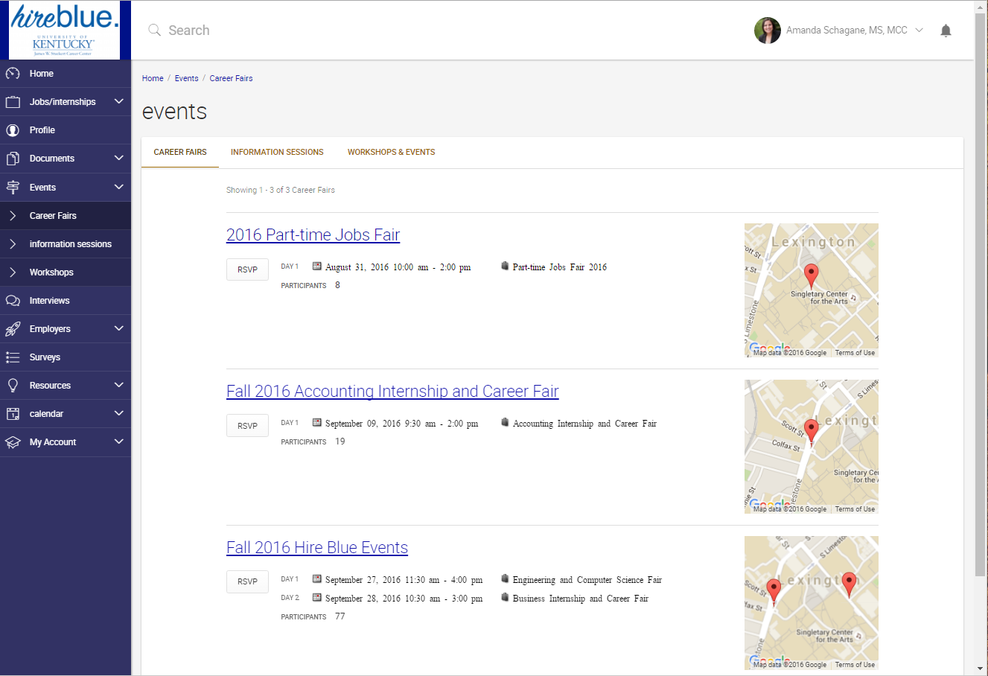
Wildcat CareerLink

Slide 12
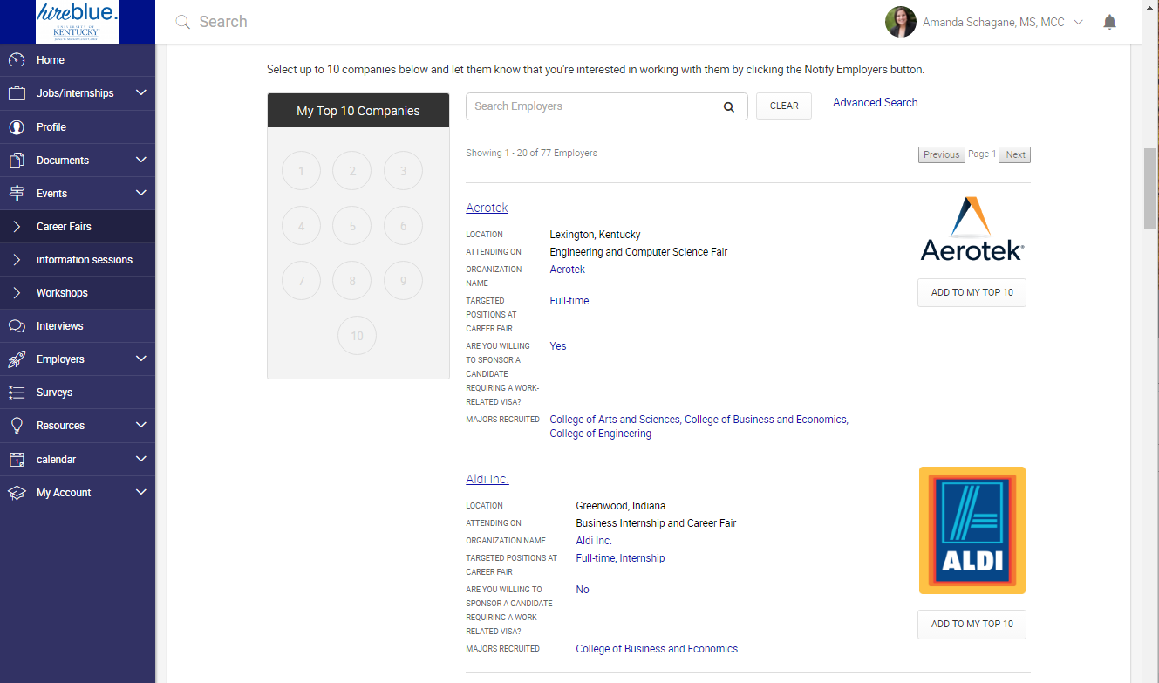
Wildcat CareerLink

Slide 13
Research Employers via UK Career Fair+
Visit the App Store or Google Plus to download
Get details about both career fairs
Interactive floor map to save favourite employers
Receive Real-time Announcements & Notifications
View internship, co-op and job postings

Slide 14
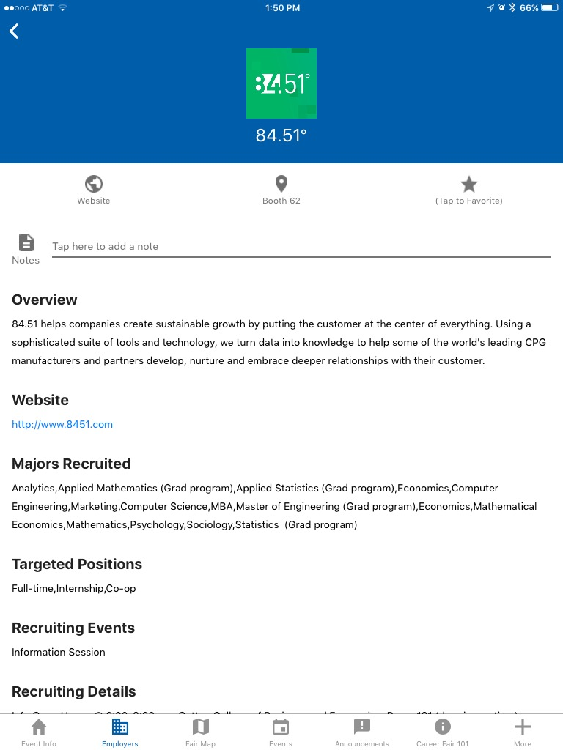
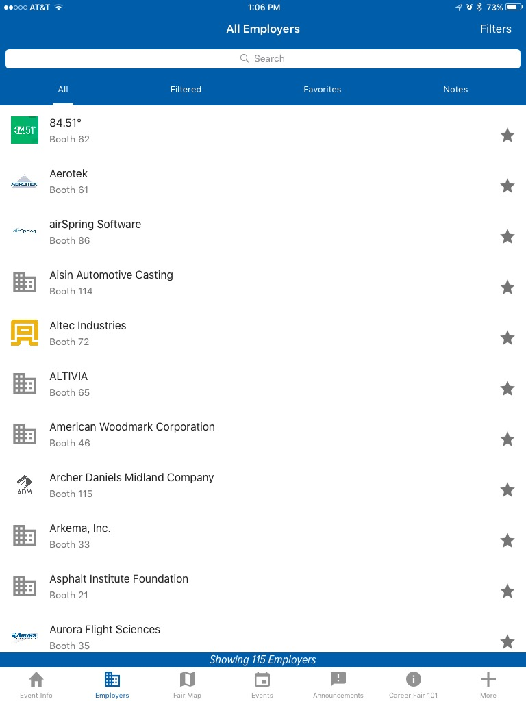
UK Career Fair+
Add the employer to you favorites and make easier to locate on map during the event
Don’t forget to use the filters
Explore all the bottom tabs – they are loaded with great information!

Slide 15
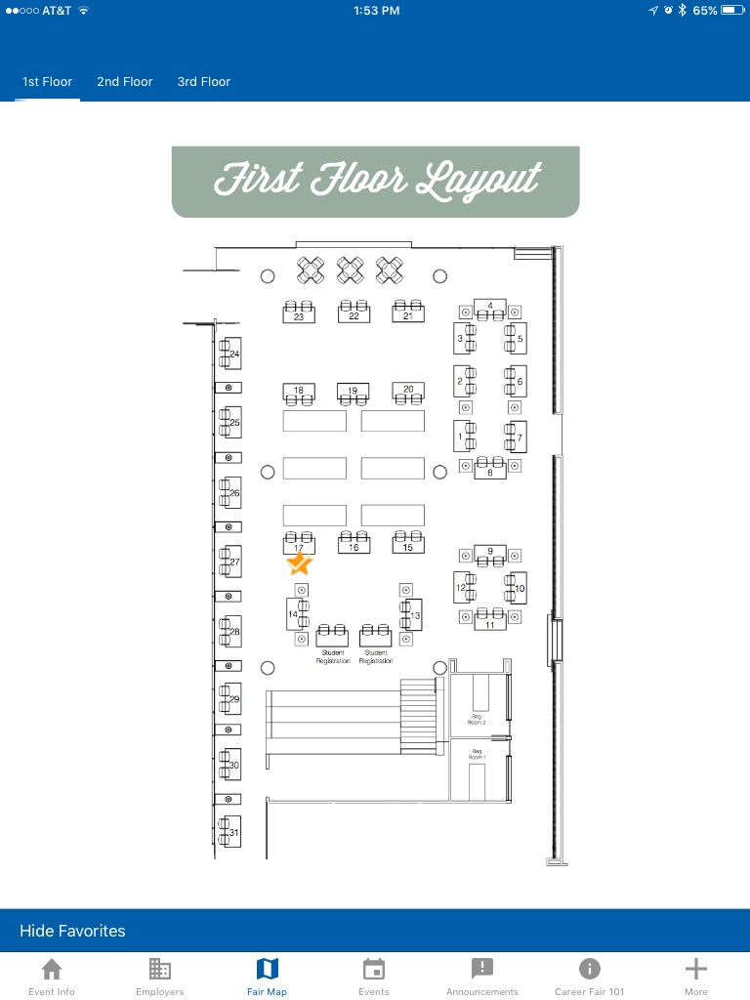
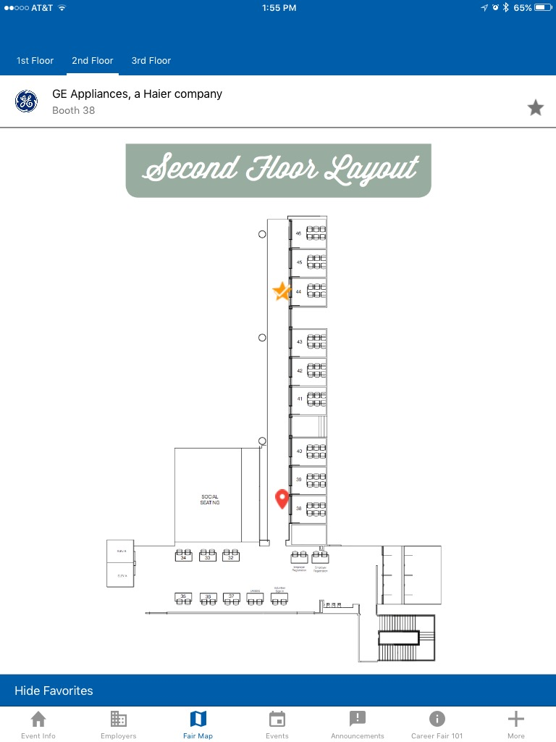
UK Career Fair+
You can find your favorite employers quickly on map with gold stars
Or you can select a table number and view employer information

Slide 16
Interviewing
Organizations may have sign-up sheets at their tables, you want to ask the following:
When is the interview?
(confirm the date & time)
Where is the interview taking place?
(on- or off-campus, if on-campus which building)
Please remember….
That if you sign-up for an interview, you are obligated to show up and don’t cancel unless emergency
Dress appropriately, interviewers do pay attention
You are representing yourself, your major, your college and the University of Kentucky

Slide 17
Strategic Research
Have a target list of 10-15 companies
Don’t plan to visit your top company first
Plan to start from the bottom and work your way up
Notes:
Have a list of the top 10-15 companies that you’d like to meet when you arrive at the career fair. You’ll need your student ID # and an up-to-date Wildcat CareerLink account to register and once you’ve registered you’ll be given a map with an alphabetically listing of all the companies as well as their table number. Take some time to identify where the companies in which you are interested are located so that you don’t miss anyone. Be strategic when attending the career fair. Start with a company that may not be your top choice in order to get comfortable with introducing yourself. Then work your way to visiting your top company last.

Slide 18
Research Appropriate Attire
Dress the part
Practice good grooming
Check the details
Lose the backpack
Use cologne/perfume & accessories sparingly
Notes:
Ladies leave your purse locked in your trunk. Turn off your cell phone. Don’t even take it into the fair.

Slide 19
Research Appropriate Attire
WOMEN
Suit– matching jacket with pants/skirt
White or pastel colored shirt
Closed-toe pumps with medium or low heels; dark color
Keep jewelry to a minimum

Slide 20
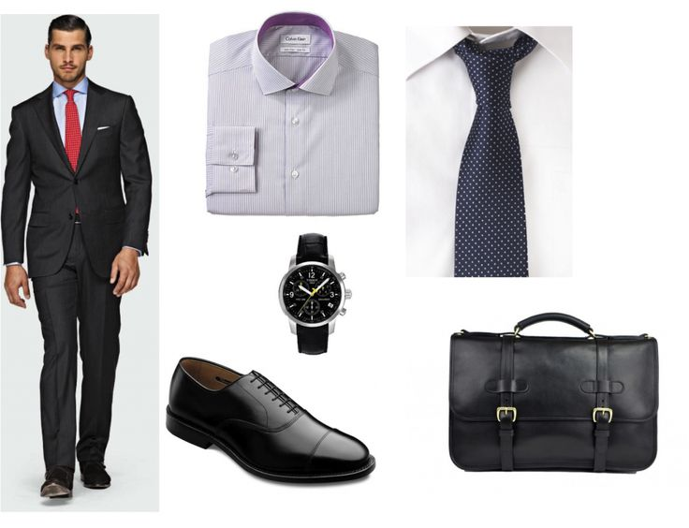
Research Appropriate Attire
MEN
Dark suit
White/light dress shirt
Tie: muted colors in solid, stripes, or small pattern
Leather, dark colored, polished shoes
Hair should be neatly groomed (including facial hair)

Slide 21
Polish Your Resume
Review, review, review
Bring lots of copies in folder or portfolio
Use a general objective statement, if any
Focus on relevant experience, computer skills, internships, volunteer experience
Separate list of references, not on resume
Notes:
Moving from Research to your Resume….It’s important to have your resume prepared prior to the showcase as it is the most important marketing document that you have to brand yourself with an employer. Have a counselor in the career center proof your resume prior to the career fair or stop by a Resumania event on campus. You’ll want to have multiple copies, perhaps as many as 25 prepared to take to the career fair. Be sure to focus on your most relevant skills for the direction that you want your career or internship to take.

Slide 22
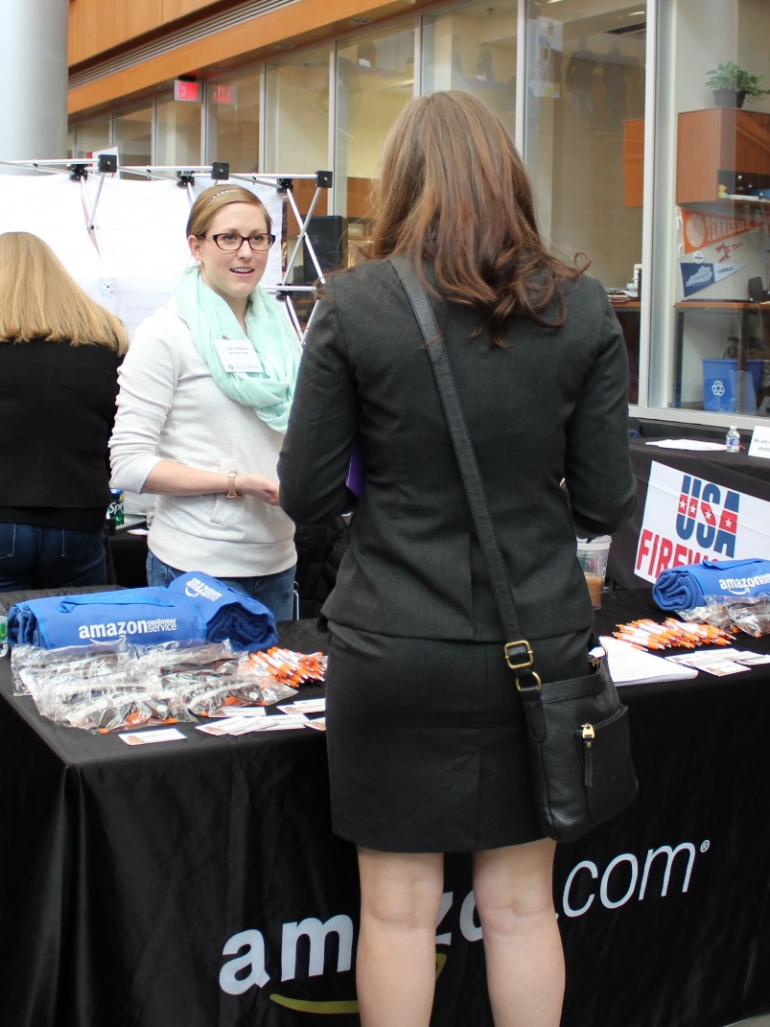
Rehearse Your Pitch
Include:
Name
Major
Graduation date
Any relevant experience
Career goals
Why you’re interested in THIS company and SPECIFIC opportunities they offer
Notes:
You want to be able to make a positive first impression when your first meet an employer at the showcase. One of the best ways of doing so is to rehearse a strong introduction. You’ll want to include a bit about your professional (not personal) background as well as what you can offer the company. You’ll want to shake the employers hand with a firm shake, make eye contact, and smile as you begin introducing yourself. A strong introduction will provide the employer with enough information to begin asking your relevant questions about your background and a conversation will begin!

Slide 23
Let’s take a few minutes to practice now.

Slide 24
Elevator Pitch/30 Second Commercial
First Impressions Matter!
60 – 65% of communication to others is non-verbal communication
Tips for Non-verbal communication
Dress professionally and have good posture
Make good eye contact and smile
Give a firm handshake
Wear nametag on right side
Listen carefully for names when introduced
Notes:
What you say in the introduction is very important but be aware that you will also be evaluated upon your non-verbal communication . Follow the tips on the slide to make a great first impression. Be sure to dress professionally in a conservative colored suit. As you want to be remembered for what you say – not what you are wearing. Speak clearly and confidently. You’ll want to listen carefuly as an employer introduces him or her self at the career fair but if your forget, most of the employers will be wearing a nametag that will allow you to wrap up the conversation by saying “Thank you for your time, Mrs. Doe. I look forward to hearing from you regarding next steps in the hiring process”.

Slide 25
Refine Your Approach
Use the person’s name
Say “Thank you”
Move on if there is a long line
Do not cruise the booths with friends- Make your own positive impression
Be respectful
Don’t just grab goodies!
Notes:
Now that you’ve dressed professionally, exhibited a great handshake and eye contact, and remembered your manners when speaking with employers, you are ready to refine that first impression a bit more. Be sure to use the company representatives name when speaking to them as people like to hear their own name! Be respectful of the representatives time and move along if you see the line growing. Be sure to visit the booths alone so that you can make the strongest impression. If you are going to the Employer Showcase with friends, then split up and you can speak with double the employers in the same amount of time. The employers will have great freebies at the career fair but please don’t just take them from the table. Engage the representative in a conversation first even if you aren’t interested in the employer. It’s the polite thing to do!

Slide 26
Make Appropriate Requests
Ask smart questions that demonstrate your knowledge about the company
I read on your website that the company undertook a major new project, how did this influence your role in the company?
How does the company measure success in this type of role?
Notes:
Use the career fair as an opportunity to gain as much information as you can about the company and their future plans or the work expected in the position which interests you. On the slide are some good questions which you may want to ask.

Slide 27
Make Appropriate Requests
Be sure to ask:
What is the next step in the process?
What’s the best way to follow up with you?
Make notes about your conversation
Send a personalized thank you email within a day
Notes:
Be sure to get contact information from the representatives with which you speak at the career fair. Some employers will direct you to apply online but don’t let that discourage you! Take the time to follow-up with the representative that you met at the career fair after you have taken his/her advice an applied online. Feel free to ask who the best contact person is or what the next steps in the hiring process may be? One tip is to take notes on the back of the business card or company material as once you’ve talked to 5 + employers , it can be difficult to remember who told you to apply online or who told you that they’d review paper resumes and get back to you within the month. Be sure to follow-up with companies in which you are particularly interested. Taking the initiative to reach out to these companies a couple weeks after the career fair if you haven’t heard anything can be a great strategy to separate you from other candidates.

Slide 28
Don’t Forget!
Explore options. You can’t tell what a company has to offer by simply looking at their name
Successful candidates will find a match regardless of what positions a company currently has advertised
Don’t put all of your eggs in one basket; continue the job search through a variety of avenues
Bag & coat check room available for Engineering & Computer Science Fair. Bag drop room available at Business Internship & Career Fair.
1st Level in the Gatton College of Business and Economics
Notes:
Don’t overlook the company whose name you don’t recognize as they may have the best opportunities! Be open minded when attending the career fair as it never hurts to talk to someone. It is up to you to sell yourself to a company. Many employers are open to candidates with all majors as they are more interested in transferable skills such as communication, teamwork, and leadership than they are a specific major. Even if you feel the career fair was a great success and you made wonderful contacts, continue searching until you have an offer letter in hand!

Slide 29
Relax and Be Yourself
Your career services office is here to help.
Enjoy the opportunity to meet new people and build your network!
Notes:
The career fair can be fun. Take a deep breathe and relax and enjoying meeting new people and building your network while job searching. Research shows that networking is a more effective job search strategy than sitting in front of your computer searching job boards such as CareerBuilder.com not that you shouldn’t also be doing that!

Slide 30
Career Fair VIP Program
Participants will have the opportunity to:
Enter student registration 1 hour before the fair begins
Network with employers 30 minutes before the Internship & Career Fair opens to all students & alumni
Receive a special VIP nametag
Prepare for your professional career
In partnership with:
Notes:
The VIP Program collaboration with Engineering Career Services and the Graham Office of Career Management college to better prepare students for career fairs. (PASS OUT VIP FORMS) The advantages to participating include…(READ SLIDE)…By participating in todays workshop, you’ve already completed a good amount of the requirements to be a VIP.

Slide 31
Career Fair VIP Program
Engineering VIP’s will be able to pick-up your nametags for the event on Monday, Feb. 20!
Save time and not have to wait in line…
See Marsha Phillips, RGAN 287 between 9am-4pm
On Tuesday morning, go to study room on the 1st floor

Slide 32
Engineering Career Advising Drop-ins
Tuesday & Wednesday from 3:00-5:00 pm in RGAN 289
Graham Office Drop-ins
Monday – Thursday from 1:00-4:00 pm in the Office of Career Management
10-15 minute career consultations can include:
Resume critique
Cover letter critique
Questions regarding internships, job searching, interviewing, and graduate school admissions
Notes:
Additional help from the Stuckert Career Center staff is available during walk in hours for a 15 minute consultation…

Slide 33
Card Deadline
Before 12noon – Friday, Feb. 17
Each College Career Development office has different VIP requirements,
make sure you review the back of card carefully and
complete each step before the deadline
Due to: John Beck, RGAN 289
Due to: Graham Office of Career Management

Slide 34
Career Fairs on Campus Spring 2017

Slide 35
VIP
11:30am-12n

Slide 38
Co-op & internship fair

Slide 39
2017 University of Kentucky
Just in Time Job and Internship Fair
Wed., April 5 ~ 10:00 AM - 2:00 PM Hilary J. Boone Center

Slide 40
Career Services on Campus

Slide 41
Career Services on Campus
For Engineering Majors
Engineering Career Development
Email EngrCareer@uky.edu to schedule an appointment
For Business Majors
Graham Office of Career Management
Email GattonCareer@uky.edu to schedule an appointment
For Agriculture, Food & Environment Majors
AG Career Services
Email Amanda.Saha@uky.edu to schedule an appointment
Notes:
ALL CAREER SERVICES ON 2 SLIDES – SLIDE 1 OF 2

Slide 42
Career Services on Campus
For Nursing Majors
Nursing Career Resource Center
Email Sue.Strup@uky.edu to schedule an appointment
For All Other Majors
James W. Stuckert Career Center
Drop-in hours, Tuesday-Thursday from 1:00 to 4:00pm
Notes:
ALL CAREER SERVICES ON 2 SLIDES – SLIDE 2 OF 2

Slide 43
Questions?
Call: 859-218-1685 Email: engrcareer@uky.edu
Call: 859-257-2001 Email: gattoncareer@uky.edu

