Slide 1
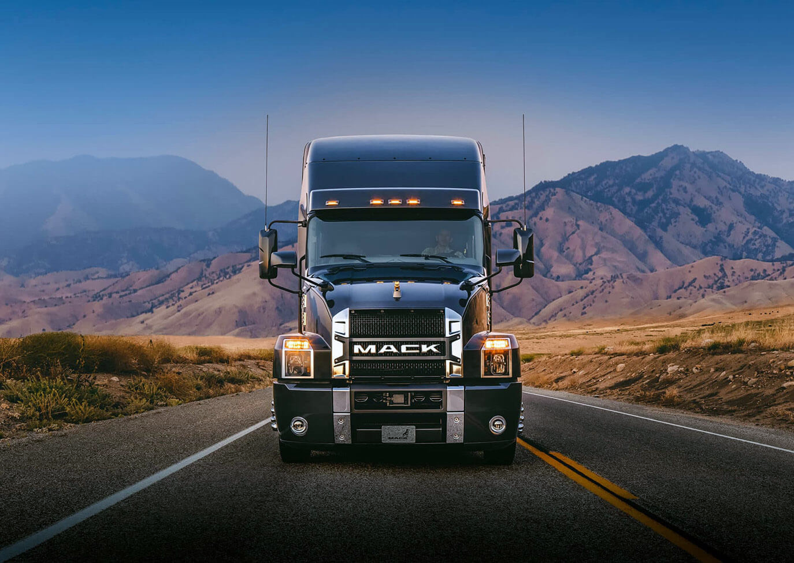
RXO: Built for the Long Haul
R X O
University of Kentucky Stock Pitch 2023
Jake Keys & Trevor Payne

Slide 2

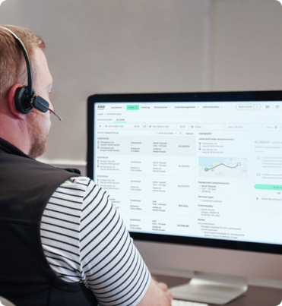

Table of Contents
Investment Thesis Overview
RXO Background
RXO Connect
Superior Platform
Carrier Trends
Built for the Future
Financial Projections
Comps Analysis
Spin-Off Details
Sell-Side Short-Termism
Analysis of Management
Valuation and Price Target
Risks and Mitigations
Conclusion

Slide 3

Investment Thesis Overview
Key Thesis Points
$28.36
1
QUALITY
Unique asset-light business model leads to high ROIC and shareholder returns
Management is experienced with the ability to execute
2
VALUE
Fundamentally undervalued using conservative assumptions
Significant demographic market share tailwinds and not reflected in multiple
3
OPPORTUNITY
Spinoff leads to insufficient coverage and inconsistent trading with peer group
Cyclical concerns are overblown – macro overshadows future cycle potential
Investment Highlights
Recommendation: | LONG
Expected Value: | $28.36
Base Case Upside: | ~50%
Reward/Risk: | 2.5x
Weighted Valuation
DCF w/ Perpetuity: | $25.93
DCF w/ Exit Multiple: | $28.84
Peer Group EV/S: | $26.77
Implied P/E Multiple: | $32.73

Slide 4
RXO Background
Historical Financial Results
RXO, Inc. is a high-performing brokered transportation platform defined by cutting-edge technology and a nimble, asset-light business model
Industry Leading Platform
RXO operates as a technology leader in the 3PL and brokered transportation space, boasting an industry leading booking and data analytics platform
Four main service offerings: Truck Brokerage, Last Mile, Managed Transportation, & Freight Forwarding
Key Trading Statistics
2022 Q4 Revenue by Service
Key Trading Statistics
2022 Q4 Revenue by Service
Ticker |  |  | RXO
Share Price (as of 4/17) |  |  | $18.65
FDSO |  |  | 118.5m
Market Cap |  |  | $2.2B
Adj. P/E |  |  | 12.8x
52 Wk. Range |  |  | $14.75 - $25.50
Adj. EPS |  |  | $1.43

Slide 5
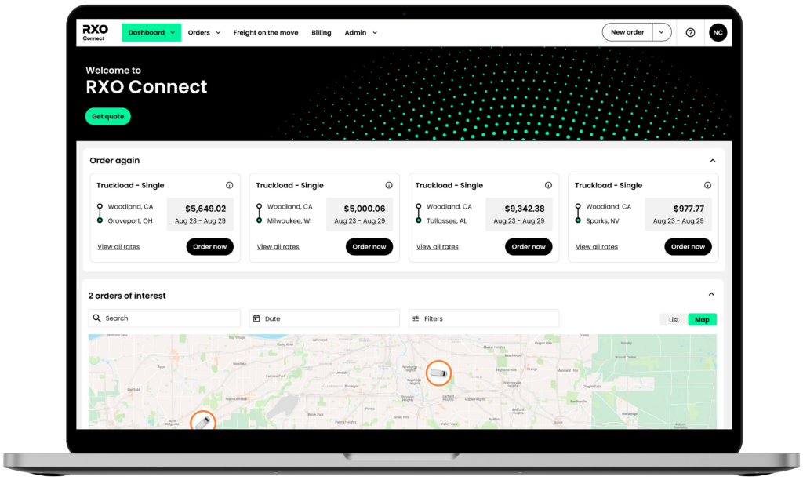
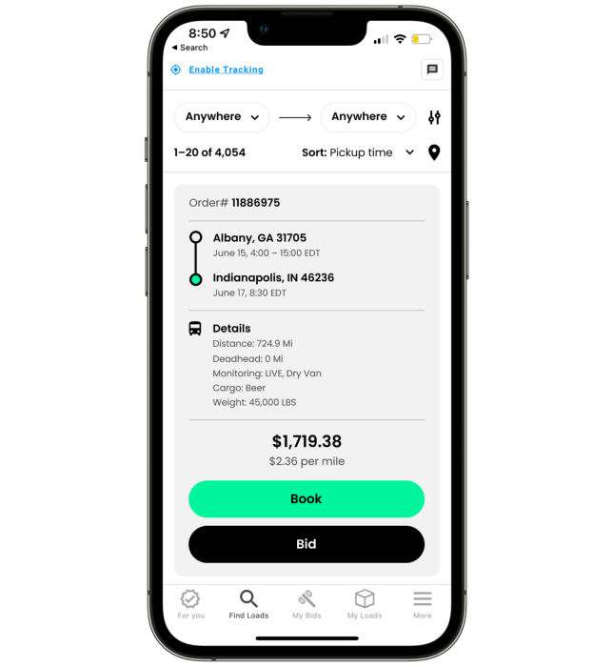
RXO Connect
Industry Leading Platform
Fully automated digital brokerage platform enhances convenience, transparency, and data collection capabilities
Industry Leading Platform
Allows carriers & shippers to track & transact, backed by a cutting-edge pricing algorithm driven by available capacity & shipping demand
Improves productivity & scalability by facilitating transactions through automated processes, increasing the productivity of shipper and carrier representatives
QoQ "RXO Drive" Downloads
The RXO Connect platform’s dynamic pricing model not only enhances convenience and productivity for carriers & shippers, it simultaneously boosts margin & scalability of RXO as a whole. Aligning of incentives is key to realizing significant share growth.
8.6% growth
87% of Loads Originated and Executed via RXO Connect
74% 7-day Carrier Download Retention

Slide 6
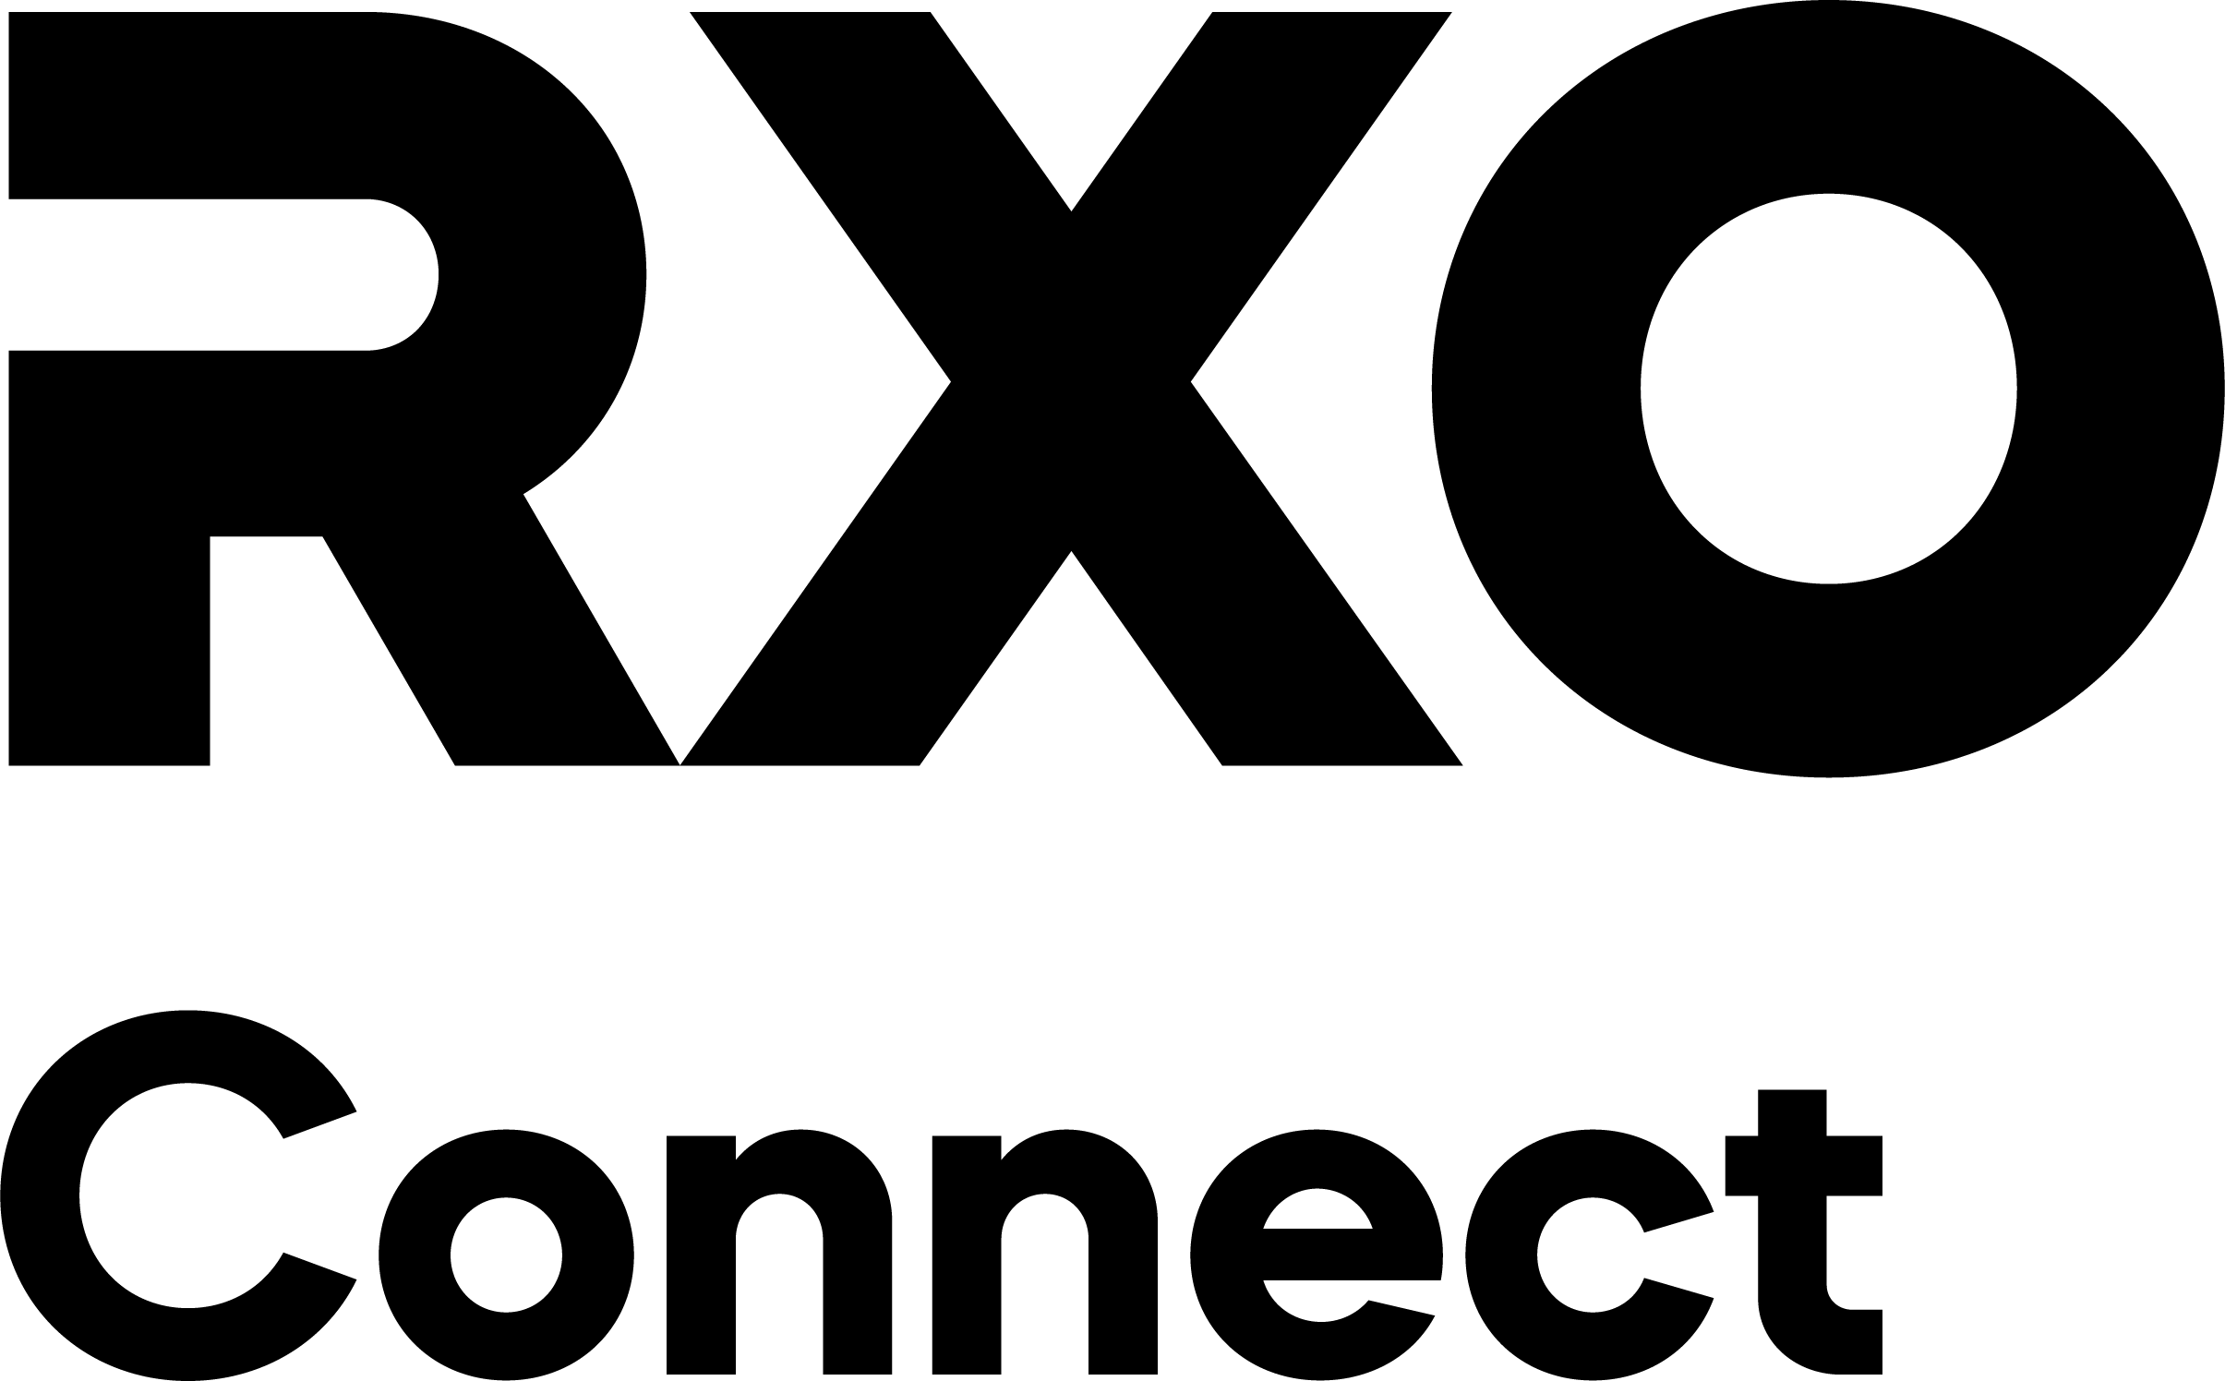








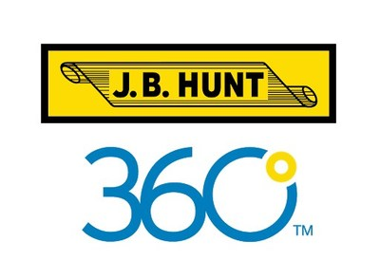
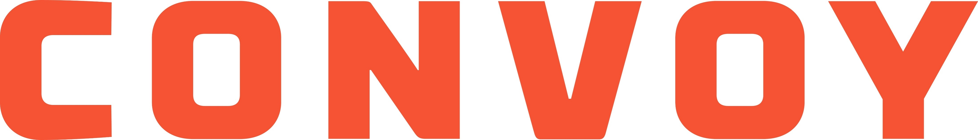
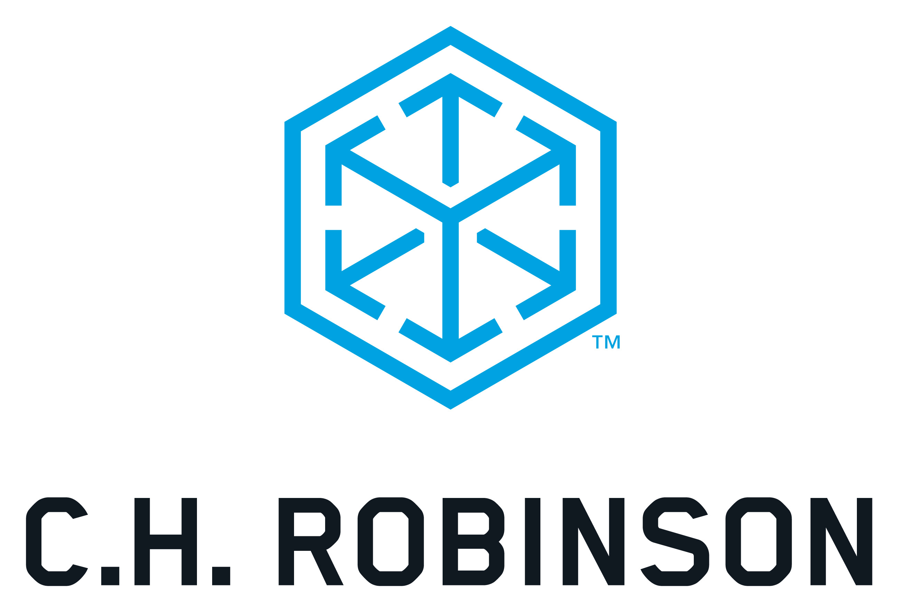
Superior Platform
RXO is the only company that treats their digital platform as the core business, rewards loyal carriers, possesses automated pricing, and has no company owned trucks with priority in network. This unique combination has resulted in a platform with more reviews, better reviews, and more carriers despite being a relatively new application.
Own Trucks?
Auto Pricing?
Carrier Rewards?
Core Business?

Slide 7



Carrier Trends
34.8% of the carriers in the United States are classified as “for hire” by the US DOT
Approximately
1 in 4 truckloads in the United States is currently handled by a TL broker
RXO is positioned to take advantage of the outsourcing trend in TL
Only 1 in 4 truckloads are handled by a broker, while over 1 in 3 carriers is for hire
Significant headroom to be captured in coming years indicated by graph below
Broker Penetration of Overall Truckload Market
4% CAGR
6% CAGR

Slide 8
Built for the Future
Pursuing Share
RXO has managed to outpace the truck brokerage industry’s CAGR of 10% from 2013-2021 with 27% revenue CAGR across same period, capturing nearly 4% of the total market in the process
While capturing market share, RXO has managed to maintain higher gross margins than competitors as illustrated below
RXO & Comp Set Gross Margin
RXO Gross Margin vs. Comp Set
*GM Data via Cap IQ, includes add’l items vs. company reports
*Industry data via JP Morgan

Slide 9
Financial Projections
Growing and Maintaining
Select Charting
We expect significant gains in both revenue generation and profitability metrics to be driven by further truck brokerage market share capture and continued automation of internal processes
With the industry’s premier technological platforms and favorable industry tailwinds, these projections represent our base case scenario
Brokerage Market Share Projection

Slide 10
Comps Analysis
P / EPS*
LQ Gross Margin
P / EPS*
EV / EBITDA
EV / Revenue
EV / EBITDA
EV / REVENUE
*EPS adjusted for one-time expenses
*Data via Capital IQ

Slide 11
Spin-Off Details
Spin-Off Overview
Dominant Idiosyncratic Volatility
XPO has striven to realize value as the conglomerate has traded at a discount to peers over the last decade
RXO was key spin-off candidate as overhead synergies were absent
XPO spins off RXO on November 1st, 2022
As an S&P 400 Midcap Index constituent, index funds holding XPO must sell received shares
RXO is now sole focus of company resources
Source: JP Morgan and MSCI Barra
Relative Performance Post Spin
Source: Bloomberg Data
11

Slide 12
Sell-Side Short-Termism
Valuation Methods
Troubling Macro: Yesterday’s News
Current sell-side price targets are too simplistic and use peer group average multiple on FY '24 EPS
Sell-side arguments revolve around which multiple RXO should be valued at
RXO is clearly growing faster than peers with more attractive unit economics thus deserving a higher multiple
Street is also focused on near-term outlook, while story should be driven by long-term industry tailwinds
Supply Shock: Next Cycle To See Dramatic Shifts in Spot Rate Again
Spot Rates are a function of supply and demand
In the last 4 trucking cycles, total net purchases for Class 8 trucks have increased ~20% on average per cycle
In the most recent cycle, total net purchases decreased by 6%
The data suggests capacity will be constrained in the next cycle, leading to a rapid increase in spot rates
Trucking Brokerage is the direct beneficiary of this
Source: St. Louis FED and Bloomberg Data

Slide 13
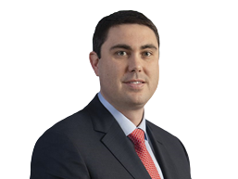
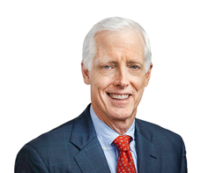
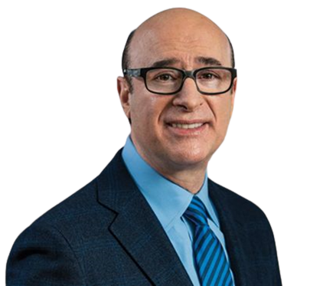
Analysis of Management
CEO: Drew Wilkerson
Relative S&P 500 Outperformance*
Started career at C.H. Robinson in traditional brokerage
Executive Roles at XPO from 2016
Extensive, top to bottom experience
CFO: James Harris
CFO of SPX Technologies 2020 to 2022
Various Roles at Coca-Cola Consolidated 2008 to 2019
Experienced outside hire with strong performance record
Compensation
Chairman: Brad Jacobs
~80%+ Performance Based
CEO of XPO 2011 to Spin
Chairman of URI from 1997-2007
Owns 1.3 million shares via Jacobs Private Equity and an additional 0.4 million shares personally
*Measured Period is Exact Dates of Tenure

Slide 14
Valuation and Price Target
Valuation Commentary
Composite Valuation
The composite valuation depicted to the right is comprised of sensitized projections based on three cases:
Base, Bear, and Bull
Current Share Price: $18.65
Price Target:
$28.36
Expected Return: 51.1%
DCF –
Perpetuity Growth
Case
Weight
Return
2-4%
Base
65%
53.0%
DCF –
Exit Multiple
65%
9-11x
Bear
25%
Trading Comps -
EV / Revenue
(18.8%)
10%
.7x-.8x
Bull
10%
74.1%
Implied Multiple -
Terminal ROIC
25%
$24.55

Slide 15
Risks & Mitigations
Trucking Recession
Competitive Market
RISK
RISK
Trucking recession currently underway after great cycle
Revenues will be down, the question is by how much
Truck brokerage is fragmented and competitive
A highly competitive market introduces risks to performance
MITIGATION
MITIGATION
Financial profile is superb compared to traditional brokers
Cost structure is 87% variable ➔ 17% contribution margin
Implies a > 27% decrease in revenues to realize loss
RXO is the only profitable digitally native platform
Competitors will be forced to focus on profitability
RXO will capture more share as industry consolidates
Automated Trucking
Bear Case Valuation
RISK
No Gain in Market Share
Sticky Depressed Margins
No Growth in Brokerage Penetration
Trucking Growth at Less Than Nominal GDP
Terrible Scenario: Stock Down Just 20%
Trucking is projected to become automated in the future
Owner-Operators will be obsolete in this case
MITIGATION
Automated trucking fragments industry further
Brokerage platforms become mission-critical as a result
Tech-forward platform stands to especially gain

Slide 16


Conclusion
RXO has a significant advantage with their digital platform’s pricing technology when compared to other legacy brokers pricing algorithms. Management has a history of outperformance and will capitalize on upcoming shifts in the marketplace.
With favorable economics and leg up in technology, RXO will capture more share at a profitable rate. Our base case projections are moderate and still show significant upside, leading to a sufficient margin of safety in valuation.
As a spin-off, RXO is subject to structural inefficiencies within the market. Sell-side coverage is too fixated on near-term developments. Insiders are invested and are motivated as a result. We like the stock.

Slide 17
Begin Appendix

Slide 18
Business Unit Overview
Truck Brokerage
Last Mile
24% of Q4 2022 Revenue
Facilitates consumer deliveries via network of third-party contractors
Largest provider of outsourced last mile transportation in the US
58% of Q4 2022 Revenue
Digital & traditional truck brokerage services provide clients with efficient access to capacity
Proprietary platform links carriers and shippers with pricing and matching algorithms
Over 60% of RXO customers utilize more than one service
Managed Transportation
Freight Forwarding
11% of Q4 2022 Revenue
Asset-light solution for shippers looking to outsource freight transport for cost savings or reliability
Bespoke load planning, performance monitoring, and data analytics in real time provide transparency and trust
7% of Q4 2022 Revenue
Facilitates ocean, road, & air transportation while assisting with customs brokerage
Global network of company & partner-owned locations across 160 countries

Slide 19

RXO Value Chain
CLIENTS
CARRIERS
RXO’s customer base avoids end market concentration and supplies network with steady demand
According to USDOT and RXO data, nearly 32% of US private carriers are a part of RXO’s 1.5M truck network
Industry-best 87% of Client – Carrier connections are handled completely digitally via
RXO Connect and RXO Drive
RXO’s long-established, diversified client base and massive carrier network allows its digital platform to handle the dirty work, resulting in a highly efficient automated shipping process for clients and drivers alike.

Slide 20
Confident Insiders and Institutions
XPO CEO Owns in the PA
Insider Option Exercises, No Selling
Founder and former XPO CEO owns 1.6% of shares outstanding as a result of the RXO spin-off via Jacobs Private Equity and personal holdings
Jacobs believes in the vision established by new CEO Wilkerson – he appointed him himself
Jacobs has started and grown 5 separate $1B companies as an entrepreneur
Source: EDGAR
High Conviction Bet From Orbis Investment Management
Orbis Investment Management, known for concentrated, high conviction positions in undervalued companies, disclosed a position of 13.2% of outstanding shares of RXO Dec. 31st, 2022
$17.60 open on date of disclosure
Source: OIMUS

Slide 21
Base Case Financials

Slide 22
Bear Case Projections
Downside Case
Select Charting
Competitor technology adaptations prevent significant market share capture and erode historical margin advantage
Margins never return to 2020/2022 levels, instead remaining depressed
Truckload brokerage market growth comes in below analyst estimates
Brokerage Market Share Projection

Slide 23
Bear Case Financials

Slide 24
Bull Case Projections
Upside Case
Select Charting
RXO’s automated processes and superior technology contribute to considerable market share gains and buffeted margins
Continuation of outsourced brokerage trend causes market growth to outpace analyst estimates
RXO’s automation and algorithm allow it to survive any cyclicality and seasonality related to trucking
Brokerage Market Share Projection

Slide 25
Bull Case Financials

Slide 26
Market Share Comparison
Market Share Growth Across Cases

Slide 27
Industry Share Breakdown
2021 Truckload Brokerage Industry Top Players
RXO has the potential to capture significant share in coming years in a fractured market through increased network effects, a superior technology, and ability to focus solely on the further development of their stack.

Slide 28
Projected ROIC – Base Case

Slide 29
Truck Orders and Spot Rates

Slide 30


Trucking Cycles Overview
The U.S. Brokered Truckload market is complex and ever-changing. Three cycles run simultaneously, and brokers are contracted to simplify the logistics process. Below is an overview of the trucking cycles, and how RXO rises to the occasion in each instance.
Seasonal Demand Cycle
The seasonal demand cycle is essentially pre-planned surges in shipping volume, often coinciding with agricultural or holiday shopping seasons. RXO’s large network of carriers have immense capacity and via automated processes match shipper with space.
Annual Procurement Cycle
Businesses enlisting brokered transportation bring forecasted shipping needs to carriers, accepting bid or RFP to secure contract pricing on their highest volume lanes. RXO provides a platform through which annual procurement can take place without a single in-person interaction between parties as well as full bid transparency.
Market Capacity Cycle
Capacity and rates are also affected by simple truck supply and demand. With RXO, any last-minute shipping needs are met with truckers in Superman capes. Additionally, any new carriers can place their capacity on RXO Connect quickly and easily with the completion of minimal paperwork.

Slide 31
Industry M&A Activity

Slide 32
Superior Platform
Platform Age
Industry Leading Platform
Active Carriers
*Do not disclose
Apple App Store Reviews
QoQ “RXO Drive” Downloads
App Ratings*
87% of Loads Originated and Executed via RXO Connect
74% 7-day Carrier Download Retention
*App shared with in-house shippers
*1-5 Scale, via Apple App Store

Slide 33
DCF Assumptions
 | After-Tax Cost of Debt |  |  | 5.6% | 5.6%
 | Cost of Equity:
 | Risk Free Rate |  |  |  | 3.9%
 | Beta |  |  |  | 1.20
 | Equity Risk Premium |  |  |  | 5.0%
 | Cost of Equity |  |  |  | 9.9%
 | Weighted Average Cost of Capital:
 | Debt / (Debt + Equity) |  |  |  | 17%
 | Equity / (Debt + Equity) |  |  |  | 83%
 | After-Tax Cost of Debt |  |  |  | 5.6%
 | Cost of Equity |  |  |  | 9.9%
 | WACC |  |  |  | 9.2%
Perp. Growth Method
Long-Term Growth Rate (g) |  |  | 3.5%
Year 5 Cash Flow |  |  | $260.5
Exit Mult. Method
Year 5 EBITDA |  |  | $491.6
Peer EV/EBITDA Mult Avg |  |  | 9.9x

Slide 34
Comps Operating Statistics

Slide 35


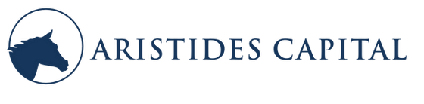
A Special Thank You to Our Mentors * **
*Our pitch does not represent the views of these kind people or firms
** Not Investment Advice – For Informational Purposes Only

