Slide 1
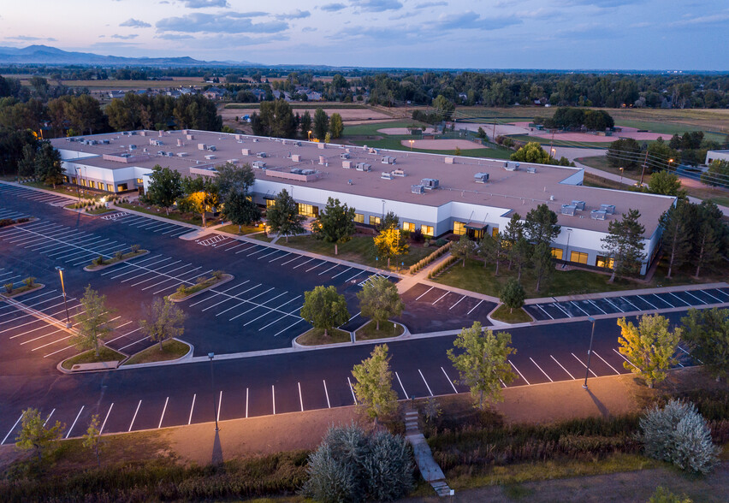


April 2023
Ticker | CROX
Share Price (4/17/2023) | $139.04
Implied Share Price | $179.75
Recommendation | BUY
Joshua Tuman
Sam Schroder

Slide 2
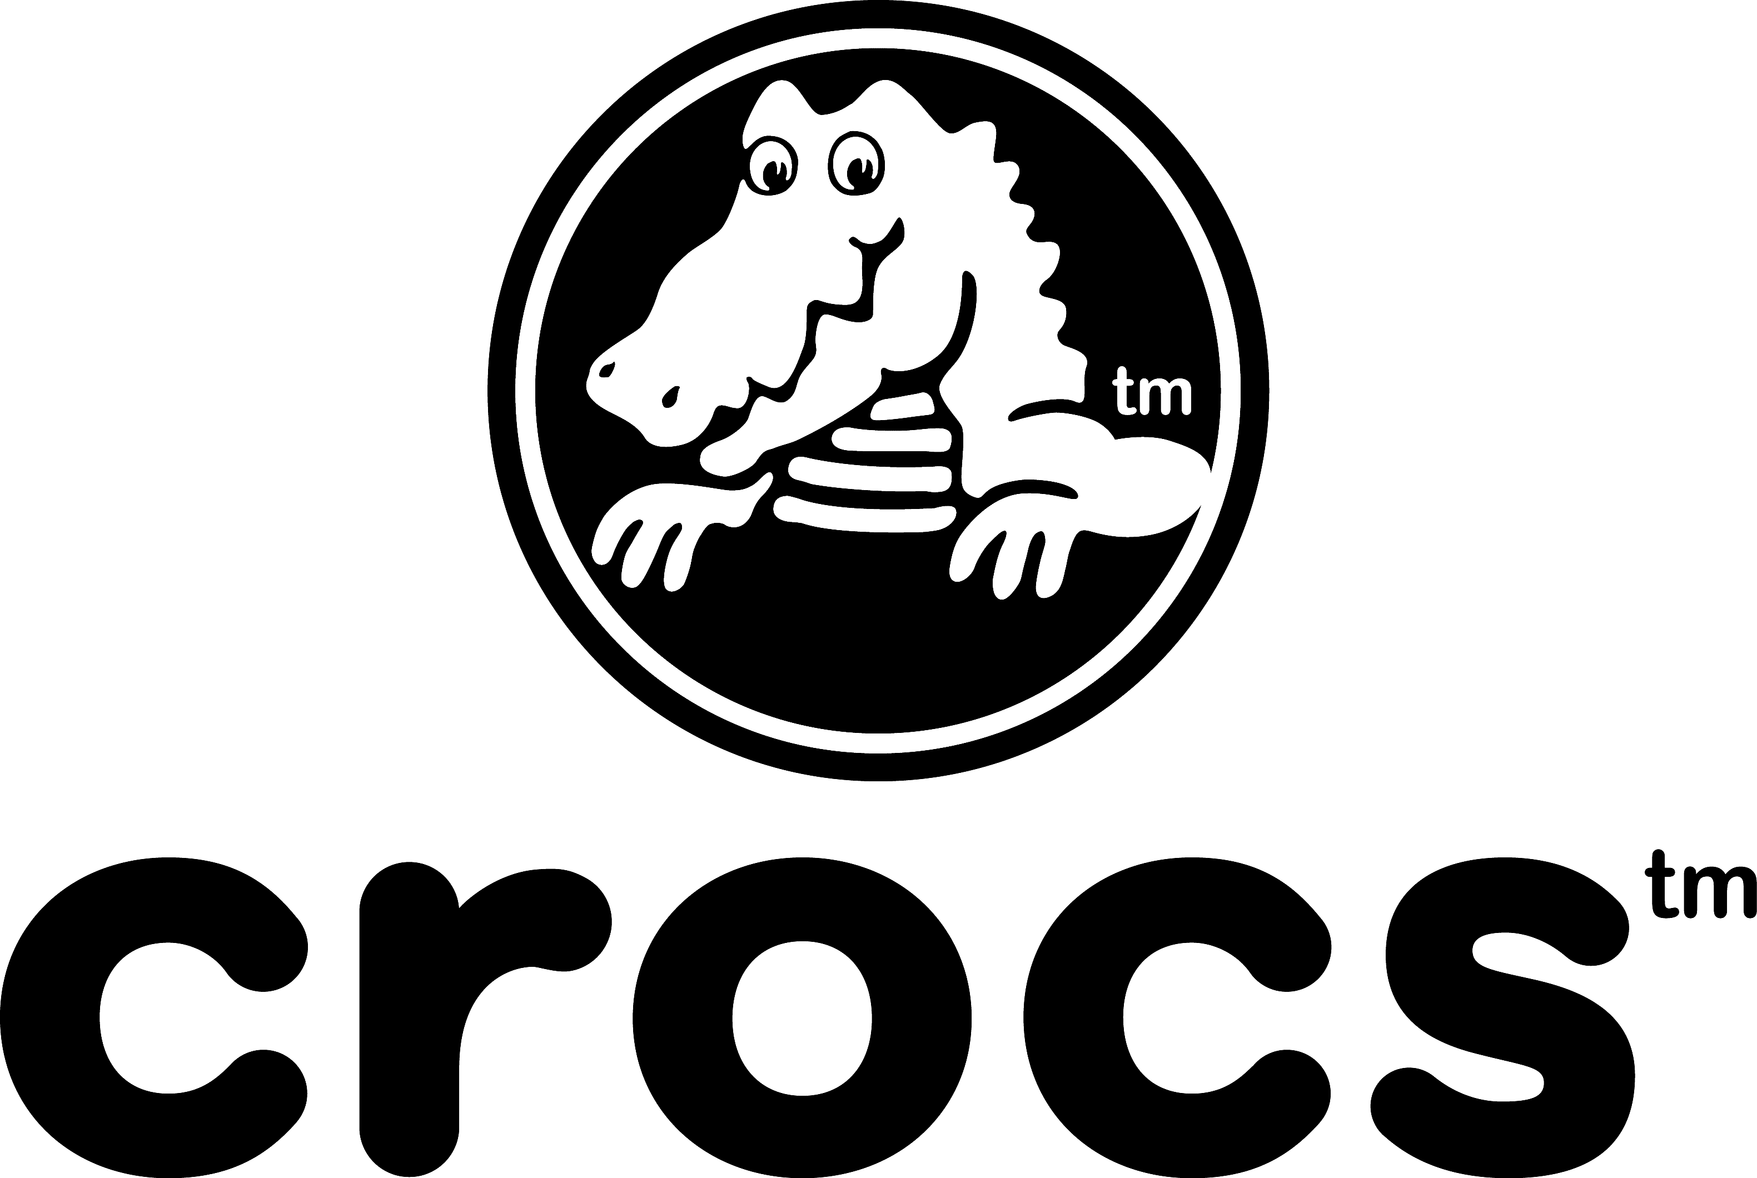
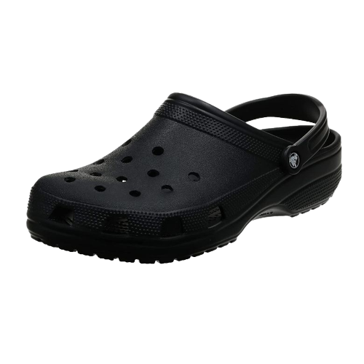
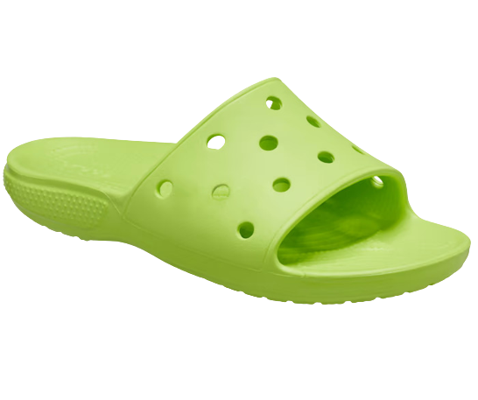
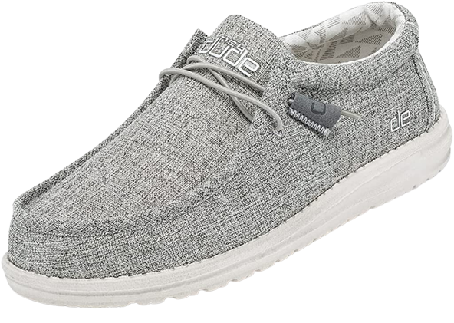
Company Overview
Crocs is a wholesale, retail, and e-commerce company that sells various designs of foam-based shoes.
Investment Thesis
Underappreciated path to growth through domestic and international digitalization.
Best in class operating margin and profitability led by a strong management team.
Overblown debt concerns.
These factors have led the market to undervalue the intrinsic value of the company.

Slide 3
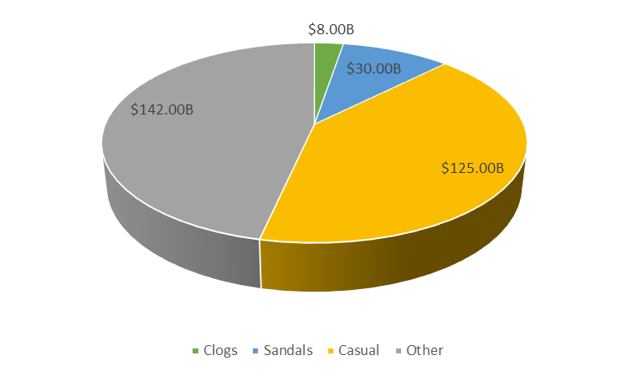
Shoe Industry Overview
Non-Athletic Footwear Market
Clog
The clog market that Croc's main model falls under has an addressable market of $8B.
Croc heavily differentiates from the rest of the clog market and offers a very different product than the rest.
Crocs are very unlikely to be swapped for other clogs in the mind of customers as the shoes are bought heavily on brand name.
Sandals
Casual Footwear
The flip flop and sandal market size was valued at $30B in 2022.
Through extensive research and surveying they have found that flip flops and sandals are interchangeable with Crocs in the mind of consumers.
This is a much larger market than the clog market that they currently operate.
Taking more of the sandal market allows more room for growth than the clog market alone.
Casual footwear has an addressable market of $125B.
With the acquisition of HEYDUDE they expect to be able to capture a much larger share of this market than with Croc's main line alone.
This market is increasing at a rapid rate in regions outside of the Americas and aggressive advertising should help this market share increase.
The casual footwear market started to increase since the pandemic and the increase of work from home and hybrid schedules.

Slide 4
Growth Strategies
Digital Sales
Asia Pacific Region
Digital sales currently account for 37% of revenue, up from 14.6% in 2017.
Strong digital sales growth in both EMEALA and Asia Pacific regions.
Digital sales allow for quicker inventory turnover as well as higher profit margins.
Gives the ability to address a wider range of customers where physical stores are not available.
Plan to achieve over 50% in digital sales or over $2.5B long-term.
Asia Pacific revenues grew by 82% compared to the previous year on a constant currency basis.
Only accounts for 19% of total revenues by geography.
Plan to increase this to 25% of all revenues through intense digital marketing.
China accounts for <5% of Croc's revenue as the second largest shoe market in the world. Plan to grow this to >10% of total revenue.
HEYDUDE
ESG
Expected to reach $1B in revenue by 2023 beating their original prediction of 2024.
Investing in industry leading marketing to increase brand awareness with <5% international revenue.
Leveraging Croc's strong wholesale relationships and distribution networks to enhance global growth.
Investing to scale supply chain.
Creating new silhouettes to make HEYDUDES for every occasion.
Currently have a Morningstar ESG rating of 16.5 which puts them in the low-risk category.
Using their patented material Croslite to cut carbon emissions in half by 2030.
Have donated almost 1,000,000 pairs of Crocs to frontline healthcare workers since 2020, gaining marketing and exposure in the healthcare sector in the process.
Crocs Cares program has donated over 3,000,000 pairs to foreign countries.

Slide 5
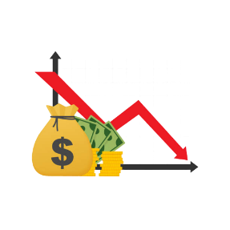

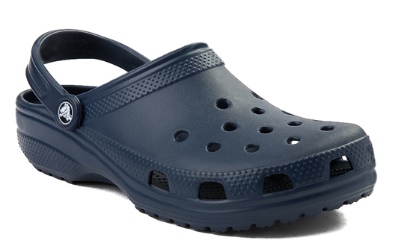
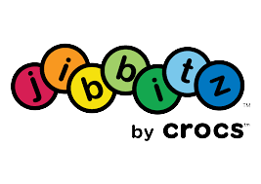

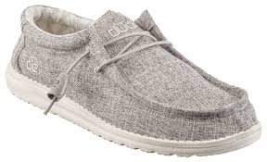
Company Timeline
2002-2006
2007-2013
2014-2017
2018-Present
In 2002 the classic clog was born and quickly became popular with multiple different demographics.
Acquired Foam Creations Inc. to have exclusive rights to the patented material Croslite.
Crocs completed largest IPO in footwear in the U.S. in 2006 by raising $239 million and started at $21.00 a share
Acquired jibbitz for $10 million
Crocs in the late 2000's and earlier 2010's experienced repercussions from overextension of products.
Overextension of products led to poor gross margins.
Cost margins were high. SG&A was 47% of revenues.
Physical store locations reached over 600 stores in 2013.
Appointed Andrew Rees as president in 2014. His goal was to reignite and focus on the classic clog.
Marketed new successful campaign "Come as you are".
Implemented a more cohesive global strategy goal.
Started their shift to digital sales and cut physical store locations.
Reduced $80 million in fixed expenses and reinvested into marketing.
4+ year double digit revenue growth started in 2018 and revenues exceeded $2 billion in 2021.
Target operating margin was reached in 2019 and expanded their operating margin to an industry leading 30% in 2021.
Acquired HEYDUDE in 2022 for $2.5 billion.

Slide 6
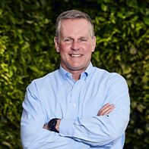
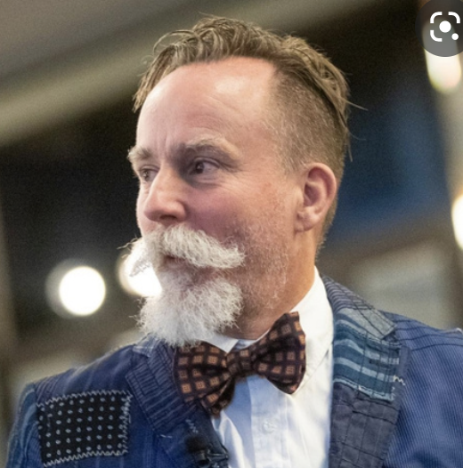

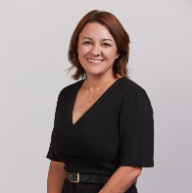

Company Overview- Management
Andrew Rees
CEO
(2014-Present)
Rick Blackshaw
BP HEYDUDE
(2021-Present)
Michelle Poole
President
(2020-Present)
Anne Mehlman
CFO
(2018-Present)
Adam Michaels
CDO
(2013-Present)
"When I think about the kind of characteristics we like about Crocs, I think, first of all, it's a great leadership team"
Jonathan Komp
Senior Research Analyst at Baird – Active Lifestyles (Apparel, Footwear & Fitness)

Slide 7
Financial History
Revenue ($MM)
Net Income ($MM)
Adj. EBITDA & Margin ($MM)⁽¹⁾
FCF ($MM)
(1) Adj. EBITDA = EBIDTA + Stock Based Compensation

Slide 8
Comparable Analysis
Current P/E
Forward P/E
EV/Revenue
EV/EBITDA

Slide 9
Financial Outlook
Strong Commitment to Deleveraging
Crocs currently has approximately $2.3B in long term debt mostly stemming from the purchase of HEYDUDE's in February of 2022.
Their main commitment is to deleverage to ≤2.0X Gross leverage and have stopped share repurchasing until they do.
They have been successful in this mission as it has fallen from 3.1x year end 2021 to 2.5x Q3 2022.
≤2.0 gross leverage is expected by mid-year 2023.
Reduced $550 million in debt in Q4 from strong cash flow
The risk of Crocs increased leveraging over the near future is outweighed by the risk they avoid by becoming a multi-brand company.
D/E = 4.12
Gross Debt/ Adj. EBITDA⁽¹⁾
3.1x
2.25x
≤2.0x
1.1x
2021
BOY 2022
EOY 2022
Mid-Year 2023
FCF($MM)
$651.45
$511.25
$498.95
$325.00
Mid-Year 2023
2021
2022
2023
(1) Adj. EBITDA = EBIDTA + Stock Based Compensation

Slide 10
Economic Moat
Clog Market Leader
Leads the clog market while also having differentiation to avoid substitution.
01
Best in Class Operating Margin
Allows for a higher return on capital than competitors as well as the ability to maintain profitability in an economic downturn.
02
HEYDUDE Acquisition
Allows them to grow outside the clog market and appeal to a larger range of customers.
03
Vertical Integration
Accurate manufacturing reduces product surplus during downturn and allows supply to always meet demand.
04

Slide 11
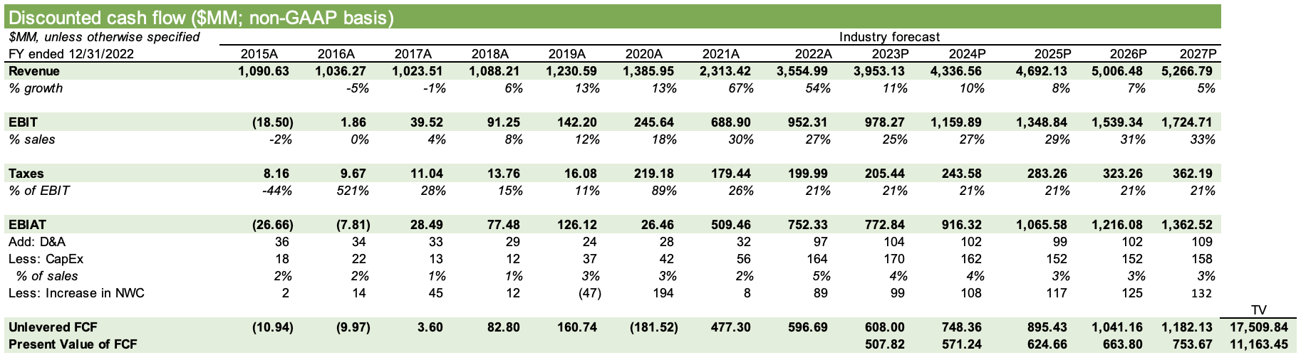
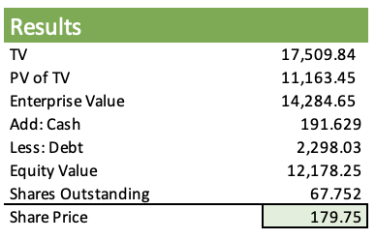
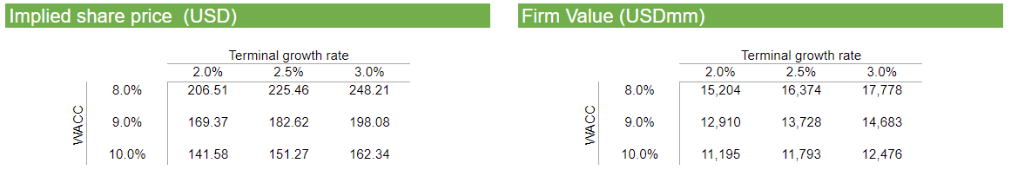
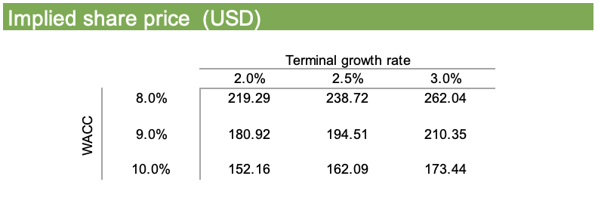
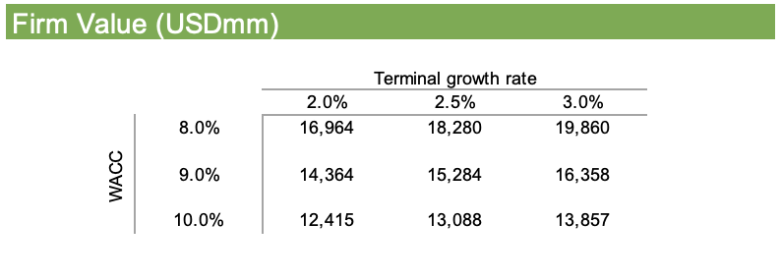
Discounted Cash Flow Analysis

Slide 12
Football Field
DCF:
Optimistic Case
$196.37
$335.21
DCF:
Street Case
$152.16
$262.04
DCF: Conservative Case
$84.18
$168.25
52 Week Range
$46.08
$143.50
Target Range: $152.16 to $262.04
4/17/23 Price: $139.04
Implied Trading Discount:
9% to 47%

Slide 13
Conclusion
We have concluded a Strong Buy for CROX.
Very optimistic future
Brand reimaging
Growth in foreign countries
Intrinsic Valuation
Crocs revenue is exponentially growing and will be sustainable in the future.
Acquisition of HEYDUDE will drive up revenue and bring a new line of products for Crocs.
CEO Andrew Rees successfully turned Crocs' public outlook around since the start of his position.
Celebrity and fashion show collaborations are becoming more frequent with Crocs brand.
Crocs sees sustainable and foreseeable growth in the EMEALA region and especially in Asia.
Our intrinsic valuation showed that Crocs is currently undervalued by approximately 23%.

Slide 14
Appendix

Slide 15
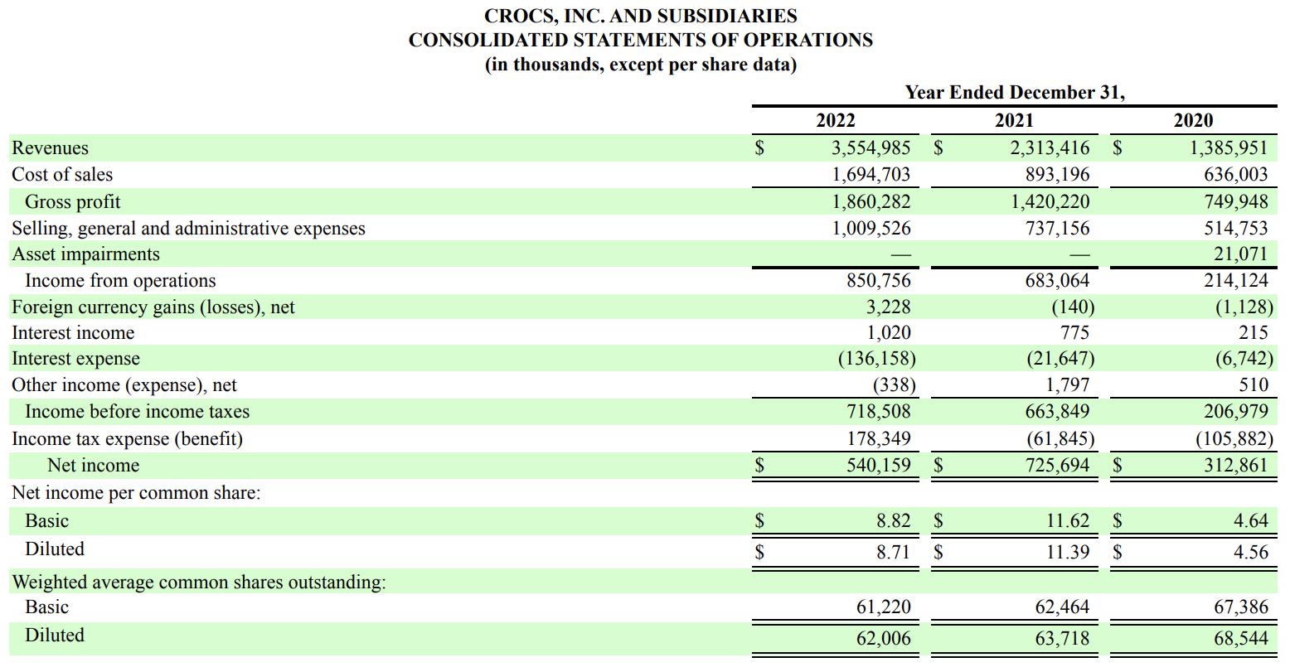
2022 Income Statement

Slide 16
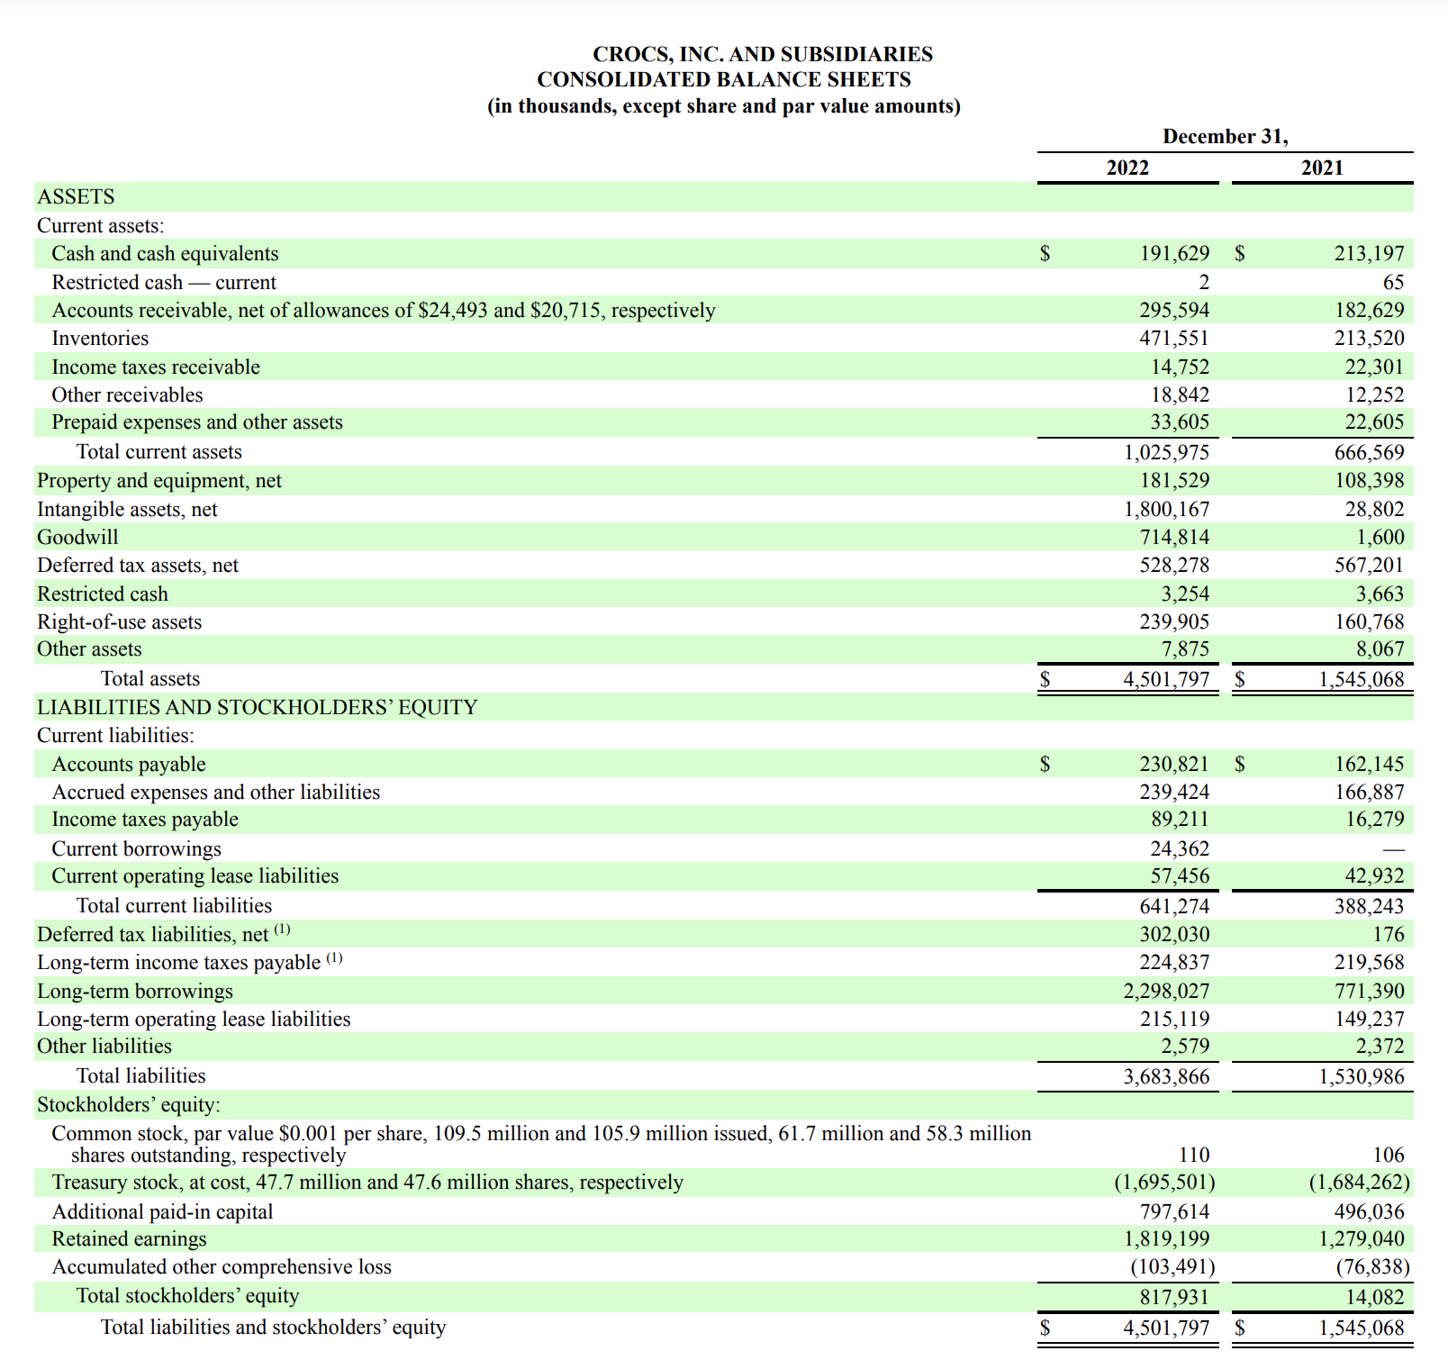
2022 Balance Sheet

Slide 17
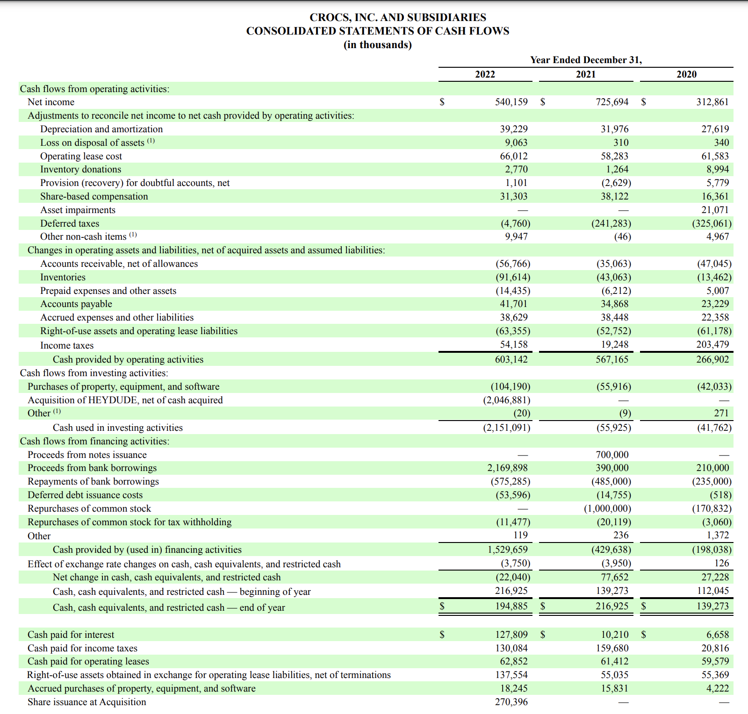
2022 Cash Flow Statement

Slide 18
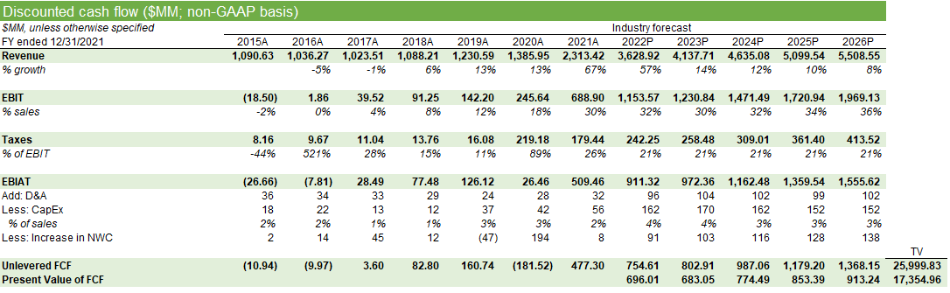
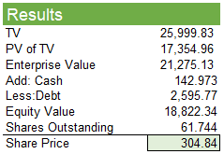
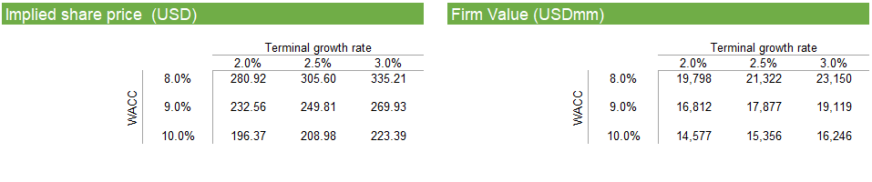
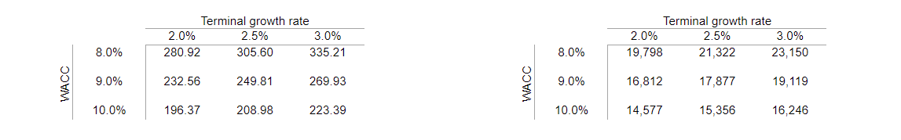
Discounted Cash Flow Analysis- Optimistic Case

Slide 19
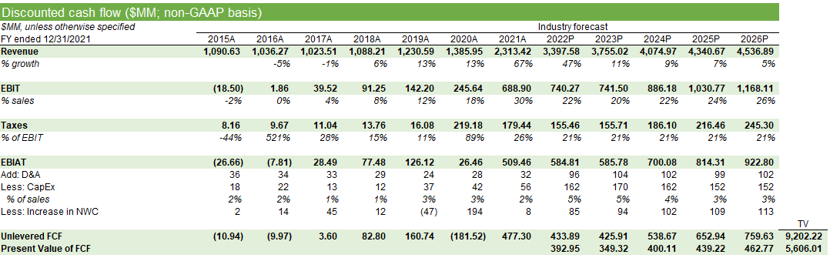
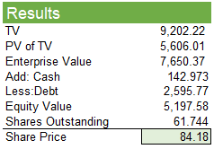
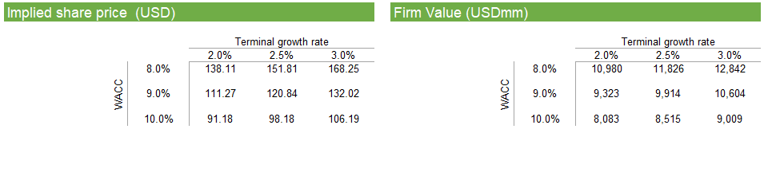
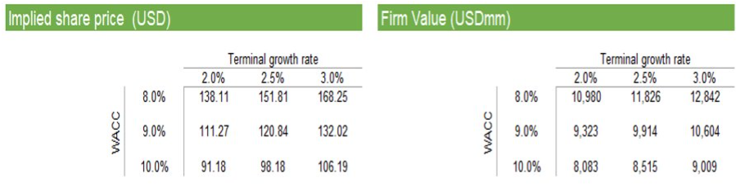
Discounted Cash Flow Analysis- Conservative Case

Slide 20
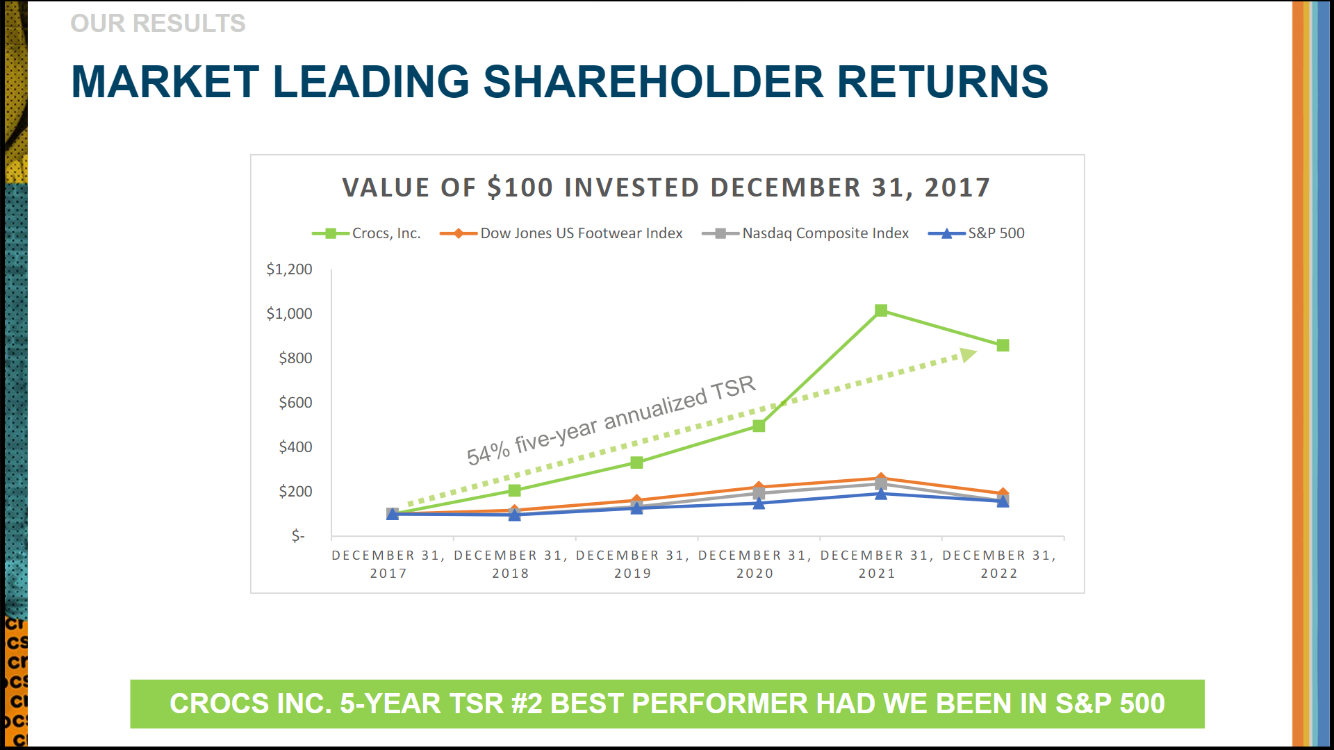
CROX vs. Market

Slide 21
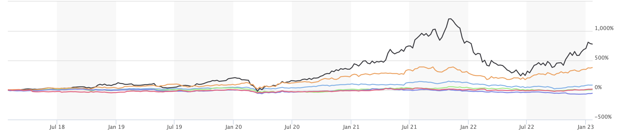
CROX vs. Competitors
CROX
DECK
DJUSFT
WWW
SHOO
SKX
Crocs has outperformed the Dow Jones U.S. Footwear index over the past 5 years as well as their competitors​
Performance since July '18
DJUSFT: 84.77%
CROX: 754.41%
WWW: -54.53%
SHOO: -46.13%
DECK: 382.26%
SKX: 16.53%

Slide 22
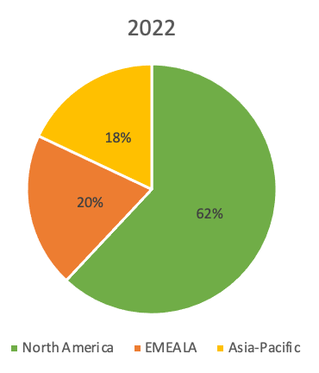
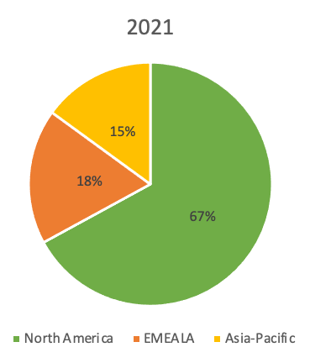
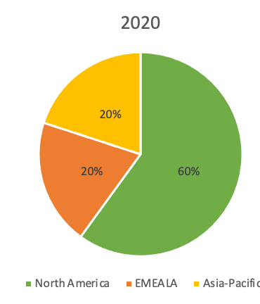
Revenue Breakdown- Geography
Sales Percentage by Region

Slide 23
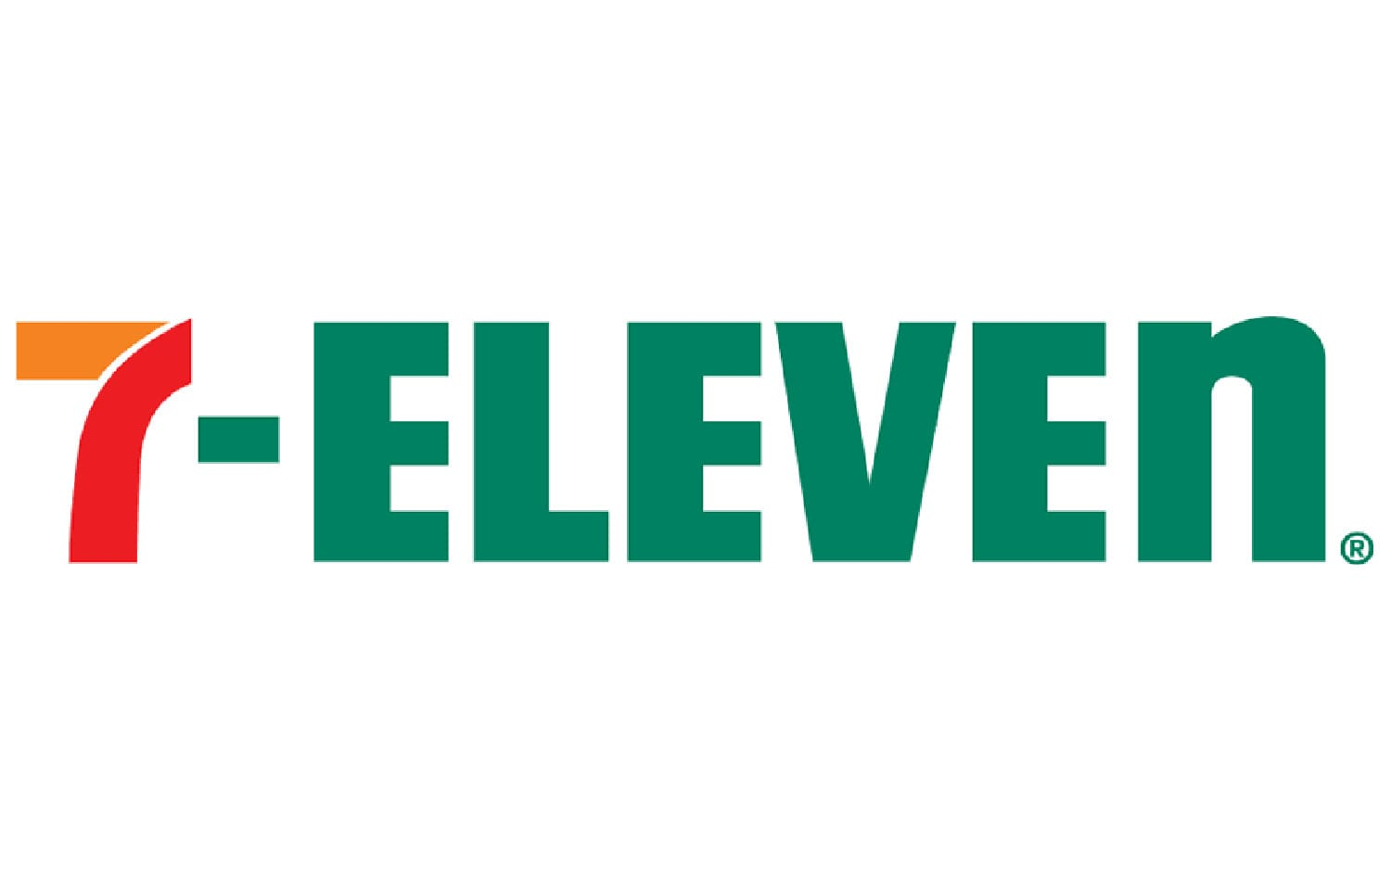
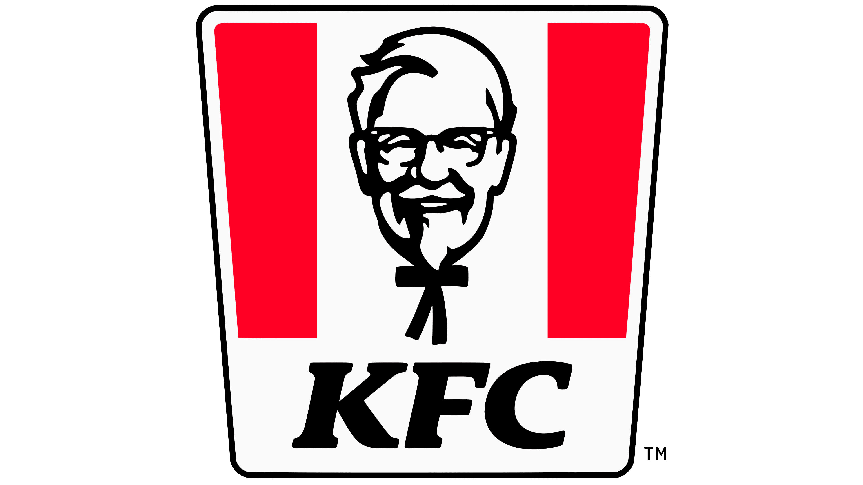



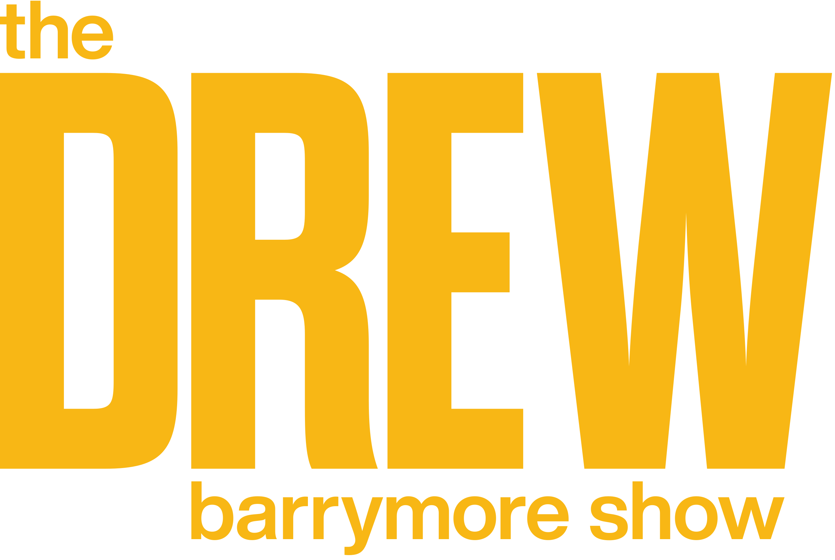







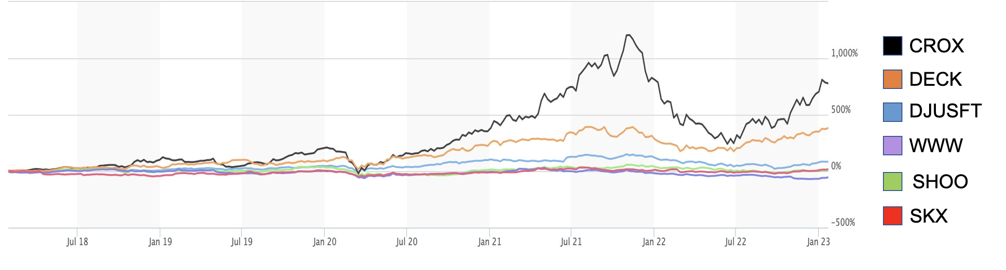
Investment Theses
Long runway for growth
Celebrity and Brand Collaborations
Crocs expects +$5B in revenue by 2026.​
With the acquisition of HEYDUDE, Crocs will have another cash cow in their line of products. Crocs expects HEYDUDE to surpass $1B in revenue by the end of this year
Consistent track record of profitability
2018 began a 4+ year run of double-digit revenue growth. ​
Brand Awareness
CROX vs. Market
2014 started a brand reignition process for Crocs. Their focus on the classic clog proved to be successful.​
Limited edition collaboration with celebrities and other brands boosted the popularity for Crocs.
Debt Concerns
Concerns about Crocs' debt is overblown, and we believe that their action in getting rid of their physical store locations will help deplete their debt.
Crocs is very dedicated to deleveraging and set a target of below 2.0x Adj.EBITDA over gross debt by the middle of 2023. They currently sit at 2.5x from 3.1x since the acquisition of HEYDUDE.

Slide 24
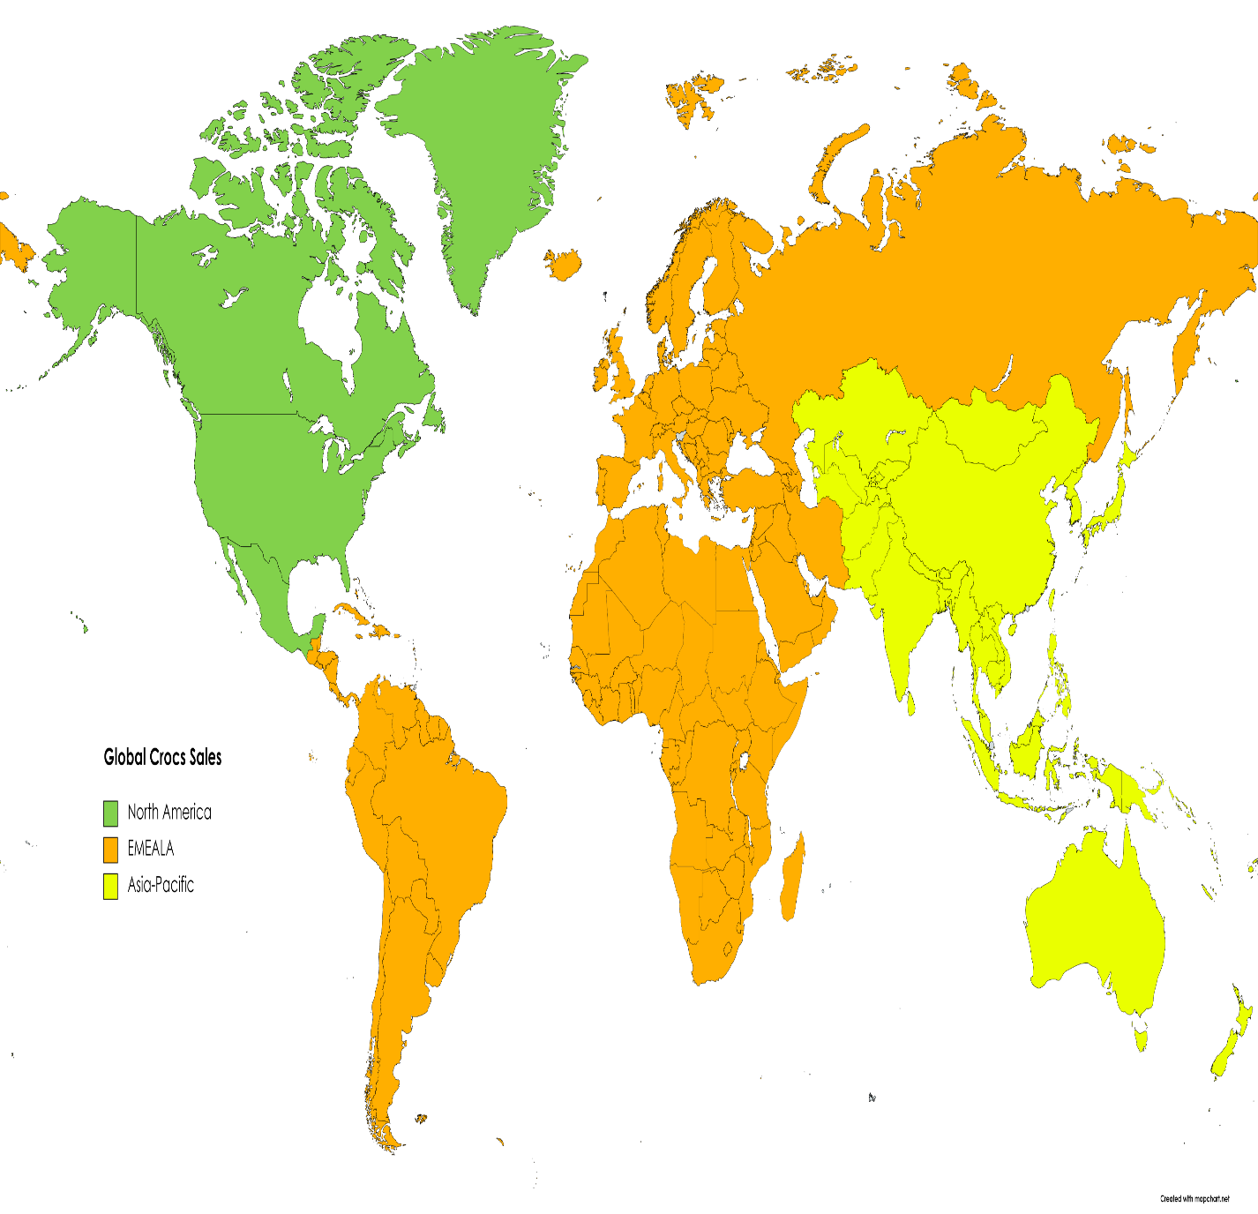
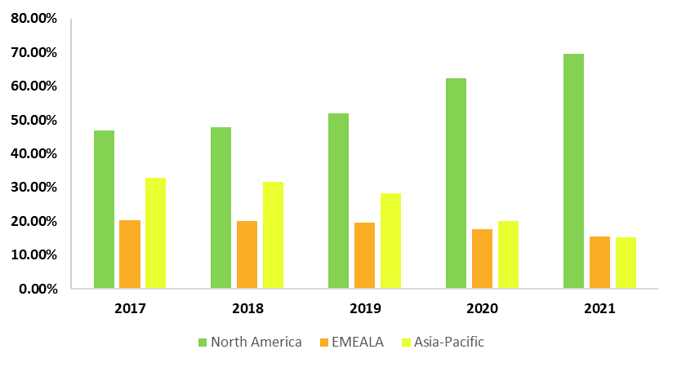
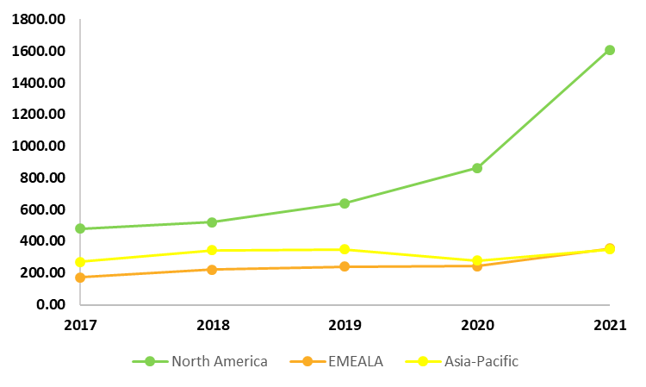
Revenue Breakdown- Geography
Sales Percentage by Region
Revenue by Region

