Slide 1

Household Finances & Consumer Sentiment
Solid Macro Data, Subdued Sentiment: Examining the Disconnect
Katie Scott
Economist, Center for Business and Economic Research
katie.scott@uky.edu
Notes:
Solid Macro Data, Subdued Sentiment: Explaining the Disconnect
today I’m going to talk about a disconnect that keeps showing up between the macroeconomic data and consumer sentiment. By traditional macroeconomic indicators, the U.S. economy has looked relatively solid. Unemployment has remained low by historical standards, real activity has held up, and inflation has cooled substantially from its peak.
And yet, consumer sentiment remains unusually subdued, and many households continue to describe their financial situation in terms of stress, tight budgets, and affordability pressure.
The goal of this presentation is to make sense of that gap. My argument is not that the headline indicators are wrong — it’s that they can be incomplete measures of household experience, especially in a period where the price level reset higher, borrowing costs rose, and household buffers thinned.
To ground that, I’ll focus on a few household finance markers that are closely tied to day-to-day constraints: housing affordability and cost burden, food security and household hardship, savings buffers, and signs of stress in consumer credit.
So the structure today is simple: first, the economy in the aggregate; second, what household-level indicators show about affordability and buffers; third, why sentiment is a rational response to constraints; and finally, what this implies for spending and resilience going forward

Slide 2
Michigan’s Consumer Sentiment Index
A summary measure of how households evaluate:
Their finances
The broader economy
Used in major economic indexes and forecasting tools
Measures consumers’ perception of the economy
Most decisions rely on limited data and lived experience—not continuous macro monitoring
Notes:
Why care?
Can be a leading indicator when expectations shift before spending changes
Can be a coincident indicator of real-time household stress
Sometimes looks lagging, reflecting cumulative price pressure already experienced
Best interpreted as a signal of risk and constraint, not a single causal driver
A natural question is: does sentiment actually matter? Is it leading, lagging, or causal?
The honest answer is: it can play all three roles, depending on what’s driving it and what part of the economy you’re watching.
Leading indicator: sentiment can move first when households become more uncertain and start delaying big purchases—before that shows up in official spending data.
Coincident indicator: sentiment often reflects what households are experiencing right now—like affordability stress or budget tightening.
Lagging indicator: sometimes it reacts after a long period of cumulative pressure, especially when prices have already reset higher and people feel worse off over time.
On causality: sentiment isn’t just “mood.” It can affect real behavior—especially discretionary and big-ticket spending—but it’s also shaped by the same underlying fundamentals households face.
So the best way to use it is as a measurement of the household decision environment: it tells us when consumers are becoming more cautious, constrained, or pessimistic—even if GDP and unemployment still look fine.

Slide 3
Michigan’s Consumer Sentiment Index
Source: University of Michigan Surveys of Consumers; accessed via Federal Reserve Bank of St. Louis FRED (UMCSENT).
Notes:
This chart shows the University of Michigan Consumer Sentiment Index over time, with recessions shaded in gray.
Historically, you can see a clear pattern: sentiment drops sharply during recessions, when job loss risk rises, incomes become uncertain, and households pull back spending.
What’s unusual in the current period is that we’ve seen a very large decline in sentiment even without an official recession.
That tells us something important: sentiment isn’t just reacting to GDP contractions — it’s reacting to lived economic pressure, especially affordability concerns like inflation, high borrowing costs, and housing stress.
So this is a key motivation for why sentiment matters: it can signal consumer strain and caution even when standard indicators still look “okay.”
Consumer sentiment is not “soft data” in the sense of being irrelevant—it is a window into how people are processing economic conditions and making decisions under uncertainty. When households face a complex and rapidly changing environment, many economic choices are shaped not only by deliberate calculation, but also by fast, automatic cognitive processes that operate outside conscious awareness.
Economic conditions change quickly—prices, interest rates, jobs, and policy can shift over weeks, not years. And households have to react in real time.
But the key point is: people don’t evaluate the economy the way a textbook model does. In practice, consumers are constantly making decisions—how much to spend, whether to borrow, whether to delay a major purchase—while facing limited attention, limited time, and too much information to fully process consciously. Curtin argues that because conscious reasoning is capacity-constrained and costly, decision-making relies heavily on nonconscious cognitive processing—pattern recognition, intuition, and learned associations.
That’s why measures like consumer sentiment are valuable: they summarize how households perceive current conditions and anticipate the future, capturing the psychological and informational layer of the economy that often drives spending behavior before official statistics fully adjust.
This compares to the lows of the 2008 and 2009 recession (and one in the 1980s). But we aren’t seeing aggregate indicators of a great deal of macro economic stress – but consumer sentiment is telling us that a good deal of stress is being felt at the micro level – the individual households

Slide 4
Real GDP vs. Sentiment
Source: BEA (GDPC1) and University of Michigan Surveys of Consumers (UMCSENT); accessed via FRED.
Notes:
Run through these – make joke about how they know this already
GDP is UP consumer sentiment – DOWN
Real Wages UP consumer sentiment Down
Unemployment – well DOWN and Consumer sentiment Down

Slide 5
Real Wages vs. Sentiment
Source: BLS (real average hourly earnings series) and University of Michigan Surveys of Consumers (UMCSENT); accessed via FRED.

Slide 6
Unemployment Rate vs. Sentiment
Source: BLS (UNRATE) and University of Michigan Surveys of Consumers (UMCSENT); accessed via FRED.

Slide 7
Savings Rates Spiked, Normalized, Then Fell
Savings surged during the start of the pandemic
Savings later returned toward pre-pandemic norms
Recent readings have been below pre-pandemic levels
Source: BEA (PSAVERT); accessed via FRED.
Notes:
This chart shows the U.S. personal savings rate over time.
During 2020, the savings rate spiked to historic highs—partly because households cut back spending, and also because many received temporary income support.
But as the economy reopened, savings returned closer to normal levels and then drifted downward.
The practical takeaway is that households today have less financial cushion than they did a few years ago, which matters for sentiment.
When savings are thin, inflation becomes more stressful—not necessarily because the economy is in recession, but because families have less flexibility to handle higher grocery bills, rent increases, insurance costs, or unexpected expenses.
This helps explain why confidence can stay weak even when employment is strong: budgets feel tighter when the “buffer” is smaller.

Slide 8
Savings as an Inflation Shock Absorber
Source: BEA (PMSAVE); accessed via FRED
Notes:
Savings are one of the main ways households smooth economic shocks.
During the pandemic, elevated savings helped offset rising prices and uncertainty.
As inflation persisted and savings normalized—and then dipped below pre-pandemic levels—that buffer weakened.
With less savings available, the same price increase feels more painful, even if income is still coming in.
This helps explain why sentiment weakened as savings declined, even without a recession.

Slide 9
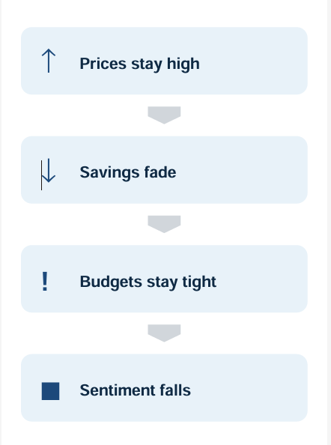
Pressure on Household Budgets
Prices are higher after the inflation surge
Essentials absorb more of the budget
Less discretionary income
Households feel more cash-flow constrained
Essential Budget Categories
Shelter prices — largest fixed monthly bill
Grocery prices — frequent purchases; shapes perception of inflation
Notes:
“Up to this point, we’ve been building the idea that the disconnect isn’t random — it starts when prices reset higher after the inflation surge. Even if inflation cools, the overall price level is still elevated, and that matters for how budgets feel month to month.
The key issue is that essentials absorb more income. Households can cut back on optional spending, but they can’t easily cut housing or groceries — those costs show up every single month.
So next I’m going to focus on two essential categories that drive the lived experience of inflation: first shelter, because it’s the largest fixed monthly bill and adjusts slowly, and then groceries, because they’re purchased frequently and are the most visible inflation signal for households.
That’s where the squeeze shows up — and it helps explain why sentiment stays low even when the economy doesn’t look like a typical recession.”

Slide 10
Housing: The Bill That Shapes the Budget
Shelter prices have risen faster than overall prices since 2022
Housing is typically the largest fixed monthly expense
Higher shelter costs keep budgets tight even as inflation cools
Source: BLS (CPIAUCSL and CPI Shelter component series); accessed via FRED.
Notes:
This chart compares overall inflation (“All Items”) to the CPI shelter index over time.
The key story is that shelter inflation has risen faster and stayed elevated, especially after 2021.
Housing costs don’t adjust like gas prices — they tend to move slowly and stay high once they rise, because rent renewals and housing affordability change gradually.
That matters for consumer sentiment because shelter is a monthly, unavoidable expense. It’s not something most households can easily cut back on.
So even if inflation improves in other areas, housing keeps the “cost of living” feeling high, which helps explain persistent consumer pessimism.
This lag story maps directly into:
“Is now a good time to buy a major household item?”
“Do you expect the economy to improve over the next year / 5 years?”
“Are you better or worse off financially than a year ago?”
Housing affordability pressures tend to pull all three down.

Slide 11
Cost-burdened Households: 2024 Cost-burdened is defined as households spending more than 30 percent of income on housing.
Source: U.S. Census Bureau, American Community Survey (ACS) 1-year estimates.

Slide 12
Cost-burden of Households 2020 vs. 2024
Source: U.S. Census Bureau, American Community Survey (ACS) 1-year estimates.

Slide 13
Cost-burden of Households 2020 vs. 2024
Source: U.S. Census Bureau, American Community Survey (ACS) 1-year estimates.

Slide 14
Current Housing Market
Median US household income: $81,600
Income needed to afford typical rental payment: $76,000
Income needed to afford a typical home purchase:
$93,000
Source: Zillow Observed Rent Index (ZORI) and Zillow Home Value Index (ZHVI) and U.S. Census Bureau, American Community Survey (ACS) (household income); accessed via Zillow and data.census.gov.
Notes:
ZILLOW DATA – CONTEMPORANEOUS – People don’t have many affordable options besides what they have currently. Very hard market to reduce housing cost and maintain standard of living at current place
Zillow’s affordability index takes a typical home price and current mortgage rates to estimate a monthly payment, then compares that payment to what a typical household can afford—usually assuming housing costs should be about 30% of income.
First, for renters: affordability was relatively stable for most of the late 2010s, but we see a clear step up in 2021 and 2022. That’s consistent with what households experienced — rents reset higher, and once rent goes up, it usually doesn’t come back down quickly. The result is that rent consumes a larger share of income, and budgets stay tight even after the peak of inflation has passed.
For homeowners, the change is even more dramatic. The index spikes sharply in 2022 and 2023, which reflects the double hit from elevated home prices and much higher mortgage rates. Even if home price growth slowed, the monthly payment burden surged — and that pushed affordability to its worst point in the series.
Together, these charts help explain the ‘disconnect’ we’ve been talking about. Housing is the biggest fixed cost in most household budgets. When affordability worsens, families have less room to adjust, less ability to rebuild savings, and more need to rely on credit to cover everyday costs. That kind of widespread budget pressure can drive broader economic anxiety and keep consumer sentiment low, even without a traditional recession.
This one is your most direct “flexibility” evidence.
What it shows:
The income needed to rent is close to average household income
The income needed to buy is well above average household income
Your affordability indices move the wrong way during/after the sentiment decline Housing is the biggest fixed cost. If it rises relative to income, families have:
less leftover for food, cars, childcare, healthcare fewer options when an expense shock hits less ability to rebuild savings

Slide 15
High Frequency Inflation: Groceries
Grocery inflation is highly visible and hard to avoid
High-frequency purchases are a constant reminder of higher prices
When grocery prices rise, budgets tighten quickly
Source: BLS (CPIAUCSL and CPI Food at Home component series); accessed via FRED.
Notes:
People experience the economy through bills, not averages.
I call groceries “high frequency inflation” because this is where people feel inflation most often.
Households might not track monthly CPI releases, but they do notice the weekly grocery bill.
That means more of each paycheck goes to essentials, leaving less room for saving or discretionary spending.
This is a big reason sentiment can stay weak even without a recession: the budget pressure shows up in everyday life.
This helps explain weak sentiment without recession – incomes can be stable and budgets can be tight – no recession no weak labor market – just bad vibes
So groceries help explain why consumer sentiment tracks everyday affordability, not just macro indicators.

Slide 16
Food Insecurity is Rising
Food insecurity increased from 2021 to 2024
A 32 percent increase in the number of households relative to 2021
Recent estimates show food insecurity remains elevated
Households are being pushed into tougher tradeoffs
Rising food insecurity may indicate that households can’t sustain necessary expenditures
Source: USDA Economic Research Service (Food Security in the United States)
Notes:
These are 2024 Federal Poverty Guidelines (48 contiguous states + DC). Below are 100% FPL, plus your commonly used program cutoffs (130% and 185%).
Household size 1
100% FPL: $15,060
130% FPL: $19,578
185% FPL: $27,861
Household size 2
100%: $20,440
130%: $26,572
185%: $37,814
Household size 3
100%: $25,820
130%: $33,566
185%: $47,767
Household size 4
100%: $31,200
130%: $40,560
185%: $57,720

Slide 17
Food Insecurity Is Highly Income-Sensitive
Food insecurity is concentrated among lower-income households
Rising grocery costs can turn small shocks into real instability
Sentiment reflects these uneven lived experiences, not just averages
Notes:
Below poverty (≈ under $31k for a family of 4)
Near-poor / moderate hardship risk (≈ under $58k for a family of 4)
130%: $40,560
Below 185% of poverty (“moderate hardship risk”): about 1 in 4
This chart shows food insecurity rates across income levels, and the message is very clear: food insecurity is highly income-sensitive.
In 2023, about 13.5% of all U.S. households experienced food insecurity at some point during the year.
But that risk is dramatically higher for households with incomes near or below the poverty line—roughly one-third to nearly two-fifths of households depending on the cutoff.
The takeaway is that inflation pressure is not evenly experienced. For higher-income households, rising grocery prices are frustrating. For lower-income households, the same price increases can force real tradeoffs—between food, rent, utilities, and other essentials.
This helps explain consumer sentiment: even if the overall economy looks stable in aggregate data, a large share of households are still living a much tighter month-to-month reality.
This slide shows that food insecurity is not evenly distributed—it rises sharply as income falls.
In 2023, about 13.5% of all U.S. households experienced food insecurity at some point during the year.
But among households below the poverty line, food insecurity is much higher—around four in ten households.
The same pattern shows up below 185% of poverty as well—about one-third of households.
This is important for our consumer sentiment story: even if the “average” economy looks fine, many households—especially at lower incomes—are living a much tighter budget reality.

Slide 18
Strong Economy, Strained Households Sentiment has dropped to historic lows without a recession
Sentiment remains subdued without a recession
Affordability pressures shape perceptions of macro-economic conditions
Household buffers against high expenses have thinned since the pandemic
Higher essential costs reduce discretionary spending and increase perceived risk
Focus areas: Housing (largest fixed cost) • Food (frequent essential purchase)
Notes:
To wrap up, the main message of this presentation is that consumer sentiment is weak not because the economy is collapsing, but because household budgets have been under real pressure.
First, after the inflation surge, prices reset higher, and many essential categories stayed elevated. That changes what life feels like financially even when inflation “comes down.”
Second, this pressure is strongest in high-salience categories—especially housing and groceries.
Housing is the biggest fixed monthly expense, and shelter inflation tends to move slowly and stay elevated.
Groceries are “high-frequency inflation,” meaning households feel those prices weekly, which strongly shapes perceptions of the economy.
Third, households don’t just respond to higher prices emotionally—they respond financially.
Savings rates spiked in 2020 and helped absorb shocks temporarily, but savings normalized and recently dipped lower, leaving less cushion.
We see that same idea in the Federal Reserve’s household budget evidence: in 2024, only about 63% of adults reported they could cover a $400 emergency with cash or its equivalent, which implies thin buffers for a meaningful share of households.
Fourth, we see coping behavior in the credit data. Delinquencies may not signal crisis, but more households carrying balances or making minimum payments is consistent with cash-flow stress.
Fifth, the burden is not evenly distributed. The food insecurity data shows that hardship is highly income-sensitive, so even if averages look stable, many households are operating with tight margins and tougher tradeoffs.
Finally, it’s important to acknowledge that economists debate whether consumer sentiment is leading, coincident, or lagging—and whether it is causal or simply reflective. But regardless of timing, it captures something that traditional headline indicators do not: the decision environment households are living in.
So the takeaway is: consumer sentiment is weak because households are constrained by affordability and reduced financial buffers, and those constraints can persist even when the macro economy avoids recession.
The most important takeaway is that we’ve seen a sharp decline in consumer sentiment without an official recession, and that’s historically unusual.
I’m not claiming there’s one single definitive explanation for this disconnect.
But the pattern across the household data is consistent: prices reset higher, essentials like housing and groceries weigh heavily on budgets, and financial buffers are thinner than they were a few years ago.
The Federal Reserve’s household survey data show that many families still lack a strong emergency buffer, and credit data suggest that more households are carrying balances or making minimum payments.
Even if the macroeconomy looks stable, households can still be financially stretched.
And if a recession does arrive, the concern is that we may be entering it with a more fragile consumer than headline indicators alone would suggest.

Slide 19
Appendix

Slide 20
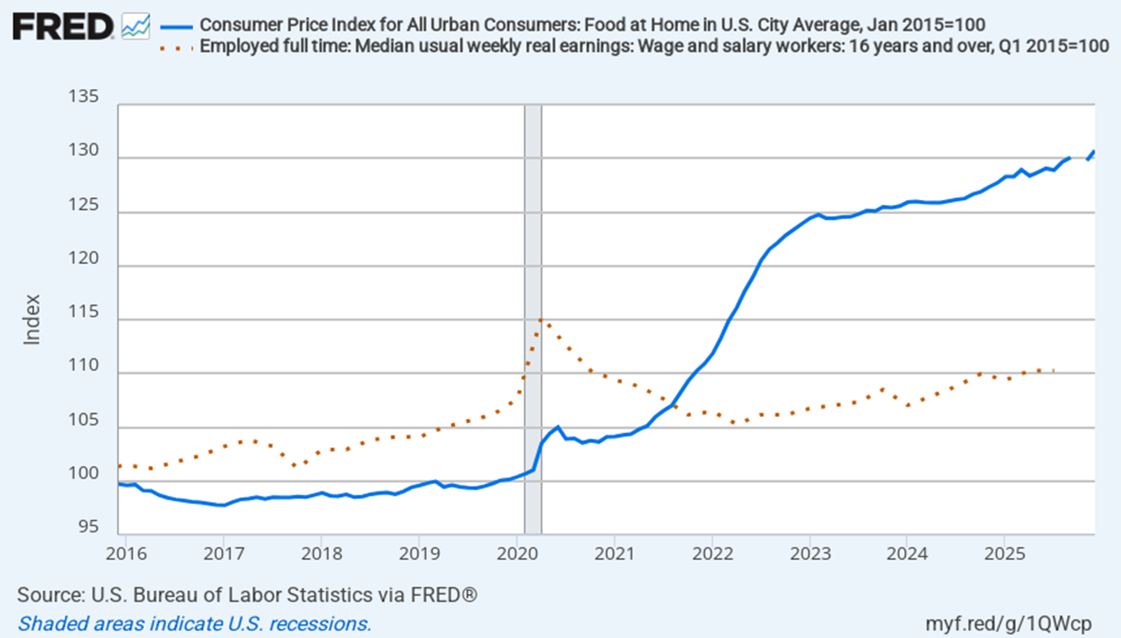
Grocery Prices v. Real Wages
Notes:
“Rising grocery prices relative to real wages suggests many households likely devoted a larger portion of their budgets to essentials—especially food leaving less room for discretionary spending.”

Slide 21
Household Spending (Aggregate)
Notes:
Change in housing – half a percent more of consumer expenditures (.55%)
Change in “All Else” is 0.49 percent
Shifts in consumption patterns (like this) may indicate households are facing an income constraint to their spending. Meaning money is being diverted from discretionary expenditures (like recreation etc.) lowering consumer qualify of life (cant get what they want)

Slide 22
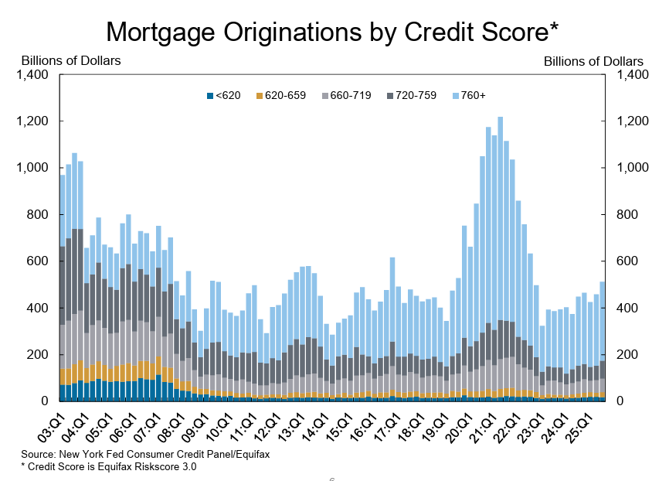

Slide 23
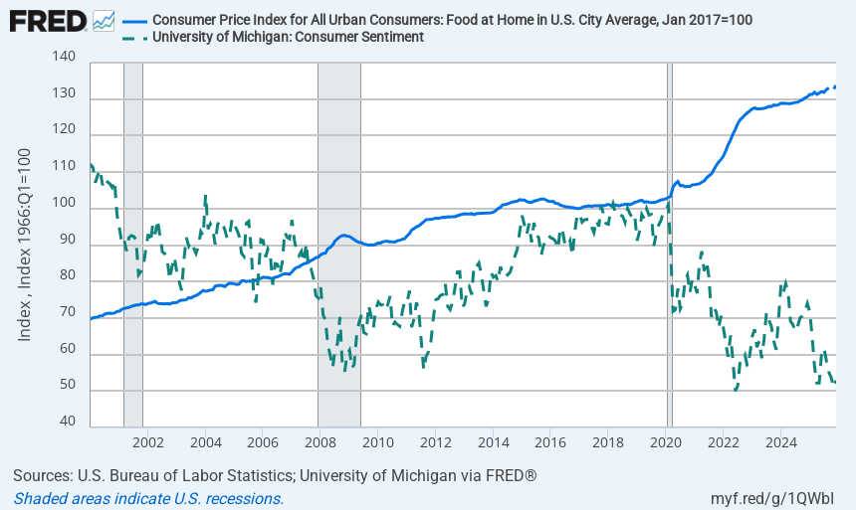
Groceries and consumer sentiment

Slide 24
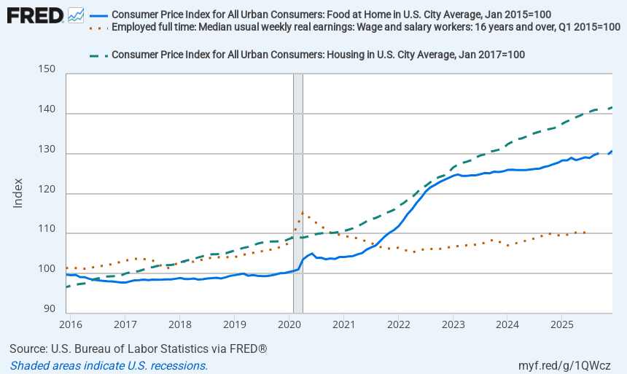

Slide 25
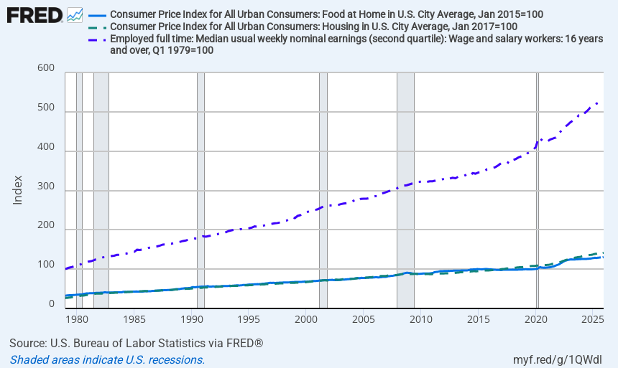

Slide 26
Stress in the Credit Data?
Percentage of accounts paying full balance is still higher than pre-pandemic
The share making minimum payments has trended upward
Delinquencies remain low overall, but have increased from pandemic-era lows
Source: Board of Governors of the Federal Reserve System; accessed via FRED (delinquency rate on credit card loans).
Notes:
This chart breaks down how people are paying their credit card bills: paying the full balance, paying part of the balance, paying only the minimum, or becoming delinquent.
One clear shift in recent years is that fewer households are able to pay off their balance in full, while a larger share are carrying balances or making only minimum payments.
That pattern is consistent with budgets being tighter: households still spend, but they’re relying more on revolving credit to manage cash flow.
Importantly, delinquency rates are still relatively low compared with what you might see in a major downturn — but they’ve moved up from the unusually low levels during the pandemic period.
The overall message is that credit conditions don’t scream crisis, but they do suggest more strain at the margin, which fits the consumer sentiment story: spending can hold up while financial anxiety rises.

Slide 27
Real v. Nominal Savings

Slide 28
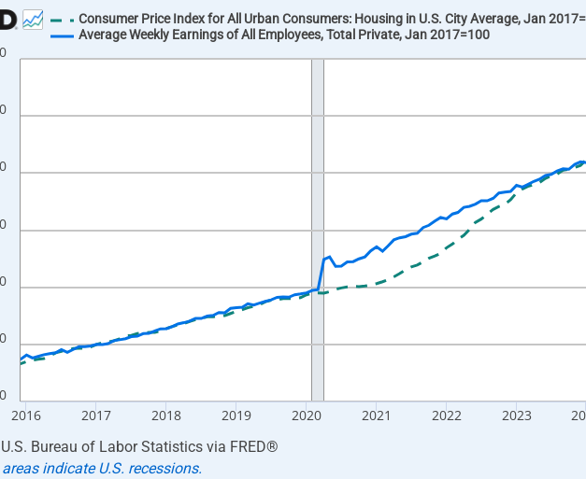
Housing and Earnings
Notes:
Consumer sentiment is strongly influenced by inflation experiences, but measured inflation—especially CPI shelter inflation—can reflect housing market conditions with a lag. This can create a persistent gap between what households feel and what top-line inflation appears to be doing at any moment.
1) Why housing is central to inflation perceptions
Housing is high-salience spending:
rent checks
mortgage payments
“can I afford a home?” decisions
visible local price changes (Zillow-like comparisons, rent increases, etc.)
Even when energy or food prices move quickly, housing is the “slow-moving giant” that shapes household expectations about the cost of living.
Sentiment connection: when households think “inflation,” they often mean housing affordability + rent stress, not just the CPI headline number.
2) What Summers emphasizes: CPI shelter ≠ house prices (and moves with a lag)
CPI does not plug in house prices directly. Instead, the shelter component is dominated by:
Rent of primary residence
Owner’s Equivalent Rent (OER) (imputed rent homeowners would pay)
Key implication: Even if house prices cool rapidly, CPI shelter inflation can remain elevated because the measurement approach captures rental-equivalent costs that adjust gradually.
3) The lag mechanism (intuitive timeline)
Housing market shock today → CPI shelter later
Think of this as a pipeline:
House prices / market rents change (t) → lease renewals adjust gradually → OER/rent measures update with delay → CPI shelter inflation peaks after the market peaks (t + several quarters)
So when people hear “inflation is easing,” they may not believe it because housing still feels expensive, and CPI shelter may still be climbing even after house prices stop rising.
4) Why this matters for consumer sentiment
Consumer sentiment can remain depressed even when:
headline CPI is falling, or
goods inflation is cooling, or
the Fed claims progress on inflation
Because for consumers:
affordability is lived inflation
the “cost of getting by” is dominated by shelter costs
housing is the biggest driver of “am I falling behind?” perceptions
This helps explain why sentiment may show persistent pessimism even when macro indicators look “better.”
This lag story maps directly into:
“Is now a good time to buy a major household item?”
“Do you expect the economy to improve over the next year / 5 years?”
“Are you better or worse off financially than a year ago?”
Housing affordability pressures tend to pull all three down.

Slide 29
Concept
Linking framework components to data sources
Affordability shocks
• CPI & component price indices (FRED)
• Housing costs & cost burden (ACS, data.census.gov)
Reduced financial buffers
• Personal savings rate (FRED)
• Liquid asset indicators (Federal Reserve)
Heightened uncertainty & expectations
• Inflation expectations (Michigan Survey)
• Job security perceptions (Michigan Survey)
Weaker consumer sentiment
• University of Michigan Consumer Sentiment Index
Household behavior
• Consumption & spending (BEA)
• Credit use & delinquencies (Federal Reserve)

