Slide 1

Kentucky’s Economic Outlook 2026
February 3, 2026
Michael W. Clark, Ph.D.
Associate Professor of Economics
Director, Center for Business and Economic Research
michael.clark@uky.edu

Slide 2
Overview
U.S. Economy
  Strong GDP growth
  Increased productivity
  Weak Employment
  Inflationary pressures remain
Kentucky Economy
  Strong GDP growth
  Job growth has stalled in recent months
  Labor supply is weak

Slide 3
Inflation: 12-Month Percent Change
Source: US Bureau of Labor Statistics. Consumer Price Index. US Bureau of Economic Analysis. PCE.

Slide 4
Real Gross Domestic Product
Kentucky & U.S.
Source: US Bureau of Economic Analysis.

Slide 5
Unemployment Rates
Kentucky & U.S.
Source: US Bureau of Labor Statistics. Local Area Unemployment Statistics. Kentucky and US are seasonally adjusted. Lexington/Fayette MSA not seasonally adjusted.
Notes:
Dec 2025 KY=4.5% US=4.4%

Slide 6
KY Labor Market Statistics, Monthly Change
Source: US Bureau of Labor Statistics. Local Area Unemployment Statistics. Seasonally Adjusted.

Slide 7
Kentucky’s Nonfarm Employment (Jobs)
Source: US Bureau of Labor Statistics. Current Employment Statistics.

Slide 8
Percent Change in Annual Total Nonfarm Employment (Jobs)
Source: US Bureau of Labor Statistics. Current Employment Statistics.
Notes:
Average employment in KY for 2024 was up 23,300 jobs compared to 2023.

Slide 9
Monthly Change in Nonfarm Employment (Jobs)
Source: US Bureau of Labor Statistics. Current Employment Statistics.
Notes:
In the last 4 months, KY lost nearly 10,000 jobs.

Slide 10
Percent Change in Annual Manufacturing Employment (Jobs)
Source: US Bureau of Labor Statistics. Current Employment Statistics.

Slide 11
Percent Change in Annual Construction Employment (Jobs)
Source: US Bureau of Labor Statistics. Current Employment Statistics.

Slide 12
Percent Change in Annual Education & Health Care Employment (Jobs)
Source: US Bureau of Labor Statistics. Current Employment Statistics.

Slide 13
Change in Average Annual Employment, Kentucky
2024 to 2025
Source: US Bureau of Labor Statistics. Current Employment Statistics.

Slide 14
Change in Average Annual Employment, Lexington-Fayette MSA
2024 to 2025
Source: US Bureau of Labor Statistics. Current Employment Statistics.

Slide 15
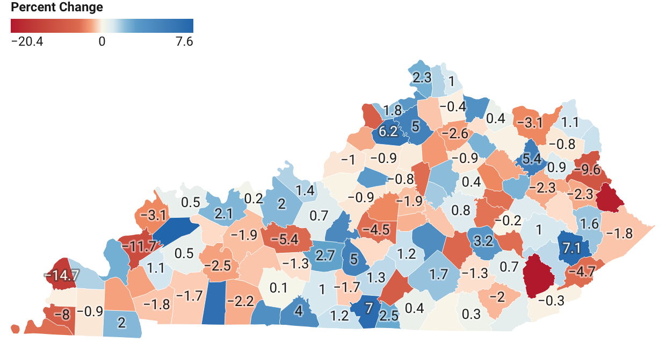
Change in County Employment June 2024 to June 2025

Slide 16
Unemployment Insurance Claims 4-week Moving Average (Kentucky)
Source: US Department of Labor. Employment & Training Administration.

Slide 17
Job Opening and Turnover
KY
US
Source: US Bureau of Labor Statistics. Job Openings and Labor Turnover Survey.
Notes:
Layoff and discharges were up in KY during 2025 but are in line with pre-pandemic levels.

Slide 18
Layoffs & Discharges by Industry U.S.
Source: US Bureau of Labor Statistics. Job Openings and Labor Turnover Survey.

Slide 19
U.S. Employment Cost Index for Private Workers
Wages and Salaries and Benefits
Source: US Bureau of Labor Statistics.

Slide 20
Housing Market

Slide 21
Mortgage Rates Have Drifted Downward as the Fed Eased Rates Last Year
Sources: Board of Governors of the Federal Reserve System (US); Federal Reserve Bank of New York; Freddie Mac; fred.stlouisfed.org.
Notes:
10-year yield has increased, so prices for these bonds decreased. So, did demand for these notes decrease? Investors must think these notes are a bad investment. Why might they think this? Could be that they think rates on longer term notes will be higher in the future. Could be they think inflation might increase.

Slide 22
US Construction Costs Have Stabilized
Source: US Census Bureau, Construction Price Indexes.
Source: US Bureau of Labor Statistics. Producer Price Index.

Slide 23
US Housing Units (000s)
Source: US Census Bureau and US Department of Housing and Urban Development

Slide 24
KY Housing Units Authorized by Permits
* Data on permits for 2025 are only available through October.
Source: US Census Bureau.
Notes:
YTD single family down 3% in 2025.
YTD multi-family down 5.5% in 2025.

Slide 25
Housing Market
Source: Realtor.com. https://www.realtor.com/research/data/

Slide 26
FHFA Housing Price Index, Percent Change Over Same Quarter Last Year
Source: Federal Housing Finance Agency. Seasonally Adjusted.

Slide 27
Outlook
Economy will continue to grow but at slower pace
Unemployment rate increases gradually
Recession seems unlikely given strong GDP growth
Little growth in employment

Slide 28
Economic Outlook
 | 2026
Real GDP—US | 2.2%
Real GDP—Kentucky | 1.7%
Inflation—US | 3.1%
Unemployment Rate—US | 4.6%
Unemployment Rate—Kentucky | 5.1%
Nonfarm Employment—US | 0.3%
Nonfarm Employment—Kentucky | 0.2%
Manufacturing Employment—Kentucky | 0%

Slide 29
Risk to Outlook
  Federal Reserve Monetary Policy
  Policy Uncertainty
    Trade
    Immigration
  Reductions labor supply
  Layoffs accelerate

Slide 30

http://cber.uky.edu/

Slide 31
Percent Change in Employment Since January 2014
US
KY
Ky’s Bordering States
Percent

Slide 32
Number of People in the Labor Force (Employed or Looking for Work)
Source: US Bureau of Labor Statistics. Local Area Unemployment Statistics. Seasonally Adjusted.

Slide 33
Labor Market
Source: US Bureau of Labor Statistics. Local Area Unemployment Statistics. Seasonally Adjusted.

