Slide 1
National Economic Outlook
Julianne Dunn, Regional Executive – Cincinnati Branch
University of Kentucky Gatton School Economic Outlook
February 3, 2026
The views expressed herein are those of the author and not necessarily those of the Federal Reserve Bank of Cleveland or the Board of Governors of the Federal Reserve System

Slide 2
Roadmap for today’s presentation
Overview of the Federal Reserve
Macroeconomic conditions
Labor market
Inflation
Interest rates

Slide 3
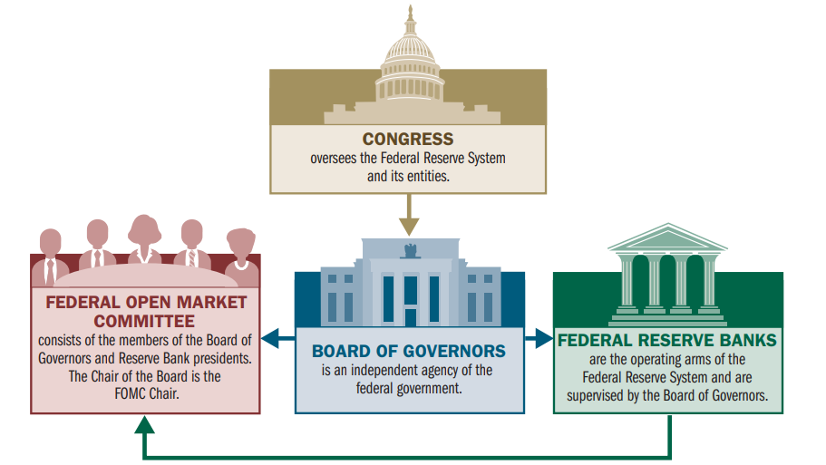
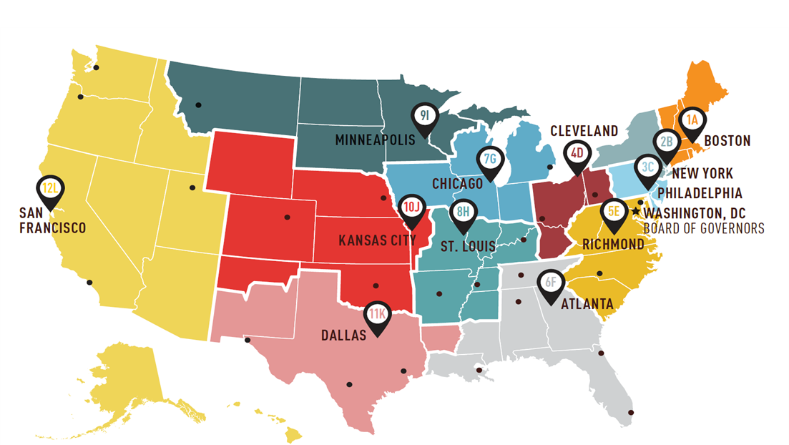

The Federal Reserve System is a decentralized central bank
Designed to balance and reflect government, industry, and regional interests
Independent from short-term political pressure while also accountable to Congress and the American people
Beth Hammack is President and CEO of the Federal Reserve Bank of Cleveland

Slide 4
The economy appears to be on solid footing as 2026 begins
Changes in Real GDP and Real Final Sales to Private Domestic Purchasers (PDFP)
Percent change, annual rate
14
12
Q4/Q4 | 2025 | 2026
Blue Chip, 1/10 | 2.1% | 2.0%
FOMC SEP, 12/10 | 1.7% | 2.3%
10
Real GDP
Real PDFP
8
Blue Chip Consensus Forecast
6
2026
3.8
4.4
4
2025:
Q4
1.9
1.9
2.0
2.0
2
1.0
0
-0.6
-2
2021
2022
2023
2024
2025
2026
Source: Bureau of Economic Analysis and Blue Chip Economic Indicators via Haver Analytics.
Last Data Points: Real GDP, 2025:Q3; Forecasts through 2026:Q4 as of January 10, 2026.

Slide 5
Consumer sentiment has fallen over the last two years, but spending continues to increase
Consumer Sentiment
Real Personal Consumption Expenditures
United States
United States
120
17
16
100
15
80
14
13
Index, 1966:Q1 = 100, NSA
Trillions of 2017$
60
12
40
11
10
20
9
0
8
Jan 2000
Jan 2005
Jan 2010
Jan 2015
Jan 2020
Jan 2025
Jan 2000
Jan 2005
Jan 2010
Jan 2015
Jan 2020
Jan 2025
Source: University of Michigan via Haver Analytics
Source: Bureau of Economic Analysis via Haver Analytics
Last data point: January 2026
Last data point: November 2025

Slide 6
Key Takeaways
Consumer sentiment has weakened, but GDP growth is expected to be above trend in 2026.

Slide 7
Private payroll gains have slowed; federal government employment dropped in October
Monthly Change in Payroll Employment
Private, Government, and Nonfarm
1000
900
Nonfarm (Government + Private)
800
Government (Federal, State, and Local)
Private
700
600
500
Thousands, SA
400
300
200
100
0
-100
October: Federal employment declined by 179k
-200
Jan 2021
Jan 2022
Jan 2023
Jan 2024
Jan 2025
Last data point: December 2025.
Source: Bureau of Labor Statistics via Haver Analytics.

Slide 8
Healthcare and hospitality led private payroll growth in recent months
Monthly Change in Private Payroll Employment
Selected Sectors
300
Total private
250
Healthcare and social assistance
Leisure and hospitality
200
All other sectors
150
Thousands, SA
100
50
0
-50
-100
Jan 2024
Apr 2024
Jul 2024
Oct 2024
Jan 2025
Apr 2025
Jul 2025
Oct 2025
Last data point: December 2025.
Source: Bureau of Labor Statistics via Haver Analytics.

Slide 9
Overall, payroll employment leveled off in 2025
Nonfarm Employment
United States
160
Dec '25
YoY % Chg
155
159.5
+0.4%
150
145
Millions, SA
140
135
130
125
Zoomed in for scale
Jan 2000
Jan 2005
Jan 2010
Jan 2015
Jan 2020
Jan 2025
Last data point: December 2025.
Source: Bureau of Labor Statistics via Haver Analytics.

Slide 10
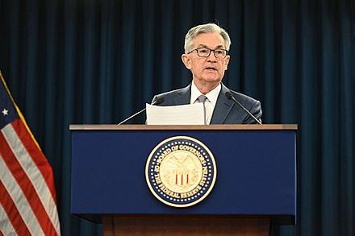
A good part of the slowing in the pace of job growth over the past year reflects a decline in the growth of the labor force, due to lower immigration and labor force participation, though labor demand has clearly softened as well.
– Fed Chair Jerome Powell, FOMC Press Conference, January 28, 2026
This Photo by Unknown Author is licensed under CC BY-SA

Slide 11
Household perceptions of the labor market have weakened…
Labor Market Differential
Share that believes "Jobs plentiful" minus share that believes "Jobs hard to get"
50
40
30
20
% Jobs plentiful - % Jobs hard to get, SA
10
0
-10
-20
Jan 2016
Jan 2018
Jan 2020
Jan 2022
Jan 2024
Jan 2026
Source: Conference Board via Haver Analytics
Last data point: January 2026

Slide 12
…but could this time be different?
Labor Market Differential
Share that believes "Jobs plentiful" minus share that believes "Jobs hard to get"
60
40
20
% Jobs plentiful - % Jobs hard to get, SA
0
-20
-40
-60
Jan 1980
Jan 1990
Jan 2000
Jan 2010
Jan 2020
Source: Conference Board via Haver Analytics
Last data point: January 2026

Slide 13
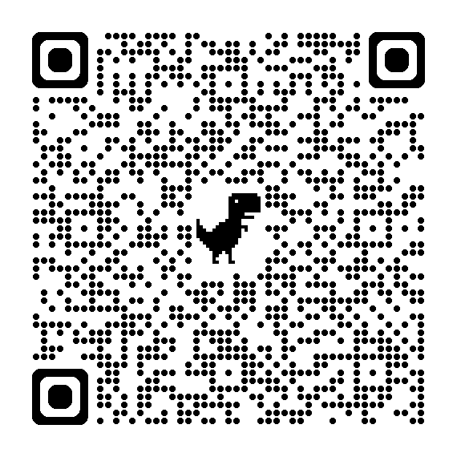
Overall, the unemployment rate remains low
Unemployment Rates
FOMC SEP
Total, 16-24 year olds, Black or African American
Dec
'25
YoY
Chg
Dec
'26
YoY
Chg
30
Total
4.4
+0.3
4.4
+0.0
16-24 year olds
10.4
+1.4
25
Black or African American
7.5
+1.4
20
15
10
5
0
Jan 1980
Jan 1990
Jan 2000
Jan 2010
Jan 2020
Source: Bureau of Labor Statistics via Haver Analytics.
Are Young College Graduates Losing Their Edge in the Job Market?
Last data point: December 2025.

Slide 14
Key Takeaways
Consumer sentiment has weakened, but GDP growth is expected to be above trend in 2026.
Employment has leveled off and the labor market is cooler than it was, but the unemployment rate remains low.

Slide 15
Inflation has moved sideways, at best
PCE Inflation Index
Headline and Core
8
Nov '25
Oct '25
Headline PCE Inflation
2.8
2.7
6
Core PCE Inflation
2.8
2.7
4
Year-over-year percent change
2
0
-2
2005
2010
2015
2020
2025
Source: Bureau of Economic Analysis via Haver Analytics.
Notes: Core PCE is PCE less food & energy.
Horizontal line represents FOMC target rate.
Last Data Point: November 2025

Slide 16
Core goods inflation has increased, and core services inflation is still elevated
PCE Inflation Index
Core, Core Goods, and Core Services
8
Nov '25
Goods ex. food and energy
1.3
Services ex. energy
3.3
6
Total ex. food and energy
2.8
4
Year-over-year percent change
2
0
-2
2005
2010
2015
2020
2025
Source: Bureau of Economic Analysis via Haver Analytics and FRBC calculations.
Note: "Core" measures exclude food and energy.
Last Data Point: November 2025.

Slide 17
But most of the over run in goods prices is from tariffs. And that’s actually good news, because if it weren’t from tariffs, it might mean it’s from demand and that’s a harder problem to solve.
– Fed Chair Jerome Powell, FOMC Press Conference, January 28, 2026
This Photo by Unknown Author is licensed under CC BY-SA

Slide 18
Average earnings have barely kept pace with inflation over the last 5 years
Consumer Price Indexes and Average Hourly Earnings
Index, January 2021 = 100
130
125
120
115
110
105
100
Last 5
years
Last 2
years
Last 12
months
Average hourly earnings
+23.7%
+7.9%
+3.8%
95
All items
+24.1%
+5.6%
+2.7%
Food at home
+25.5%
+4.1%
+2.4%
90
Shelter
+28.1%
+7.9%
+3.2%
85
Jan 2018
Jan 2019
Jan 2020
Jan 2021
Jan 2022
Jan 2023
Jan 2024
Jan 2025
Last data point: December 2025.
Source: Bureau of Labor Statistics via Haver Analytics.

Slide 19
Key Takeaways
Consumer sentiment has weakened, but GDP growth is expected to be above trend in 2026.
Employment has leveled off and the labor market is cooler than it was, but the unemployment rate remains low.
Inflation remains elevated, in part because tariffs have pushed up goods prices.

Slide 20
Interest rate projections are mixed, with a median of one 25 basis point cut this year
Federal Funds Rate
FOMC Summary of Economic Projections
4.0
Current level
3.5
Median
projection for year-end
3.0
2.5
2.0
Federal Funds Rate
1.5
It’s hard to look at the incoming data and say that policy’s significantly restrictive at this time. It may be…sort of loosely neutral, or it may be somewhat restrictive, it’s in the eye of the beholder.
– Fed Chair Jerome Powell, FOMC Press Conference, January 28, 2026
1.0
0.5
0.0
2026
2027
2028
Longer Run
Source: Federal Reserve Board via Haver Analytics
Projections from: December 2025.

Slide 21

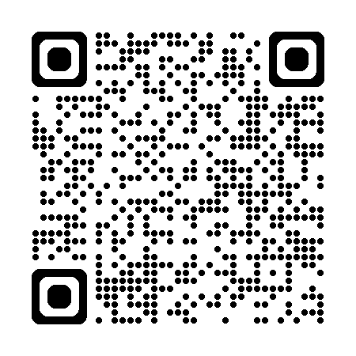
Key Takeaways
Consumer sentiment has weakened, but GDP growth is expected to be above trend in 2026.
Employment has leveled off and the labor market is cooler than it was, but the unemployment rate remains low.
Inflation remains elevated, in part because tariffs have pushed up goods prices.
Interest rate projections are mixed, with a median of one 25 basis point cut this year.
New data for Kentucky available now!

