Slide 1


Slide 2

University of Kentucky
& Kentucky REALTORS®
Econ Games 2024

Slide 3
Kentucky REALTORS® Overview
Organizational Overview
10 staff, 24 Directors, 116 Delegate Body members.
Member-based organization founded in 1922.
13,100+ REALTOR® members from across Kentucky.

Slide 4
Value Proposition
Advocacy
The Voice for Real Estate
Consumer protection
Education
Tangible Benefits:
Market Stats, Health Insurance, Legal Helpline, Tech Helpline.

Slide 5
Importance of Housing Security
Quality of Life
Increases generational wealth
Economic mobility
Childhood/Youth Experience
More housing = more tax revenue (1,000 new homes = 3,764 jobs/$57.5m in taxes (NAHB))
Low-income families occupying substandard homes moved more often (Cohen & Wardrip 2011)
Short length of residence negatively impacts math scores (Gagne and Ferrer 2006)
Workforce

Slide 6
State of Housing
Housing Security
Lack of housing for Teachers, Childcare workers, hospitality workers etc.
First-Time Homebuyers
First-time buyers accounted for 32% of all homebuyers in 2023, up from 26% in 2022, but down from historical average of 38%.
Underrepresented Groups of Homebuyers
Homeownership of Black Americans trails all other racial and ethnic groups at 44.1%

Slide 7
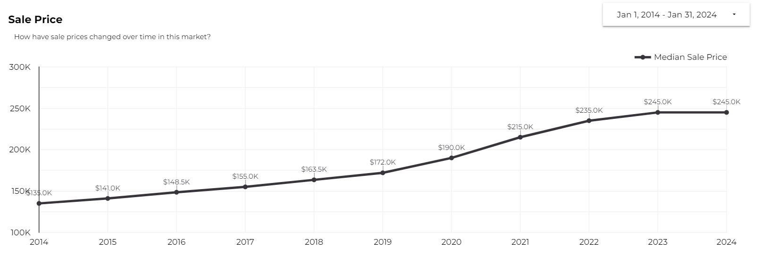
Median Sale Price

Slide 8
Obstacles
Zoning regulation/Land Use
Urban Service Boundary
Commercial/Mixed-use Zoning
NIMBY’s
Incentives for Housing
Economies of scale
Builders are not able to profit as much in rural areas compared to urban areas due to the cost per unit.

Slide 9
Solutions?

Slide 10
Build more houses.

Slide 11
Data Set Overview
Number of sales
Total Volume
Median Sale Price
Average Sale Price
Days on Market
New Listings
Average % Over Asking
# of Beds

Slide 12
Prompt
Your task is to analyze the factors influencing housing demand and supply in Kentucky (State/city/county) and determine the quantity of homes required in different market segments (e.g., by price range, number of beds, etc) to meet projected demand shifts and maintain price stability over the next 5 to 10 years.
Propose policy measures that incentivize the construction of homes in alignment with projected demand and mitigate volatility in the housing market. Consider the potential impact of policy interventions on key market indicators such as median sale price, new listings, and affordability. Evaluate how government policies can address factors such as input costs, labor availability, zoning regulations, and infrastructure development to support a balanced housing supply in Kentucky (State/city/county).
Explore long-term strategies to address housing challenges beyond short-term equilibrium considerations. Assess innovative approaches and their potential to promote affordability, sustainability, and equity in the housing market over the next decade.
Summarize your findings and recommendations based on your analysis of the housing market equilibrium, policy implications, and long-term housing solutions for Kentucky (State/city/county). Provide actionable insights for stakeholders, including policymakers, developers, and community organizations, to navigate the complexities of the housing market and foster a more equitable and sustainable future for the region.

Slide 13
External Data Sources
Census
Building Permits Survey
Demographics
Population growth
NAHB
Economic Development Associations/Organizations

Slide 14


