Slide 1


Price Dynamics in the Bourbon and Scotch Markets: 2006-2023
Has the Wave Peaked?
Kenneth Troske & Michael Clark
Department of Economics, University of Kentucky

Slide 2
Disclaimer
"Researcher(s)’ own analyses calculated (or derived) based in part on data from Nielsen Consumer LLC and marketing databases provided through the NielsenIQ Datasets at the Kilts Center for Marketing Data Center at The University of Chicago Booth School of Business.“
“The conclusions drawn from the NielsenIQ data are those of the researcher(s) and do not reflect the views of NielsenIQ. NielsenIQ is not responsible for, had no role in, and was not involved in analyzing and preparing the results reported herein.”

Slide 3
Motivation
Short term—The past two decades have seen dramatic changes in the price and supply of bourbon. What factors account for the changes? Will it last?
  Compare changes in bourbon and scotch—are changes specific to bourbon or more general?
  Look at changes at various points in the price distribution
  How has the price distribution changed over time? What about the impact of attributes on price? How has the price, cross-price and income elasticities changed?
  Have prices started to fall? Why?
Long term—What do we think the future holds

Slide 4
Data
NielsenIQ scanner data from 2006-2023
Three main type of files:
Movement files
  One file for each year
  Record is average weighted price and unit sales volume for 1 UPC code from 1 store during 1 specific week
    Have data for all weeks in a year
    Unit size can be 750ML, 1.5L, other sizes
Store file
  One file for each year. Each record contains information for each year
    Location--state, county, DMA, 3-digit zip
    Store type—convenience, grocery, drug, mass merchandiser
Product file
  One master file updated yearly. Each record contains product information for each unique UPC code
  Product module—identify specific product—bourbon whisky, other American whisky (Jack Daniels), scotch, gin, tequila.
  Information about the product. For bourbon we know—age if indicated, proof, single barrel, small batch, barrel strength, reserve. For scotch we know-- age, proof, single barrel, barrel strength. Have obtained information of type of scotch (blend vs single-malt) and location (region distilled) from other sources.
  No time series variation by UPC code. If “product” changes it generates a new UPC code.

Slide 5
Data
My sample
  For bourbon:
    Focus on products defined as bourbon, not whiskey (drop Jack Daniels).
    Non-flavored products, 750ml bottles, sold as a single unit
  For scotch
    Focus on products defined as domestic or imported. Drop the few observations of scotch produced in countries other than Scotland or the U.S.
    Attributes added shows region in Scotland where the product was distilled, or for blended products, whether the is was blended in Scotland or U.S. Single-malt scotches are ones distilled identified with a region
  All dollars converted to 2020 dollars.
  Convenience sample, retailers chose to participate, sample size changes over time

Slide 6
What is Straight Bourbon Whisky?
According to Code of Federal Regulations (CFR), 27 § 5.142:
  Fermented mash not less than 51% corn
  Distilled to less than 160 proof
  Distilled in the United States
  Stored in new charred oak barrels at 125 proof or less for two years
  No neutral spirits or coloring, flavoring or blending materials can be added

Slide 7
What is Scotch whisky?
According to Code of Federal Regulations (CFR), 27 § 5.142:
  Whisky which is a distinctive product of Scotland, manufactured in Scotland in compliance with the laws of the United Kingdom regulating the manufacture of Scotch whisky for consumption in the United Kingdom: Provided, that if such product is a mixture of whiskies, such mixture is “blended Scotch whisky” or “Scotch whisky—a blend”.
Domestic scotch was grandfather in when CFR was passed

Slide 8
Market Structure for Distilled Spirits
Since prohibition distilled spirits industry has been heavily regulated
One regulation is the three tier distribution system—distillers, distributors and retailers must be separate legal companies
  Prior to 2022 in KY if a distiller wanted to sell their product in a gift shop a wholesaler had to take possession of the product when it came out of the bonded warehouse, complete paperwork, pay taxes then sell it back to the distiller
  Since Jan. 2022 distiller can process complete the process themselves to be able to sell their own product in their gift shop

Slide 9
Market Structure for Distilled Spirits
Regulations and taxes also vary by state making it difficult for supply to quickly adjust to changes in demand. This is important for some of the analyses.
Two types of retailers, on premises, and off-premises. All my data are off-premises sales.

Slide 10
Sales Statistics for Bourbon and Scotch
Yearly sales of bourbon grows from $114M to $653M, then falls to $579M; scotch grows from $142M to $296M then falls to $178M
  Prior to 2012, scotch sales exceeded bourbon sales, by 2020 scotch sales half of bourbon sales
Almost 150% growth in per-store bourbon sales through 2020. Since then, per-store sales fell by 26%. Overall decline in per-store sales of scotch of 46%
2017 Economic Census shows that NielsenIQ data capture about 14% of distilled spirits sales

Slide 11
Sales by Store Type for Bourbon and Scotch

Slide 12
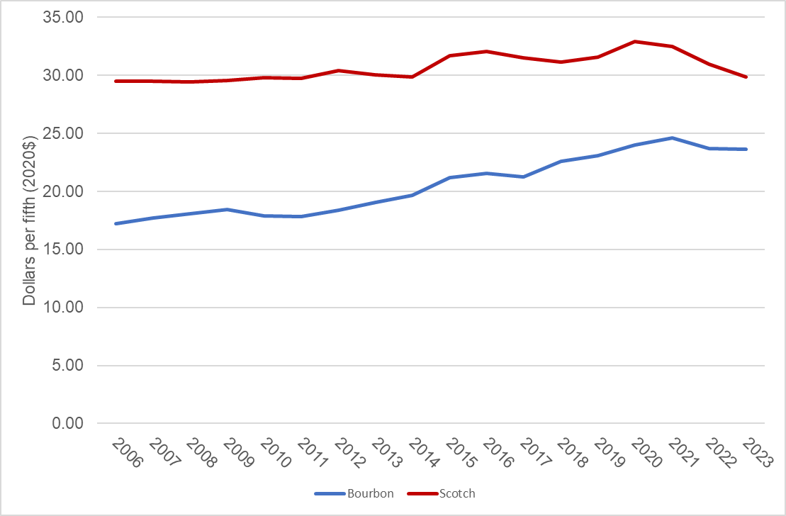
Change in the Median Price of a Fifth of Bourbon and Scotch Sold
From 2021-2023 median price of scotch decreased 11%
From 2006-2020 median price of scotch increased 11%
From 2021-2023 median price of bourbon decreased 4%
From 2006-2020 median price of bourbon increased 39%
Price in 2020 dollars. Only 750ML bottles

Slide 13
Change in the Distribution of Bourbon Prices
Price in 2020 dollars. Only 750ML bottles
Through 2020 prices increase across the distribution, but larger changes at the top of the distribution
Since 2020 declines have mainly occurred at the low end of the distribution. Price pf ultra-premium bourbon continues to increase

Slide 14
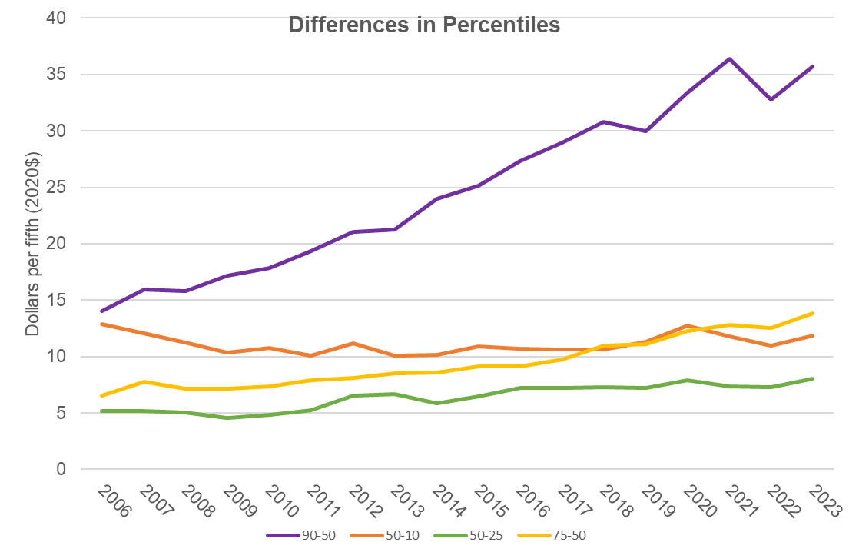
Change in the Distribution of Scotch Prices
Price in 2020 dollars. Only 750ML bottles
Through 2020 prices increase across the distribution, but largest changes occur at the very top of the distribution—switch to better scotch?
Since 2020 prices have fallen across the distribution, but mainly at the lower parts of the distribution

Slide 15
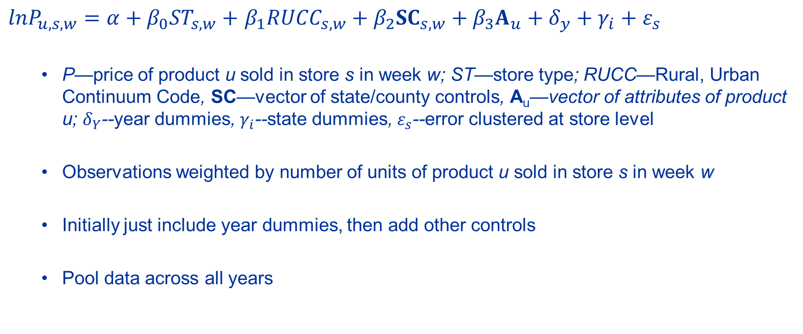
Price Regression
$lnP_{u,s,w}=α+β_{0}{ST}_{s,w}+$ $β_{1}{RUCC}_{s,w}+{β_{2}SC}_{s,w}+β_{3}A_{u}+δ_{y}+γ_{i}+ε_{s}$
  P—price of product u sold in store s in week w; ST—store type; RUCC—Rural, Urban Continuum Code, SC—vector of state/county controls, A_{u}—vector of attributes of product u; $δ_{Y}$--year dummies, $γ_{i}$--state dummies, $ε_{s}$--error clustered at store level
  Observations weighted by number of units of product u sold in store s in week w
  Initially just include year dummies, then add other controls
  Pool data across all years

Slide 16
Summary Statistics for Variables in Bourbon Regression
Only 14% of bottles sold have an age statement
Typical bottle sold is about 90 proof, around 1% is over 101 proof
Typical bottle does not list any attributes

Slide 17
Summary Statistics for Variables in Bourbon Regression

Slide 18
Summary Statistics for Variables in Scotch Regression
Over half of scotch sold has an age statement
Typical bottle sold is about 80 proof, less than 0.2% is over 101 proof

Slide 19
Summary Statistics for Variables in Scotch Regression

Slide 20
Estimated Change in Log Price: Just Year and Full Model
Price in 2020 dollars. Only 750ML bottles
Once we control for attributes see very small year effects

Slide 21
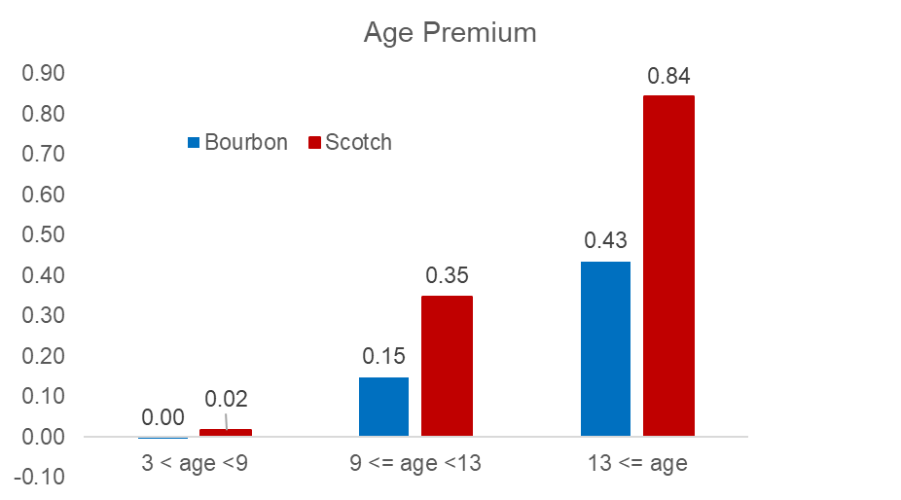
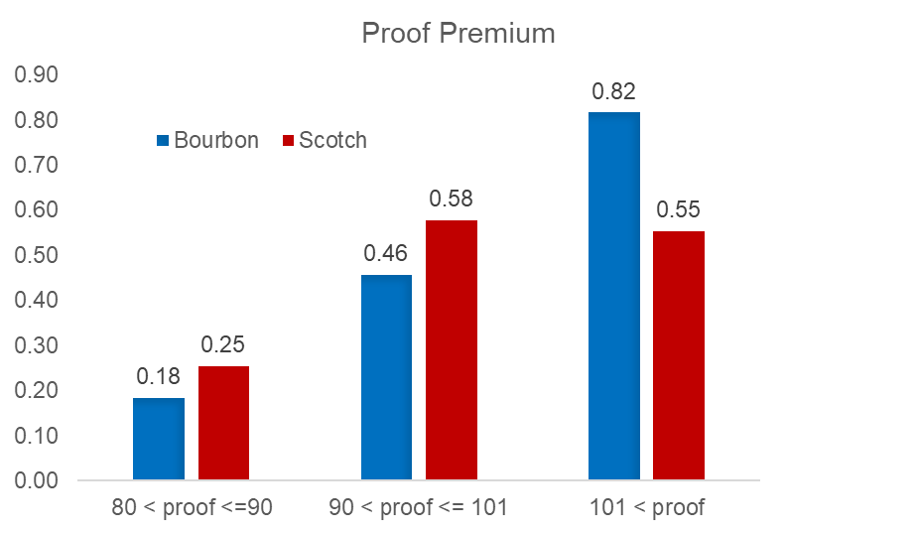
Association of Age & Proof with Price

Slide 22
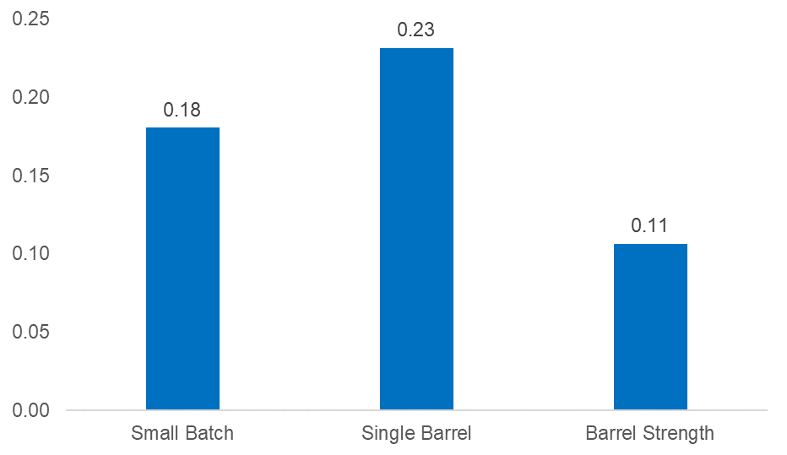
Premium for Other Bourbon Attributes

Slide 23
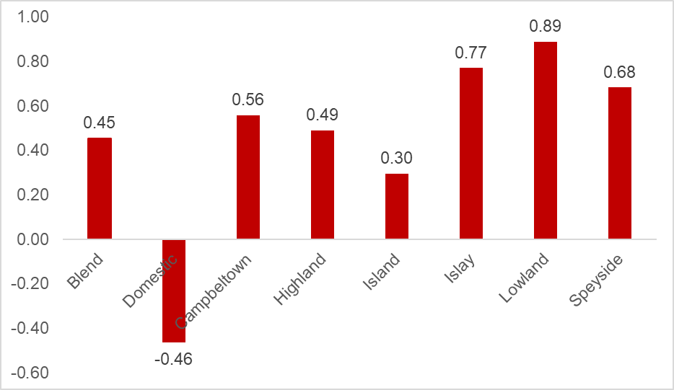
Premium by Region for Scotch

Slide 24
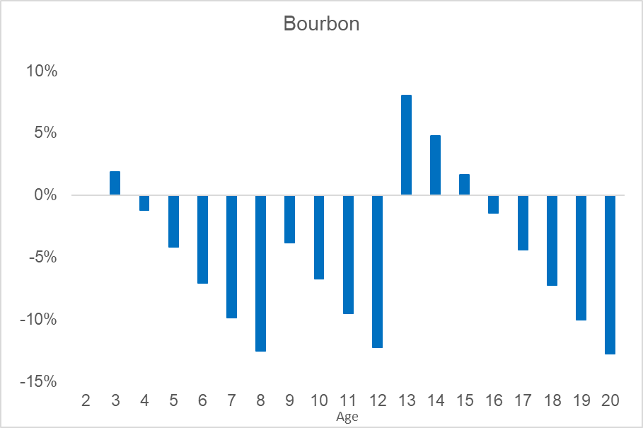
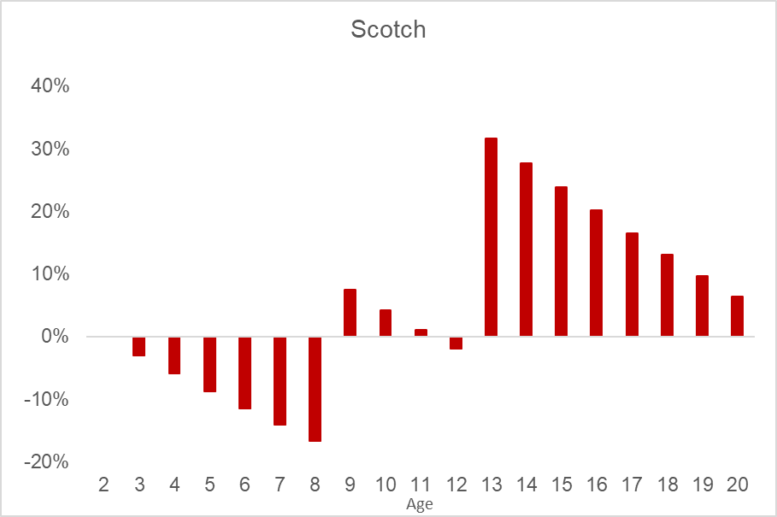
Percent Change in Revenue From Aging Longer than 2 Years (3% Evaporation Rate)
14% of bourbon sold lists an age; 52% of scotch sold lists an age

Slide 25
Age of Bourbon
According the reports from the Kentucky Distillers Association (KDA) prepared by Paul Coomes
  The most common age for bottling bourbon is four years
  In 2012 10% of inventory was older than 6 years
  By 2023 6% of inventory was older than 6 years
Return to producing old bourbon seems to be smaller than return to producing old scotch. Why?

Slide 26
Other Coefficients from Price Regression including Attributes

Slide 27
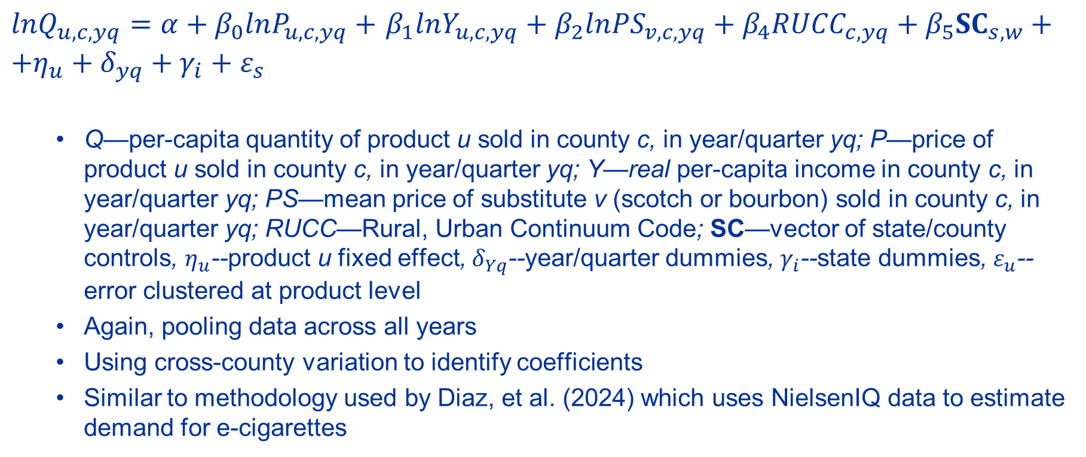
Estimation of Elasticity
$lnQ_{u,c,yq}=α+β_{0}{lnP}_{u,c,yq}+$ $β_{1}{lnY}_{u,c,yq}+β_{2}{lnPS}_{v,c,yq}+β_{4}{RUCC}_{c,yq}+{β_{5}SC}_{s,w}+{+η_{u}+δ}_{yq}+γ_{i}+ε_{s}$
  Q—per-capita quantity of product u sold in county c, in year/quarter yq; P—price of product u sold in county c, in year/quarter yq; Y—real per-capita income in county c, in year/quarter yq; PS—mean price of substitute v (scotch or bourbon) sold in county c, in year/quarter yq; RUCC—Rural, Urban Continuum Code; SC—vector of state/county controls, $η_{u}$--product u fixed effect, $δ_{Yq}$--year/quarter dummies, $γ_{i}$--state dummies, $ε_{u}$--error clustered at product level
  Again, pooling data across all years
  Using cross-county variation to identify coefficients
  Similar to methodology used by Diaz, et al. (2024) which uses NielsenIQ data to estimate demand for e-cigarettes

Slide 28
Estimate of Price, Income and Cross-Price Elasticity for Bourbon and Scotch

Slide 29
Estimate of Price, Income and Cross-Price Elasticity for Bourbon and Scotch, Separately by Price of Bottle

Slide 30
Estimate of Price, Income and Cross-Price Elasticity for Bourbon and Scotch, Separately by Years

Slide 31
Summarizing
Large increases in the median price of a bottle of both bourbon and scotch from 2006-2020.
  Bourbon saw price increase across all parts of the distribution, but larger increases at the upper end of the distribution.
  For scotch all of the action occurred at the top of the distribution.
  Both experienced large increases in price dispersion.
Declines in the median price of a bottle of both bourbon and scotch from 2020-2023.
  For both bourbon and scotch, the declines primarily occurred in the below the 75th percentile of the distribution. Price of premium whiskeys continues to rise, or at least not fall

Slide 32
Summarizing
Controls for location, store type, taxes and attributes accounts for much of the changes in price over time.
  Age and proof are associated with higher prices for both bourbon and scotch
  In isolation, does not appear profitable to produce very old bourbon
  High proof produces a higher return in bourbon

Slide 33
Summarizing
See very similar levels and trends in the estimates of own-price, cross-price and income elasticates
  Both become more price and income inelastic over time
  Both appear to be less price sensitive at top and bottom of the price distribution
Results seem consistent with a general increase in demand for whiskies and higher quality whiskies, initially and then a general decrease later.

Slide 34
But Why?
Simple demographic changes provides a compelling explanation
  As young baby boomers started entering the alcohol market in the mid- to late-60s demand shifted towards products favored by the young—beer and wine
  As boomers aged and became wealthier demand for whiskeys (and other spirits) returned to previously levels and then grew
    See WSJ article on tequila
  Now, as boomers age out of the market, demand for spirits falls
    Shifts toward cannabis? Good story, very little data
    Likely among younger drinkers and, even if true, impact will be limited
  Normal consolidation of a recently expanding industry also seems to be occurring

Slide 35
But Why?
What about tariffs?
  Tariffs are never good but,
  At least currently exports are not a big share of bourbon production
  According to data KDA data, exports grew during the first Trump administration (2017-2020) when tariffs were in place, but fell during COVID like much of world trade
  But …

Slide 36
Is there a glut of bourbon?
Some numbers:
  Scotland: population—5.5M; number of scotch barrels aging—22M; number of distilleries—151; size of global market—approx. $61B
  Kentucky: population—4.6M; number of bourbon barrels aging—13M; number of distilleries—over 100; size of global market—approx. $6B
Size of bourbon industry is consistent with trying to compete with scotch in the global marketplace
  Appears that there is plenty of opportunity to grow globally
  A trade war over tariffs would likely hurts these efforts
Future growth of bourbon likely contingent on expanding globally

Slide 37

Thank You
http://cber.uky.edu/

