Slide 1
Economic Outlook Conference Bluegrass Area Housing Market
February 11, 2025
Notes:
Good morning everyone. Thank you to the Gatton College of Business and Economics for the opportunity to speak here today in front of so many esteemed guests. It truly is a privilege.

Slide 2
Richard Gibbens
Bluegrass REALTORS & Imagine MLS CEO
Notes:
My name is Richard Gibbens, and I am the CEO of Bluegrass REALTORS and Imagine MLS here in Lexington. We serve about 4,000 REALTORS across 38 counties including the Lexington MSA down to the Kentucky Tennessee border. We are the organization that supports REALTORS by providing the tools and data they need to work every day, including their forms, lockboxes, and the MLS system that aggregates, cleans, and syndicates data to all of the internet sites you are familiar with. We also advocate for homeownership, property rights, and smart economic development, as well as a wide range of charitable giving throughout our communities to help show that REALTORS do more then just sell homes, they are an integral part of the communities that they serve.

Slide 3
Richard Gibbens
Bluegrass REALTORS & Imagine MLS CEO
Notes:
As for me, I have been working in the real estate industry for about 8 years now, starting in Panama City, FL as a MLS Support, moving to Albuquerque, NM to run the MLS there as an Executive Director, and recently moved here to Lexington in July of last year to take over the CEO position at Bluegrass REALTORS. I am well regarded within my industry as a speaker, thought leader, and innovator, earning numerous accolades that you’ve never heard of and probably don’t care about.

Slide 4
Notes:
Although it was pretty cool to be the cover story of a magazine recently….

Slide 5
Richard Gibbens
Bluegrass REALTORS & Imagine MLS CEO
Notes:
Anyway, in this presentation I’m going to spend some time giving you a view of the Lexington Housing Market.
I’m actually going to start with a few of the national trends that we are seeing in housing, then spend some time drilling down into the Lexington market. From there I have some data from the National Association of REALTORS Home Buyers and Sellers report that I find quite interesting that gives you a profile of who is buying and selling homes, and how that has changed recently, ending with some brief comments on regionalism.

Slide 6
National Market Data
Dr. Lawrence Yun
Chief Economist
Notes:
As we dig into the national data, I’d just like to take a moment to give credit to Dr. Lawrence Yun, Chief Economist of the National Association of REALTORS, and his team for preparing this data. While I am a self-certified market stats nerd, I am not an economist, and I didn’t even stay at a Holiday Inn Express last night, so just know that this national data is coming from someone smarter than me. At the end of the national data we’re even going to get something from Dr Yun that most economist hesitate to do. Forecasts.

Slide 7
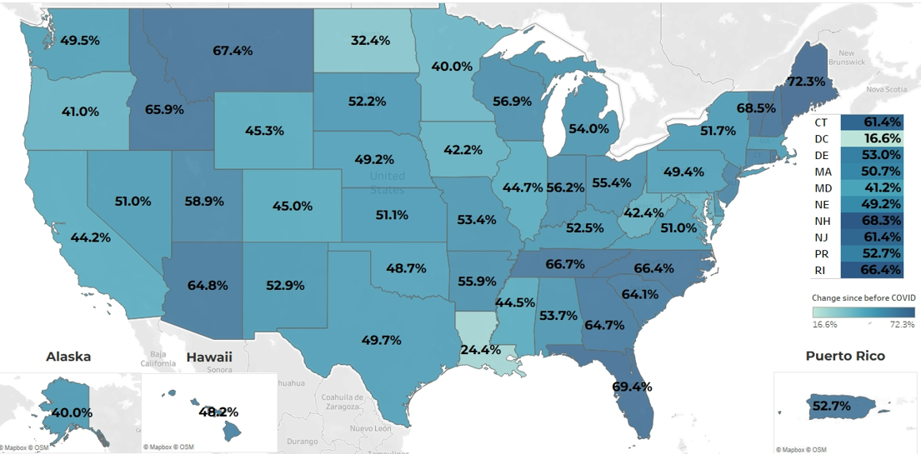
Home Price Gains Since Pre-COVID: 52.5% in KY
% change from 2020 Q1 to 2024 Q3
Source: NAR Analysis of FHFA data
Notes:
The big story in real estate is of course, home price gains. Here you can see a map of the US comparing home prices from the first quarter of 2020 to the 3rd quarter of 2024. Some of these numbers are eye-popping – 72% in Maine, just shy of 70% in Florida, high 60s in Montana, Tennessee, North Carolina, New Hampshire and Rhode Island. Even the lowest states saw pretty significant increases at 24% in Louisiana and 32% in North Dakota.

Slide 8
Home Price Gains Since Pre-COVID: 52.5% in KY
% change from 2020 Q1 to 2024 Q3
Source: NAR Analysis of FHFA data
Notes:
Kentucky comes in right around the middle as the 26th ranked state at 52.5%. So just to put this in perspective, the median sales price in the Lexington MSA in 2020 was in the low 200s, for the sake of easy math I’m going to use $200,000.

Slide 9
Home Price Gains Since Pre-COVID: 52.5% in KY
% change from 2020 Q1 to 2024 Q3
$200,000
Source: NAR Analysis of FHFA data
Notes:
So, if you purchased a home in the Lexington MSA for $200,000 in the first quarter of 2020

Slide 10
Home Price Gains Since Pre-COVID: 52.5% in KY
% change from 2020 Q1 to 2024 Q3
$305,000
$200,000
Source: NAR Analysis of FHFA data
Notes:
that home is now worth about $305,000 from market increases alone.
Put a pin in those two numbers, we’re going to come back to them in a moment.

Slide 11
FHFA Housing Price Index, Percent Change Over Same Quarter Last Year
Source: Federal Housing Finance Agency, Seasonally Adjusted
Dr Michael Clark
Notes:
I’m bringing back Dr Clark’s slide from earlier to really drive this point home. Prior to 2020 you can see year over year increases by quarter hovered right around 3 to 6 percent. But then, throughout 2020 to 2023, prices were climbing at crazy rates, and even though the percent increases have slowed down during 2024, they are still higher than the increases we were seeing prior to 2020. It’s also important to note here that the Lexington MSA is still elevated versus the rest of the state.

Slide 12
Median Net Worth between Owners and Renters
Source: Median Net Worth from Federal Reserve Survey of Consumer Finance
Notes:
Of course all of this is great news for the homeowners in the U.S. who have seen their median net worth increase since the pandemic. The Median net worth of a homeowner has increased by 40% since 2019.

Slide 13
Household Equity in Real Estate in U.S.
Source: Federal Reserve
Notes:
In fact the total Household Equity in Real Estate in the U.S. is at it’s highest levels ever, reflecting this steep increase since 2020. So homeowners are sitting on tremendous amounts of equity in their homes right now.

Slide 14
Median Net Worth between Owners and Renters
Source: Median Net Worth from Federal Reserve Survey of Consumer Finance
Notes:
But it’s not quite as great for American Renters. They’ve still seen some net worth increase from lack of consumer spending and other economic factors, but it is also becoming much harder to get into home ownership.

Slide 15
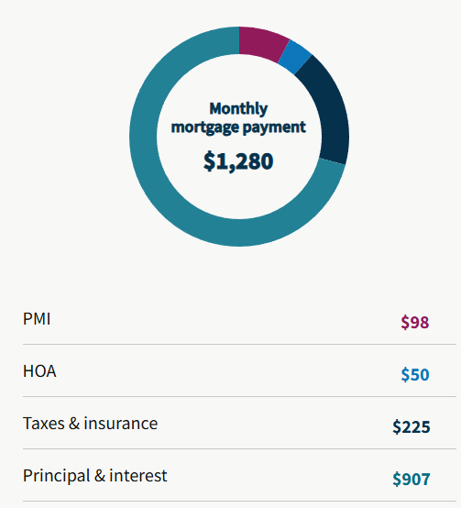
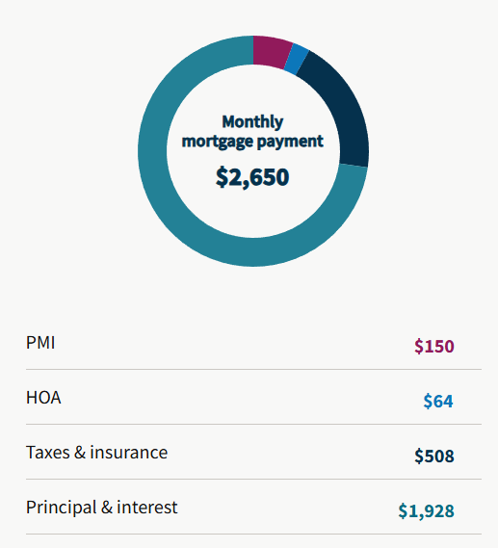
$200,000, 5% down,
30 year, 4% interest
$305,000, 5% down, 30 year, 7% interest
2020
2024
Source: Fannie Mae Mortgage Calculator
Notes:
Now, I’m not a lender or an economist, but I do know how to use a mortgage calculator. These are from Fannie Mae’s calculator, just using the basic settings, going back to our $200 thousand and $305 thousand dollar numbers from earlier.
On the left you have a $200,000 purchase price, 5% down, 30 year mortgage at 4% interest, which comes to a $1,280 monthly payment
On the right you have a $305,000 purchase price, 5% down, 30 year mortgage at 7% interest, which comes to a $2,650 monthly payment.

Slide 16
$200,000, 5% down,
30 year, 4% interest
$305,000, 5% down, 30 year, 7% interest
+107%
2020
2024
Source: Fannie Mae Mortgage Calculator
Notes:
This is a 107% increase in the monthly payment! For the same home!
I don’t have to be an expert on labor to tell you that wages haven’t increased 107% in the last 5 years. Quick napkin math of the Social Security Administration’s numbers suggests you’re looking at around 25 to 26% at best for that same time period.
But it’s not just first time home buyers feeling this squeeze. Even homeowners who want to move are feeling similar pressure.

Slide 17
88 million Homeowners Distribution by Mortgage Rates
Source: NAR estimate using data on mortgage distribution by FHFA 2024 Q2
Notes:
These numbers are similar to Dr Clark’s from earlier showing the percentage of mortgages in different rate ranges, it just also includes the percentage of homeowners that do not have a mortgage.
The same stat holds true that he said that 83% of all mortgages are higher than the current rates, and there is a tremendous amount of lock in there because of that.

Slide 18
88 million Homeowners Distribution by Mortgage Rates
Source: NAR estimate using data on mortgage distribution by FHFA 2024 Q2
Notes:
Numbers like the 107% increase in monthly spend for the same home are making people rethink their life choices when it comes to housing. Why should an empty nester downsize if they will be paying more money per month for less house? A growing family could really use an extra bedroom, but you could buy a really nice bunk bed setup instead of spending $1400 a month. A couple considering a divorce might even decide they like their mortgage rate better than the idea of separating.
All of these people would love to move for different reasons, but prices and interest rates have pent up that demand.

Slide 19
Existing Home Sales (red) … Two of Most Difficult Years
New Home Sales (blue) … Gains
Source: NAR
Notes:
This pent up demand has led to the two lowest years of sales that we have seen since the late 90s. You can’t see it very well here, but new home sales did gain slightly from 2022 to 2024. Going back again to Dr Clark’s slides, construction costs stabilizing and coming back down to reasonable levels has stimulated some growth in new construction.
Of course, a lot of that demand hasn’t exactly disappeared. People still want to downsize, upsize, or move to different living situations, so what is keeping prices so high?

Slide 20
National Inventory
Source: NAR
Notes:
These price gains are largely driven, of course, by supply and demand. As alluded to by Dr Clark earlier, we simply are not building at the rate we were previous to 2008, and inventory has been on a steady decline since then.

Slide 21
National Inventory
Source: NAR
Notes:
It had started to level out with only slight decrease from 2013 to 2020, even following some fairly predictable seasonal patterns.

Slide 22
National Inventory
Source: NAR
Notes:
But housing sales far outpaced new supply during the pandemic. This was of course largely driven by historically low interest rates, but I also look forward to the social psychology dissertations that research why everyone decided they wanted to move in 2020. Was it the extended downtime that made people act on something they’d wanted to do but didn’t have time? Was it everyone suddenly realizing they wanted an extra bedroom to use as an office? Did everyone’s houses feel much smaller once the whole family was quarantined together at the same time?

Slide 23
National Inventory
Source: NAR
Notes:
The answer is probably a little bit of all of these, but regardless, inventory has been a little more chaotic since then. Our year-over-year numbers for inventory can vary wildly, and seasonal trends aren’t holding nearly as steadfast as they used to.
Sales and inventory the last two years seemingly pick up and slow down in fits and starts. Purely anecdotally with no empirical basis at all, they are often driven by outside factors, such as layoffs, mass hires, relocations, natural disasters, or simply consumer confidence.

Slide 24
National Inventory
Source: NAR
Notes:
We did, finally, started to see a little bit of an uptick in inventory towards the end of 2024, but unexpected and unseasonably high sales in November and December brought it back down.
All of these factors compound the issue of high home prices and low housing attainability. Something has to break, but when?

Slide 25
Nationwide Forecast
Forecast
 | 2025 | 2026
Existing Home Sales | +9% | +13%
New Home Sales | +11% | +8%
Median Home Price | 2% | 2%
Mortgage Rate | Near 6% | Near 6%
Source: NAR Chief Economist Dr. Lawrence Yun
Notes:
Which brings us to NAR’s Nationwide Forecast.
Dr Yun believes that Mortgage Rates will drop slightly during the year to around 6%. To be clear, he believes the days of 3 and 4% are long gone and that the low 6s will be the “new normal” – he doesn’t see them dropping much lower than that.
But, if that does happen he feels it is going to unlock a lot of pent up demand that will lead to a 9% increase in existing home sales and 11% increase in new home sales in 2025, followed by a 13% increase in existing homes and 8% increase in new homes in 2026. He believes most of this demand is from people who currently own a home, so every time they buy they will also sell, which is going to help inventory and keep median sales price increases dropping back to a more reasonable 2% per year level.

Slide 26
Local Market Data
Notes:
Next I want to take these trends and bring them down to the local level, and show you what all of this means for the Lexington market.
All of this data is compiled by Bluegrass REALTORS through data obtained from our subsidiary, Imagine MLS. The MLS is a broker cooperative of real estate agents who agree to submit their listings and follow by a standard set of compliance rules that ensure the most complete and accurate data sets available for our 38 county area. MLS data is the gold standard for breadth and accuracy of data, often capturing more than 90% of total single-family sales in any given market.

Slide 27
County | Total # of Listings 2024
Fayette | 4,514
Bourbon | 248
Clark | 497
Jessamine | 916
Scott | 1,241
Woodford | 369
Residential Single-Family
No Commercial or Multi-Family
Long transaction cycles
Source: MLS Data
Notes:
Second, note that this data focuses on single family homes, townhomes, and condominiums. It does not include Land, Multi-Family sales, or any form of commercial sales.
And finally, Real Estate Data is often notoriously hard to pin down exact dates because of the nature of the transaction. It is extremely common for a home to be listed in one month, go into pending 15-20 days later, and have a closing period of 30-60 days. In most cases we count the date the home closed for statistics purposes, but sometimes we may use Active date or Pending data. So if you notice that some numbers don’t add up exactly across slides, that is why.

Slide 28
County | Total # of Listings 2024
Fayette | 4,514
Bourbon | 248
Clark | 497
Jessamine | 916
Scott | 1,241
Woodford | 369
Residential Single-Family
No Commercial or Multi-Family
Long transaction cycles
Source: MLS Data
Notes:
Second, note that this data focuses on single family homes, townhomes, and condominiums. It does not include Land, Multi-Family sales, or any form of commercial sales.
And finally, Real Estate Data is often notoriously hard to pin down exact dates because of the nature of the transaction. It is extremely common for a home to be listed in one month, go into pending 15-20 days later, and have a closing period of 30-60 days. In most cases we count the date the home closed for statistics purposes, but sometimes we may use Active data or Pending data. So if you notice that some numbers don’t add up exactly across slides, that is why.

Slide 29
Lexington MSA Sales Prices Over Time
2017 | 2018 | 2019 | 2020 | 2021 | 2022 | 2023 | 2024
5.4% | 8.1% | 4.7% | 8.2% | 12.5% | 11.8% | 7.4% | 7.1%
Percent Change from Previous Year
Source: MLS Data
Notes:
The biggest topic of conversation around national data was related to median sale price. This is what that looks like in the Lexington MSA and you can see that we are no exception. In case you can’t see it, the bars here are Median Sale price and the line is Average Sale price.
Median sale price in 2016 was about $175 thousand, and that has nearly doubled with 2024 ending around $328 thousand.
At the bottom here I have added the Percent Change from the previous year, and you can clearly see the effect of large increases in home prices in 2021 and 2022, with somewhat of a return to normalcy in 23 and 24, but still higher than what we were seeing prior to 2020.

Slide 30
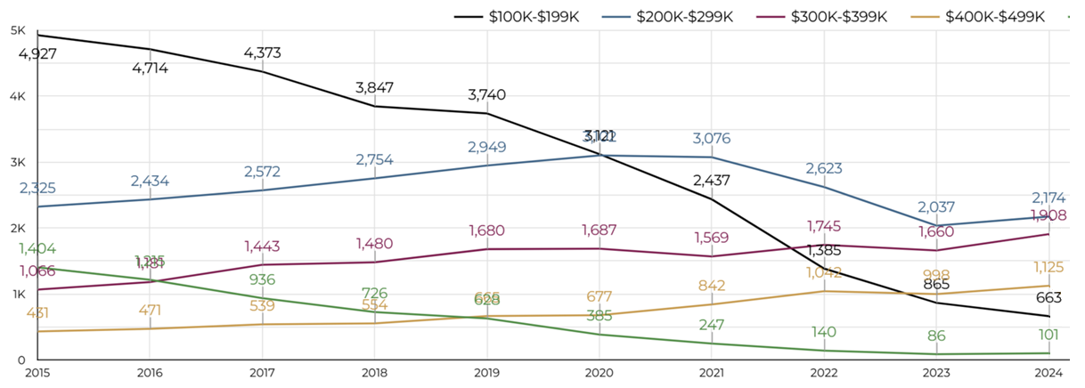
Lexington MSA New Listings By Price Range
Source: MLS Data
Notes:
But whenever I can, I also like to break down statistics by price range, and you’ll see plenty of that during this part of the presentation. We talked about inventory and new supply not hitting the market in the national numbers earlier, but let’s break that down a little more.
This chart shows new listings coming on the market by price range going back to 2015. The green line here represents 0 to 100 thousand, and black is 100 to 200 thousand. You can see by combining these in 2015 that more than half of all properties that entered the market were priced under 200 thousand dollars, and over time you have seen both of those numbers drop significantly to the point that they now only make up around 13% of all new listings.

Slide 31
Lexington MSA New Listings By Price Range
Source: MLS Data
Notes:
What’s interesting to me is that nearly all of the other price ranges are relatively flat.
The blue line is 200-300k, which increased from 2300 to a peak of about 3100 then settled back down to 2175.
The 300-400k range in purple has seen steady increases, going from 1060 homes up to it’s peak this year at just over 1900.
And finally the gold 400-500k range has seen steady increases from 430 to its peak in 2024 of 1125.
This, to me, is probably the most clear visualization you can have of the attainable housing gap we have in our area. Our inventory levels have dropped significantly, and almost all of that is at the expense of inventory under $200 thousand dollars.

Slide 32
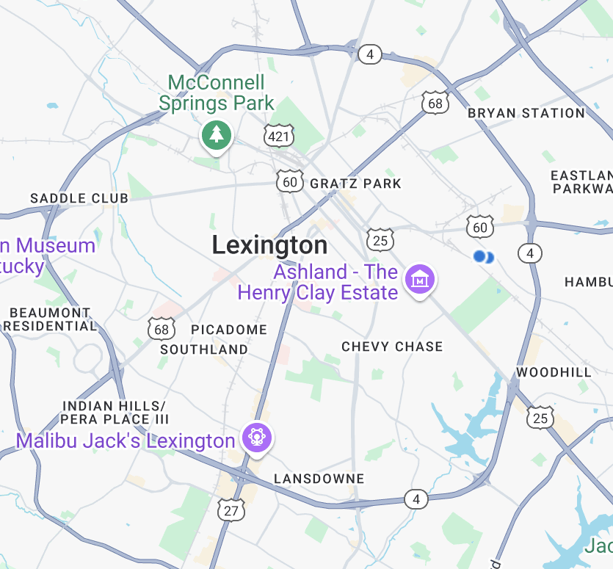
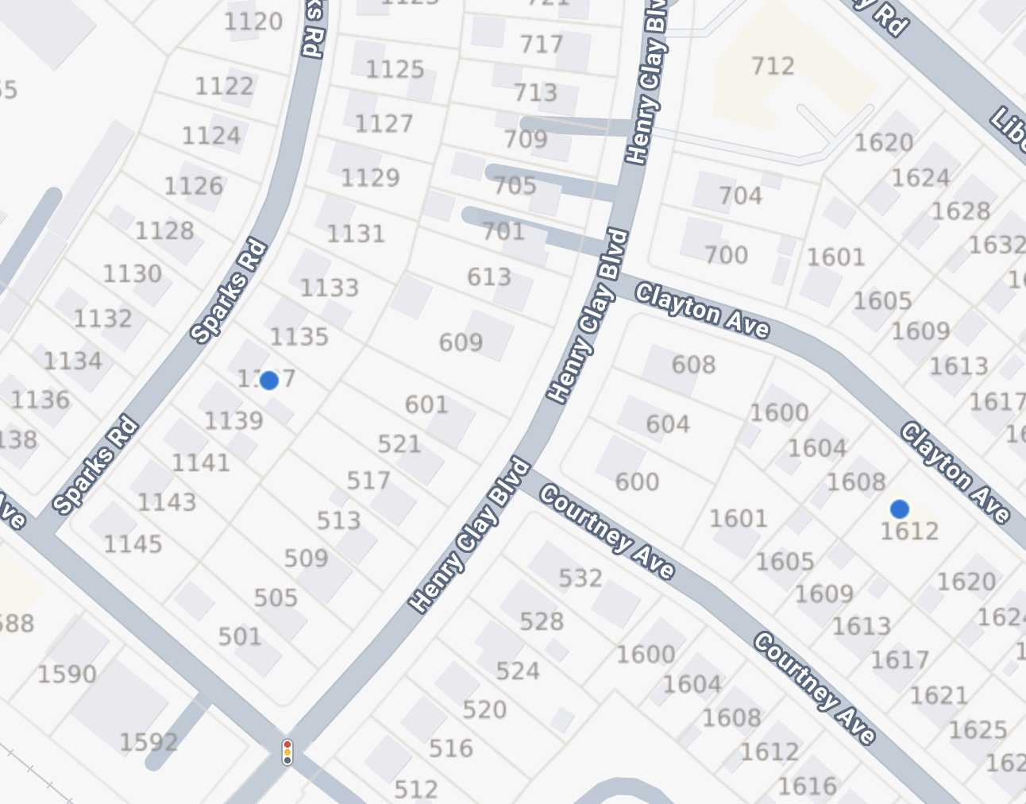
Source: MLS Data
Notes:
One of the things I want to do in this presentation is to tell you the story behind the data. To show you the real world impact of what the data actually means.
To that end let’s look at two homes that sold for around $200,000, one in 2020, and the other in 2024.
I controlled for a few things.

Slide 33
Source: MLS Data
Notes:
One, they’re both in the Liberty Heights area, only about 700 feet from each other as the crow flies.
Two, both were recently remodeled at the time they were sold.
Three, both have very similar interior finishes – stainless steel appliances, granite counter tops, hardwood floors, and bathroom fixtures
Finally, there are a lot of other similarities as well – both built in the 1940s, both have similar curb appeal, both have vinyl siding, the same style roof, etc.
This allows us to focus on the biggest differences – bedrooms, bathrooms, square footage, and lifestyle features.

Slide 34
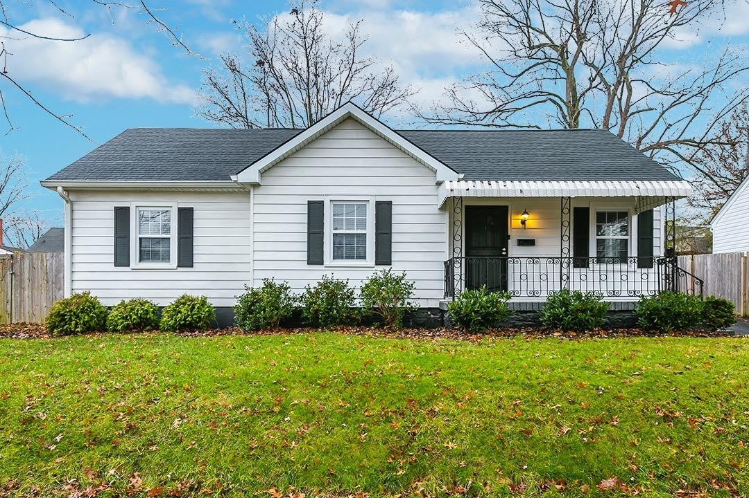
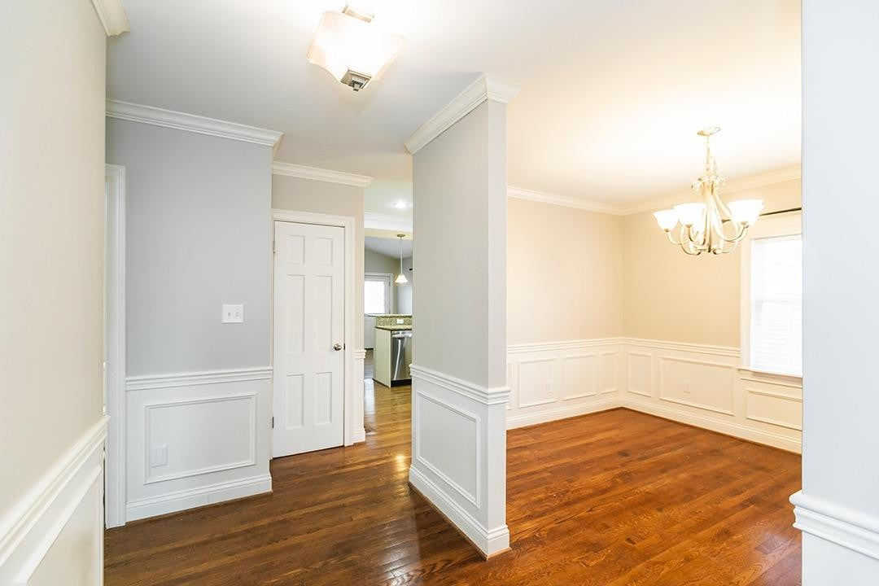
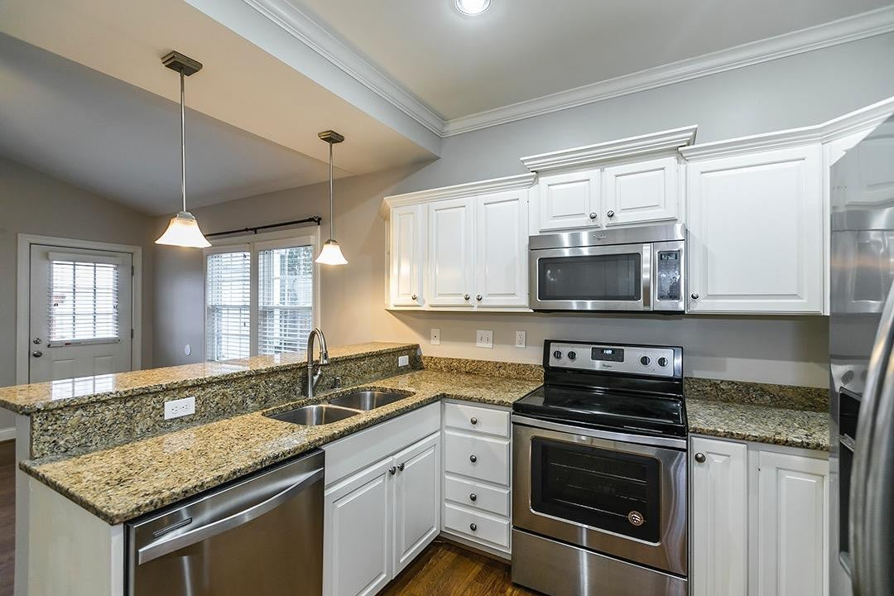
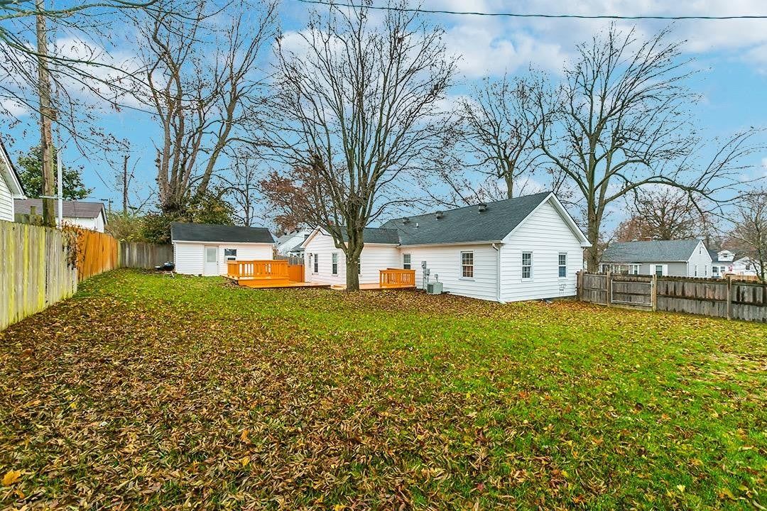
March 2020
$205,000
1323 sq ft
3 bed 2 bath
0.22 acres
Fenced Backyard
Great Deck
Single Car Garage
Source: MLS Data
Notes:
The first house closed in March of 2020 for $205,000.
It has 3 bedrooms, 2 bathrooms, 1323 square feet, and sits on 0.22 acres with a nice fenced backyard, great patio, and a detached single car garage.

Slide 35
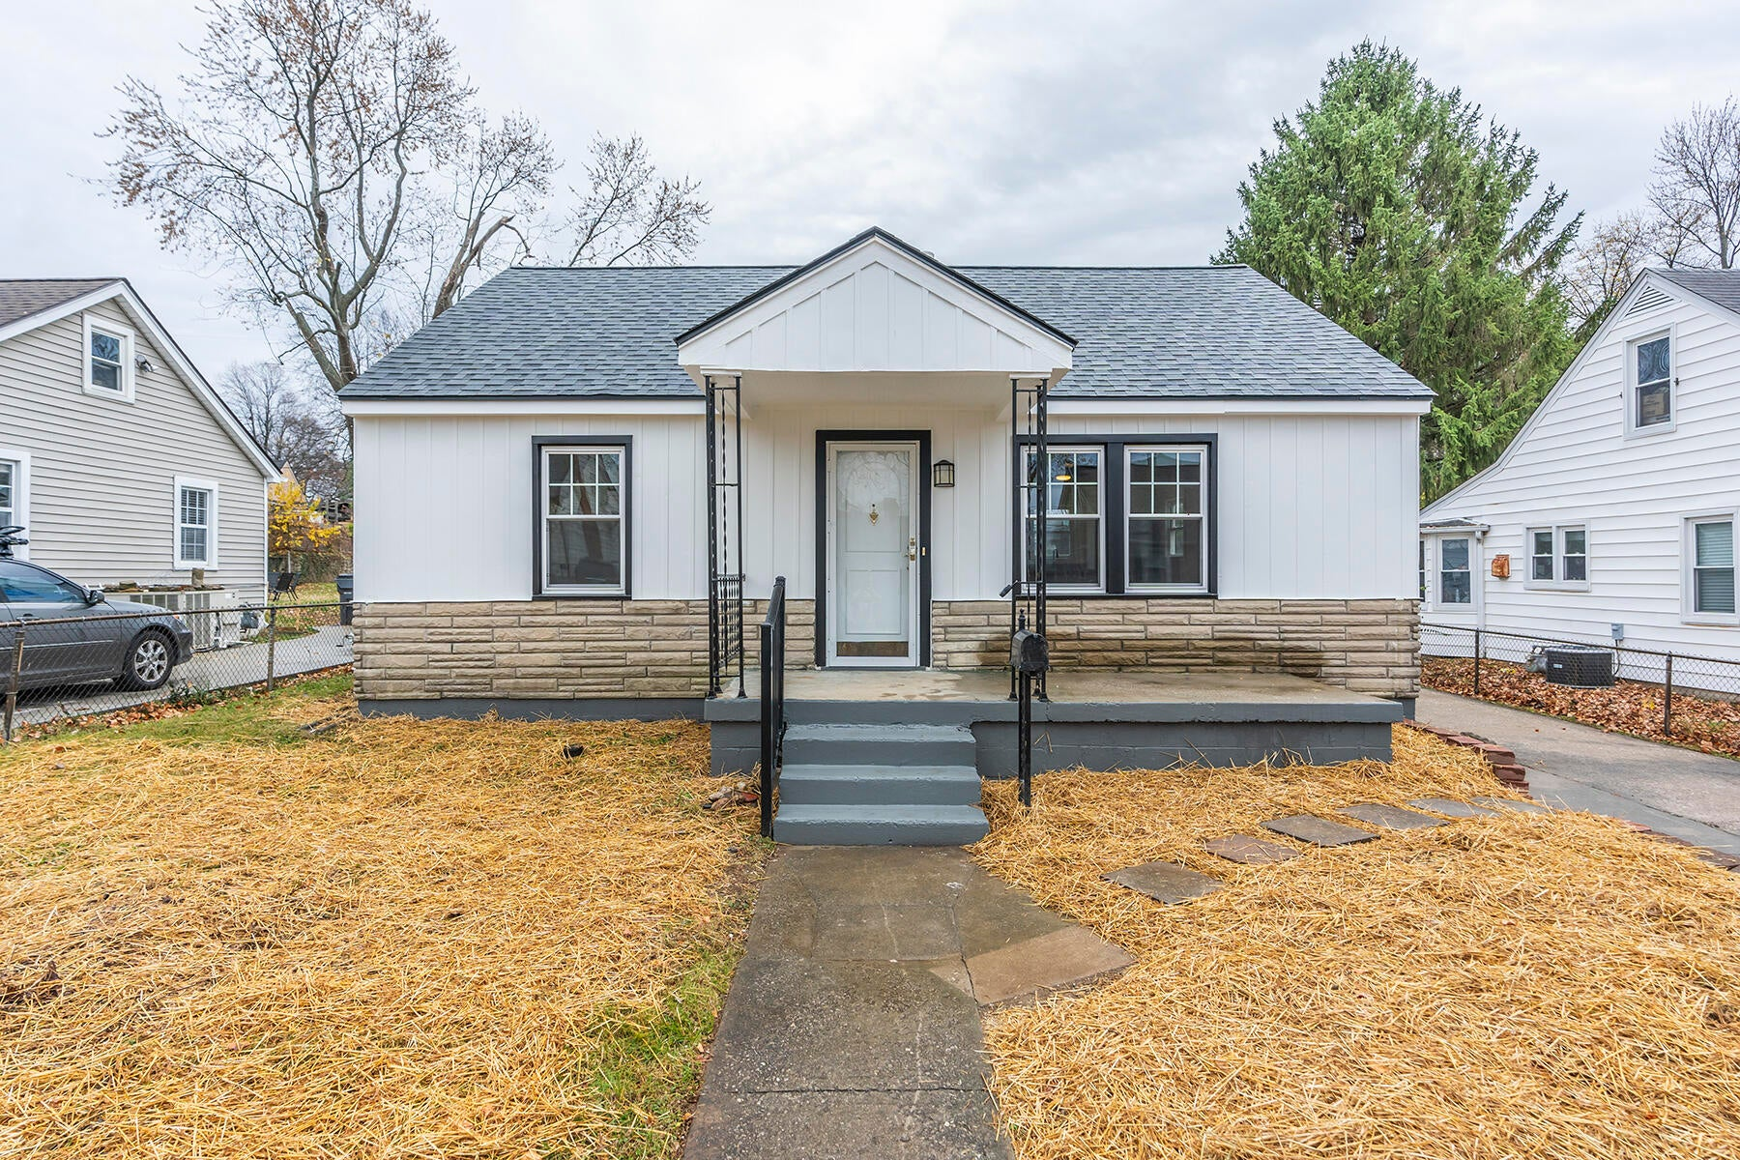
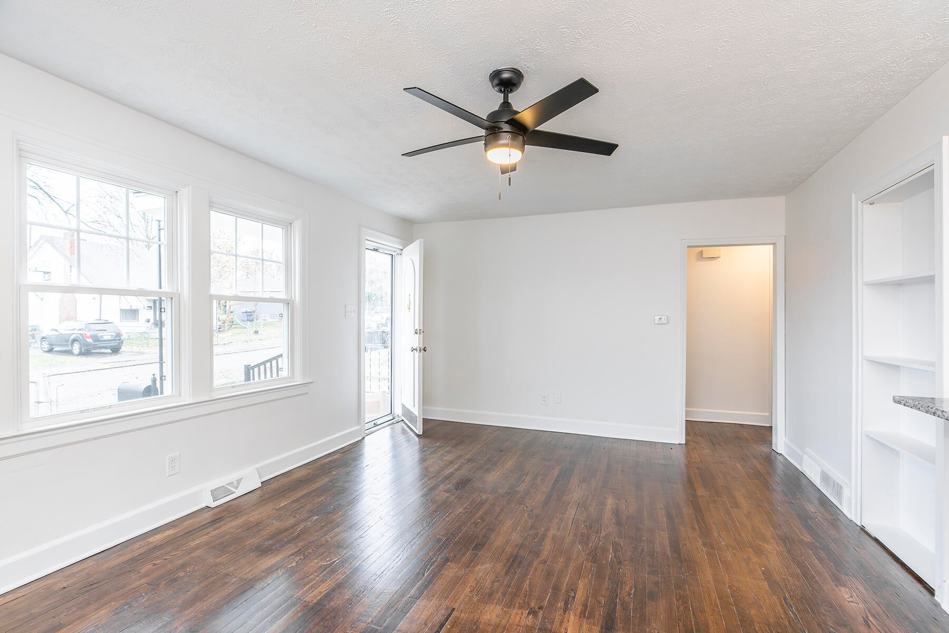
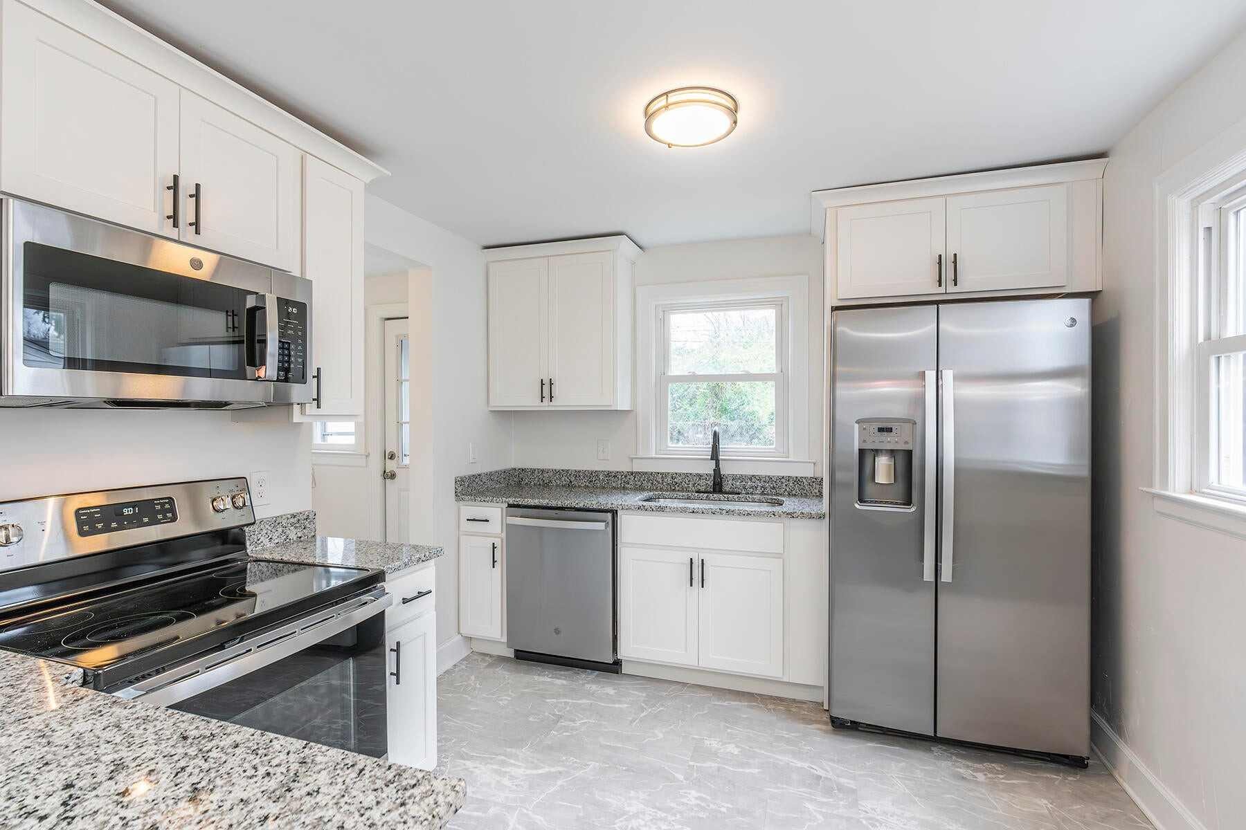
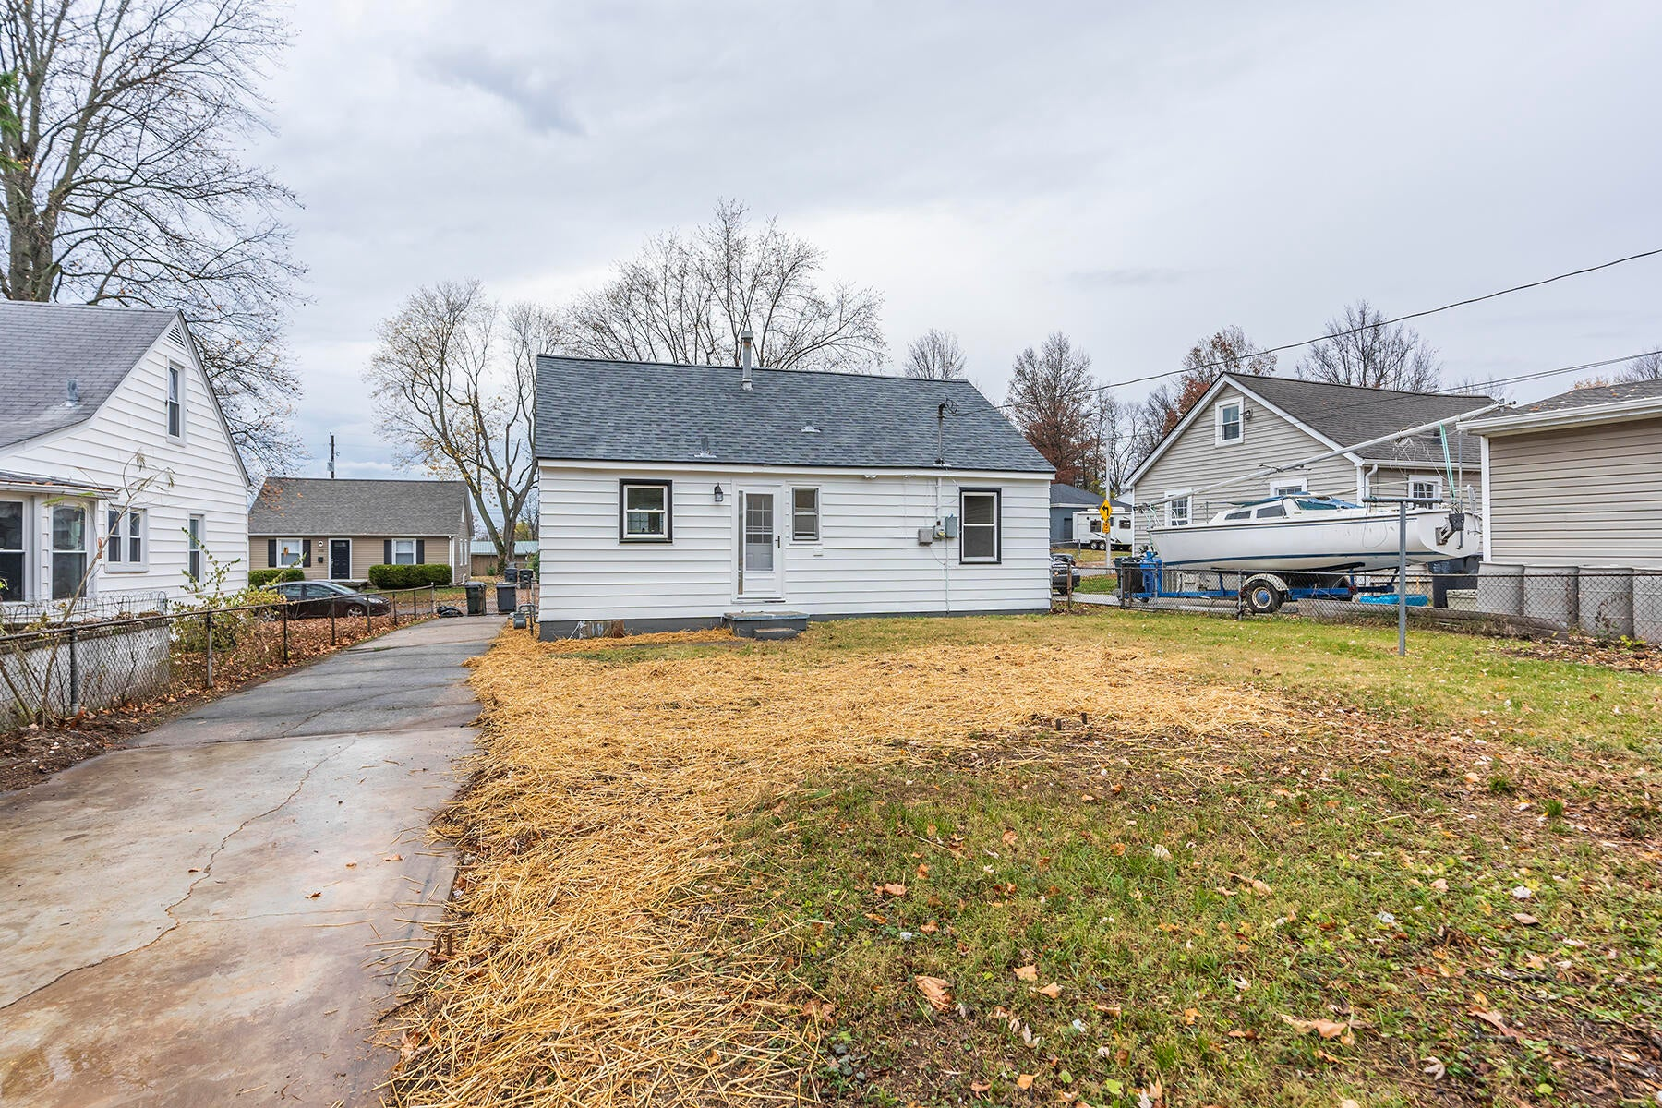
February 2024
$202,500
1120 sq ft
2 bed 1 bath
0.14 acres
No Fence
No Deck
No Garage
Source: MLS Data
Notes:
The second house closed February of 2024 for $202,500.
It has 2 bedrooms, 1 bathroom, 1,120 square feet, and sits on 0.14 acres with no fenced backyard, patio, or detached garage.

Slide 36
March 2020
$205,000
1323 sq ft
3 bed
2 bath
0.22 acres
Fenced Backyard
Great Patio
Single Car Garage
February 2024
$202,500
1120 sq ft
2 bed
1 bath
0.14 acres
No Fence
No Patio
No Garage
Source: MLS Data
Notes:
The most significant difference here is obviously the loss of 200 sq ft, a bedroom, a bathroom, and a 36% smaller lot, but those other lifestyle conveniences like a garage, deck, and fenced backyard are quite important as well.
This goes back to what I was talking about earlier about mortgage lock-in. Let’s just say the person who purchased the 2020 home wanted to downsize to the 2024 home so they could stay in the same neighborhood.

Slide 37
March 2020
$205,000
1323 sq ft
3 bed
2 bath
0.22 acres
Fenced Backyard
Great Patio
Single Car Garage
Mortgage: $1,415
February 2024
$202,500
1120 sq ft
2 bed
1 bath
0.14 acres
No Fence
No Patio
No Garage
Source: MLS Data
Notes:
Using the same assumptions as earlier, right now their mortgage would be $1,415 a month on the 2020 home.

Slide 38
March 2020
$205,000
1323 sq ft
3 bed
2 bath
0.22 acres
Fenced Backyard
Great Patio
Single Car Garage
Mortgage: $1,415
February 2024
$202,500
1120 sq ft
2 bed
1 bath
0.14 acres
No Fence
No Patio
No Garage
Mortgage: $1,759
Source: MLS Data
Notes:
To purchase the 2024 home they would move to a mortgage of $1,759.

Slide 39
March 2020
$205,000
1323 sq ft
3 bed
2 bath
0.22 acres
Fenced Backyard
Great Patio
Single Car Garage
Mortgage: $1,415
February 2024
$202,500
-200 sq ft
-1 bed
-1 bath
-0.08 acres
No Fence
No Patio
No Garage
Mortgage: $1,759
+$344
Source: MLS Data
Notes:
An increase of $344 a month, for less house, less yard, and less lifestyle features. Anyone in here taking that deal?

Slide 40
Image from ChatGPT/DALL-E
Notes:
Now, I should probably stop here and say this – I do still think now is a good time to buy. Especially for the first time home buyer, and especially in the Lexington Market. This is mainly based on two beliefs that I pointed out earlier – Interest rates aren’t going to get much lower, and home prices are just going to keep going up. The folks that are “locked in” in the example I just gave are more a function of getting lucky taking advantage of historically low interest rates that aren’t coming back, versus any kind of cautionary tale.
You ever heard the saying “The best time to plant a tree is 30 years ago, the second best time is now”? Real Estate is the same way.

Slide 41
Lexington MSA Days on Market
Source: MLS Data
Notes:
Another factor to consider when looking at the local stats is Days on Market.
Here is the Days on Market by month over the last 3 years. I always like displaying both average and median days on market because I feel like there’s a story to tell in the difference.

Slide 42
Lexington MSA Days on Market
Source: MLS Data
Notes:
An Average Days on Market of 33 days in April of 2023 doesn’t really tell the whole story. You see that on the news or in a press release and you think “oh, the market seems relatively healthy, buyers have plenty of time to look at inventory and make a decision.”
Meanwhile the Median of 5 days on market tells a different story. That tells you that more than half of the homes that are sold are selling in 5 days or less.

Slide 43
Lexington MSA Days on Market
Source: MLS Data
Notes:
But even that doesn’t show you exactly how competitive the lower end of the market is. Let’s drill down into the Days on Market by Price Range for 2024.
Before I show you that, just notice here that the Median price range for 2024 ranges as high as 21 days to as low as 5 days throughout the entire year, with a whole-year median of about 10 days. So in these months where you see Median DOM around 5-7 days, those were even more competitive months than what we are about to look at.

Slide 44
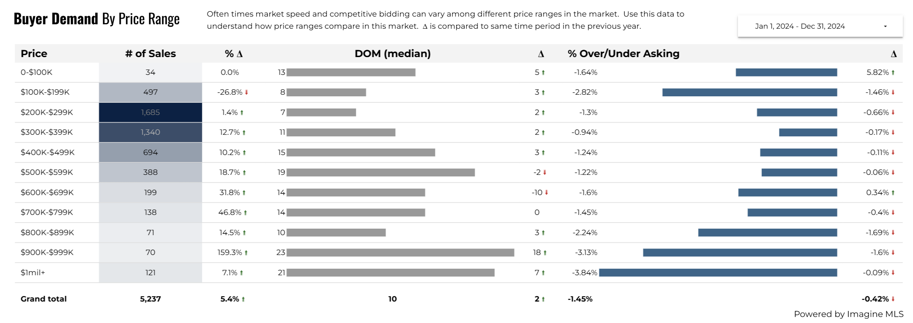
Lexington MSA Days on Market by Price Range
Source: MLS Data
Notes:
Here is the number of sales, median days on market, and % of asking for all of 2024 broke down by Price Range. A few things to point out specifically on this slide because it is so dense with data.

Slide 45
Lexington MSA Days on Market by Price Range
Source: MLS Data
Notes:
There were only 497 sales during the entire year that were in the 100-200k range, representing a 26.8% drop from the previous year.

Slide 46
Lexington MSA Days on Market by Price Range
Source: MLS Data
Notes:
Meanwhile, all other price ranges saw increases in the number of sales as the prices creep higher.

Slide 47
Lexington MSA Days on Market by Price Range
Source: MLS Data
Notes:
As a reminder, the Median sales price for 2024 was about $328,000, and you can see that Median Days on Market is markedly lower for under-median sales price homes compared to over median.

Slide 48
Lexington MSA Days on Market by Price Range
Source: MLS Data
Notes:
Speaking of the median, the range with the most sales is just below median at 200-300k, constituting about 32% of total sales.

Slide 49
Lexington MSA Days on Market by Price Range
Source: MLS Data
Notes:
And you can see a pretty steep drop off in sales once you get above 400 thousand, with all those sales together making up about 32% of total sales. This isn’t out of the ordinary for most markets, though. It’s very normal to see a steep drop off in sales and inventory above the conforming loan limits, which in 2024 was around $766 thousand dollars.

Slide 50
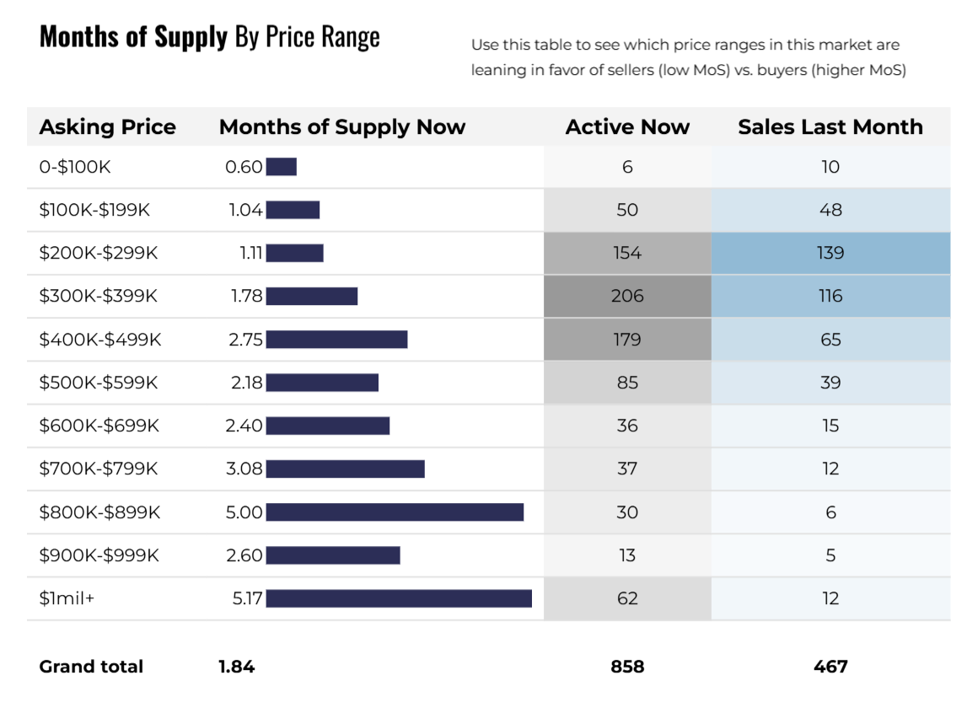
Lexington MSA Months of Supply by Price Range
Source: MLS Data
Notes:
This trend of differences above and below median is visible in the Months of Supply as well.
This measure essentially asks “If no new inventory was added to the market, and your current sales remained steady, how many months would it take you to run out of inventory?”

Slide 51
Lexington MSA Months of Supply by Price Range
Source: MLS Data
Notes:
And again your months supply of inventory below the median is half the size of your months of supply above it.

Slide 52
Lexington MSA DOM and MOS by Price Range
Source: MLS Data
Notes:
Hopefully you’re starting to see the pattern that I’m trying to show here. I think everyone knows that affordable housing is a problem. Anytime an issue is reaching the top important issues lists for both presidential candidates it’s obvious that it is a problem. But I’m trying to highlight exactly how bad it is and tell the story of attainable housing.

Slide 53
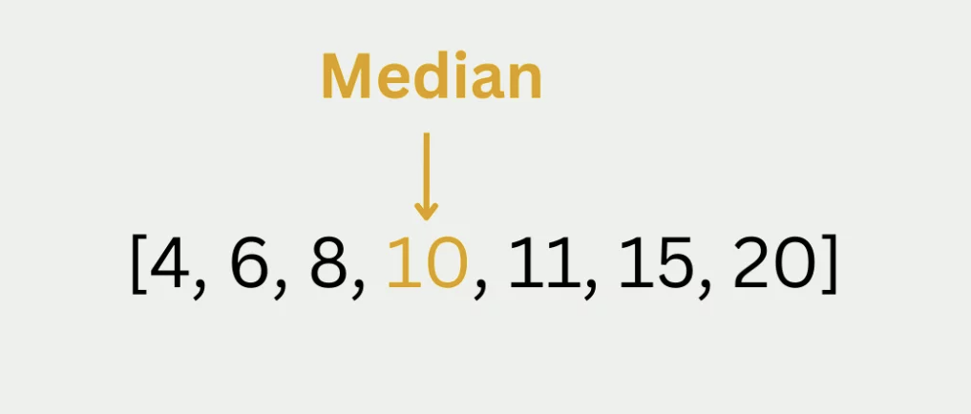
Notes:
But Richard, you might be asking, isn’t that just how median works? Doesn’t what you’re saying just prove the definition of what median means?
Well, yes.
But this is one of those times that we really must step back and think about the people behind the data. When Days on Market it down to 5 to 8 days, that often means a lot of multiple-offer situations, a lot of short timelines on big decisions, and a lot of frustration for the buyers in the market.

Slide 54
Notes:
We can sit here and talk about numbers and logic and business all day long, but any REALTOR out there actually working with consumers will tell you – residential real estate is emotional. It is relational. It is humans pursuing the dream of homeownership and needing help from a REALTOR to navigate the most complex and expensive transaction of their lives.
I’m trying to help you see the pain points of the current market for first time or second chance home buyers, because with all apologies to Charles Dickens what I’m trying to show here is what I call…..

Slide 55
Markets
Notes:
....... “A Tale of Two Markets.”
For some, it was the best of times.
For others, it was the worst of times.
The classic opening of this book resonates with us because the words ring true of so many things in our lives. Real Estate is not immune to the dichotomies of good times versus bad times, wisdom versus foolishness, belief versus incredulity, Light versus Darkness, and hope versus despair. In fact, I think most REALTORS would tell you they experience all of the above in every transaction.

Slide 56
Median DOM
15
Months Supply
2.5
Markets
Source: MLS Data
Notes:
If someone is doing pretty well, maybe carrying over some equity from a previous home purchase, and they have the opportunity to look above the median sale price, they are competing in a market with 2 and half months of inventory, a median days on market of 15 + days, and likely not a whole bunch of multiple offer situations (though some do still exist).

Slide 57
Median DOM
15
Months Supply
2.5
Median DOM
5
Months Supply
1.1
Markets
Source: MLS Data
Notes:
Meanwhile those looking to purchase their first home are not only being priced out by high mortgage rates, but they’re also dealing with significantly shorter time on market to the point they can’t really afford to even sleep on a decision, and constrained months of supply giving them fewer available options as well. There are likely a lot more multiple-offer situations to deal with leading to more stress and frustration for these buyers.

Slide 58
Who Are the Buyers of 2024?
Notes:
Which segways into my next section that looks at who are these buyers, and what are they buying?
Much of this data comes from the NAR Profile of Home Buyers and Sellers 2024 report which is an annual survey of recent home buyers and sellers who recently completed a transaction between July 2023 and June 2024. This flagship report has been published since 1981 and allows industry professionals to gain insight into detailed buying and selling behavior.
A 16 page summary of this report is available for free at nar.realtor, but the full 141 page report is also available at a cost.
Similar to the housing data, we’re going to start with a national look, and then drill down some into the Lexington area specifically.

Slide 59
First-Time Buyer Share (Among Primary Residence Buyers)
2024 Profile of Home Buyers and Sellers
Notes:
One of the most shocking findings from the 2024 survey is that First Time Home Buyers only accounted for 24% of total sales for the year This is the lowest the number has been since they started tracking it in 1981, and it is half of the peak of 50% in 2010.

Slide 60
Median Age of Home Buyers 1981-2024
2024 Profile of Home Buyers and Sellers
Notes:
Also of note is that the ages of home buyers reached all-time highs. The median buyer age increased to a peak of 56 years old, up from 49 last year. The median first-time buyer age increased to 38 years old this year from 35 last year, while the typical repeat buyer age also increased to 61 years from 58 last year.
It’s worth noting that in the 1980s, a first time home buyer was in their late 20s, underscoring the hurdles to entering the housing market that have increased this median age since then.

Slide 61
Median Household Income
2024 Profile of Home Buyers and Sellers
Notes:
The Median Household Income to be a homeowner has also been increasing, taking a jump for First-Time buyers of $71,000 in 2021 to $97,000 in 2023., and for repeat buyers there was an increase from $96,000 in 2021 to $114,300 in 2023.

Slide 62
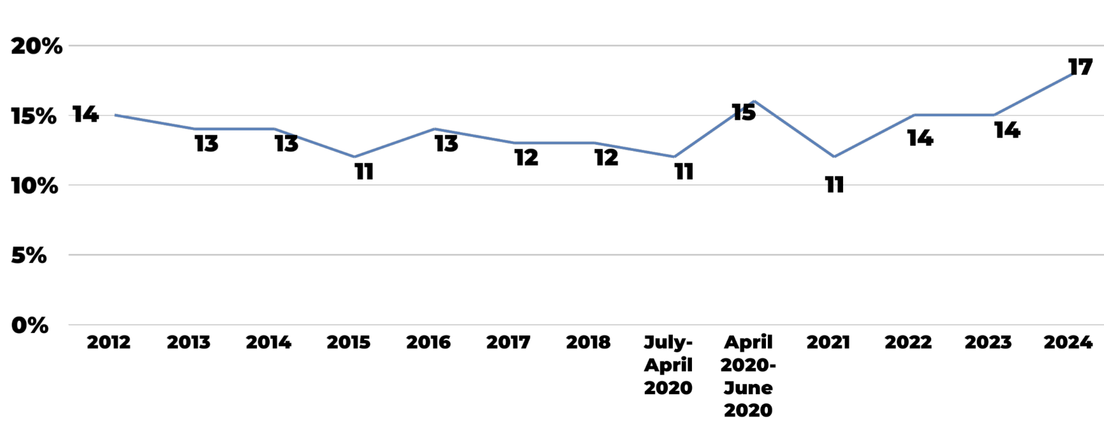
Multi-Generational Home Buyers
2024 Profile of Home Buyers and Sellers
Notes:
Another interesting trend is that seventeen percent of home buyers purchased a multi-generational home—a home that had adult siblings, adult children over the age of 18, parents, and/or grandparents—this is up from 14 percent last year and the highest since NAR began recording this.

Slide 63
Multi-Generational Home Buyers
2024 Profile of Home Buyers and Sellers
Notes:
To break that 17% down a little more, the top reasons for purchasing a multigenerational home were for cost savings (36%), to take care of aging parents (25%), because of children or relatives over the age of 18 moving back home (21%,) and children over the age of 18 who never left home (20%). This underscores the pressure that many families are feeling to have their own separate single family homes to deal with changing life situations.

Slide 64
Financing the Home Purchase
Notes:
The Home Buyers and Sellers Report also looks at how home purchases are financed, so let’s take a look at a few things in that chapter.

Slide 65
Median Percent Downpayment by First-Time and Repeat Buyers
2024 Profile of Home Buyers and Sellers
Notes:
This chart shows the differences in downpayments between First-Time and Repeat Buyers.
Repeat buyers can enter the housing market with large downpayments (median of 23 percent), and 31 percent paid cash and did not finance their home. This is likely due to the increase in housing equity. For repeat buyers, this is the highest downpayment seen since 2003.
This year, downpayments also grew for first-time buyers, as they may need to make a more substantial offer among all-cash buyers. The typical downpayment for first-time buyers was nine percent, which is the highest share since 1997.

Slide 66
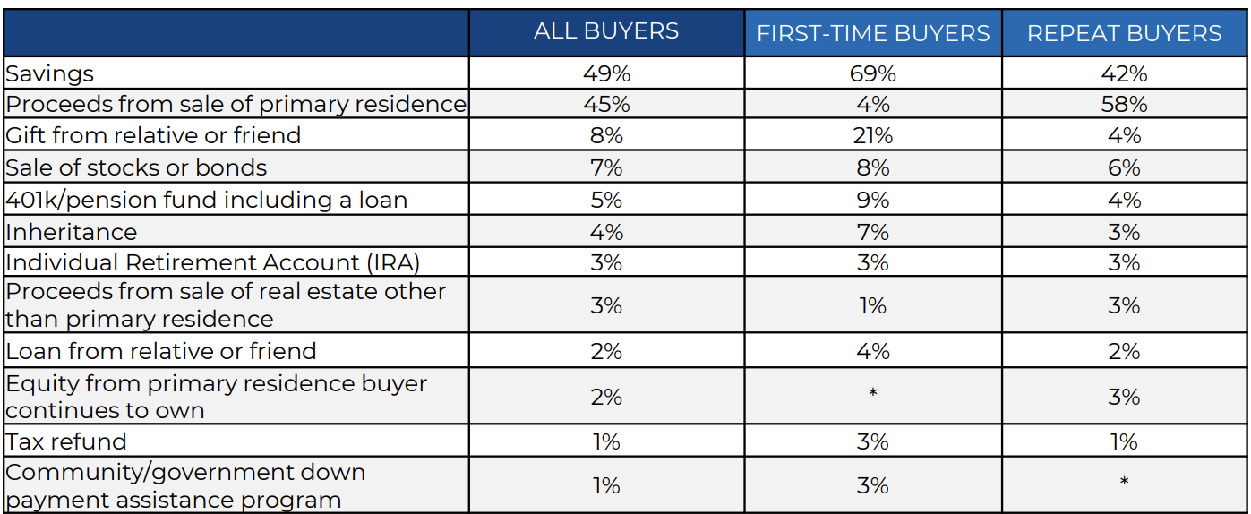
Sources of Downpayment by First-Time and Repeat Buyers
2024 Profile of Home Buyers and Sellers
Notes:
We can also look at the Sources of downpayment between first time and repeat buyers.

Slide 67
Sources of Downpayment by First-Time and Repeat Buyers
2024 Profile of Home Buyers and Sellers
Notes:
. For repeat buyers, the proceeds from the sale of a primary residence was the most commonly cited way of financing a home purchase at 58 percent, up from 53 percent last year.

Slide 68
Sources of Downpayment by First-Time and Repeat Buyers
2024 Profile of Home Buyers and Sellers
Notes:
For first-time buyers, 69 percent used savings and a 25% used a gift or Loan from relative or friend.

Slide 69
Sources of Downpayment by First-Time and Repeat Buyers
2024 Profile of Home Buyers and Sellers
Notes:
Also. Twenty-one percent of first-time buyers used financial assets such as stocks, bonds, 401k, IRAs, or crypto currency.

Slide 70
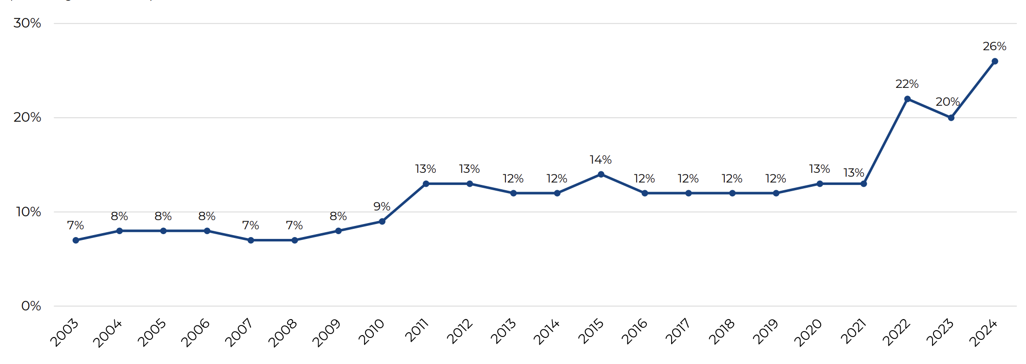
All-Cash Buyers
2024 Profile of Home Buyers and Sellers
Notes:
Speaking of All-Cash Buyers that also hit an all time high at twenty-six percent. In the 2023 report, 20 percent of buyers paid with cash for their home. Between 2003 and 2010, under 10 percent of buyers did not finance their home purchase.
This is another place I want to pause for a moment and clarify what this means. Many have taken this to mean that investors or large corporations are paying cash for homes in large quantities. While this may be true in some markets, such as New York City and Philadelphia, that is simply not the case in the majority of the country.
What is more likely happening to create this increase in All-Cash sales is Americans moving out of high-cost of living states such as New York, Hawaii, Illinois, and California who can easily sell their homes in those areas and buy elsewhere for all Cash, and likely still have money left over.

Slide 71
Buyer Use Agents
2024 Profile of Home Buyers and Sellers
Notes:
One last chart from the Home Buyers and Sellers report is one of my favorites to show, and I hope you’ll forgive me a minute or two of indulgence.
This big red line here in 2006 (added by me, not NAR), anyone know what that year represents?
That’s the year Zillow launched.
The years that followed all heralded the end of the REALTOR. Many people compared them to Travel Agents. Their time was short and the internet was going to revolutionize the whole industry.

Slide 72
Buyer Use Agents
2024 Profile of Home Buyers and Sellers
Notes:
Well, the internet DID revolutionize the industry. Zillow does a great job providing consumers access to listings, and their 10 BILLION page views per year shows that looking at homes online is America’s new pastime. But you see what didn’t change? People wanting an agent in the homebuying process. In fact, the use of a buyer’s agent has INCREASED since then. To quote the great Mark Twain, “the report of my death was an exaggeration.”
The demise of the REALTOR has been predicted time and time again, but in the end, people want that trusted professional to guide them through the complicated process they will only do a few times in their life.

Slide 73
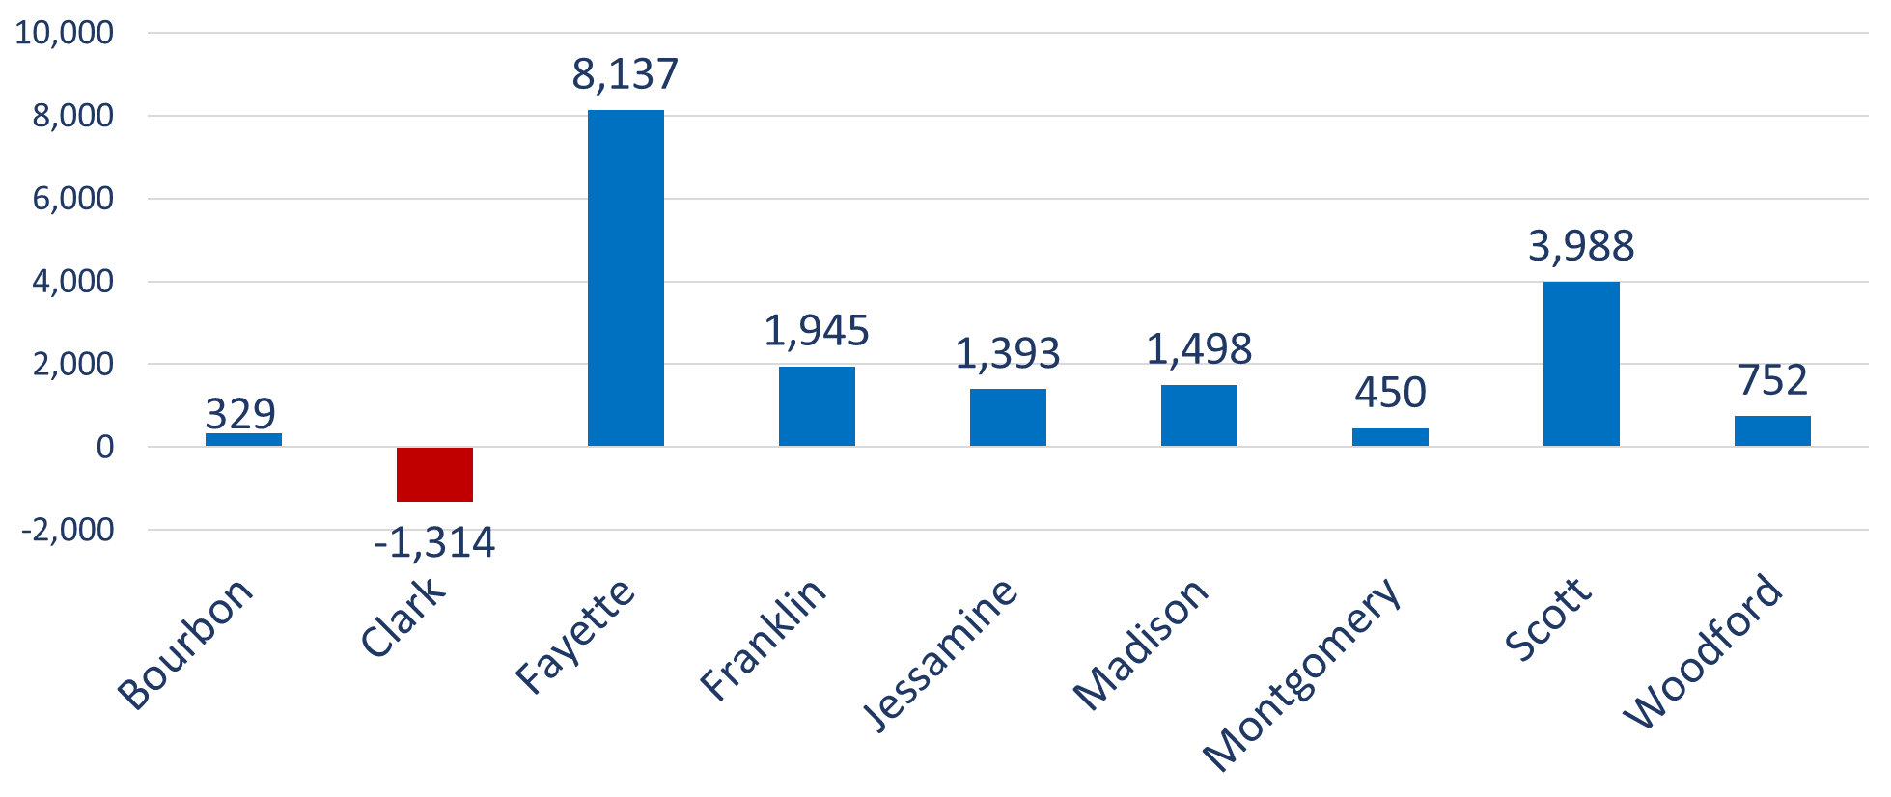
Greater LEX Regional Job Growth 2018-2023
Notes:
For these last few slides, I want to thank our friends and fellow sponsor at Commerce Lexington. Collectively, we continue to work to make this region and each community more competitive for jobs and people. At the Regional Summit in November, Ted Abernathy with Economic Leadership provided an update on jobs and workforce growth across the region and this slide shows that we have added nearly 18,000 jobs in the last five years with growth pacing just below the national average.

Slide 74
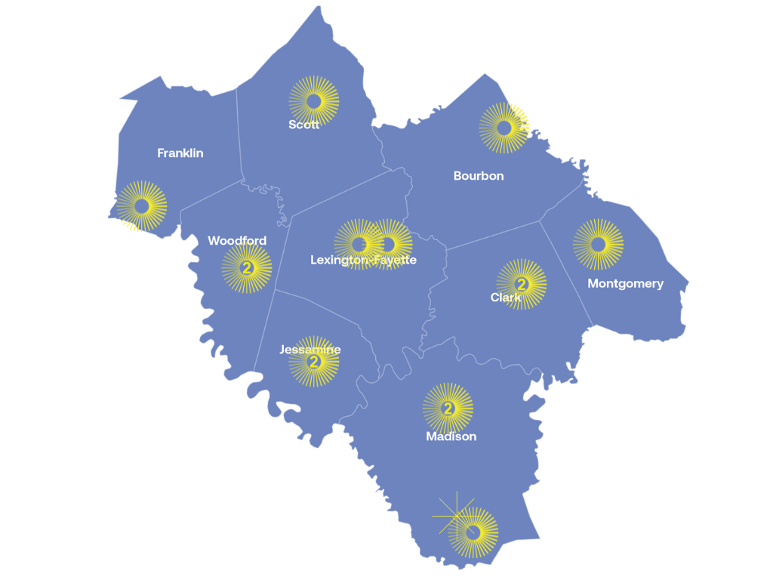
KPDI Approved Project Map
Approved Projects | 15
State Funding | $20.4 Million
Local + State Investments | $66.5 Million
Pending KEDFA Approval | 0
Kentucky Product Development Initiative 2019 - 2024
Notes:
And we have even more projects coming that are going create even more jobs. The Kentucky Product Development Initiative program has helped accelerate investments in getting more land and sites ready for jobs in Lexington and the region.

Slide 75
Greater LEX Regional Job Growth 2018-2023
Notes:
But I want to go back to the graph for a moment, to help visualize a real problem that we have with this job growth.
If we keep the Y axis range the same and change over to the graph showing the growth of our labor force over the last 5 years……

Slide 76
Greater LEX Regional Labor Force Growth 2018-2023
Notes:
You can see that workforce attraction and retention remains a challenge. We are simply not producing enough workers to meet our job needs. Reminder – this is FIVE YEARS of job growth, not one.
There are a lot of other factors here, but one major factor is that Kentucky is one of the worst states in the country for “brain drain,” that is, we are losing a large number of college graduates to other states. We have about 20,000 graduates each year from universities in the state, but our labor force is growing by less than 1,000 each year.
Combine this with what I showed you earlier about the difficulty of buying an affordable home, the drastic increases in median age for first time home buyers, and the larger income and downpayments necessary to purchase, and you can start to see a pattern that part of the reason we may be losing college graduates is that we simply don’t have anywhere available for them to live.
People often try to talk about jobs and housing like they are separate issues, but really…..

Slide 77
Housing is where jobs go to sleep at night.
Notes:
Housing is where jobs to go to sleep at night. They go hand in hand, and cannot be separated. If any city, region, or state wants to see sustainable growth, they must address both issues simultaneously.
I’m not here to tell you which policies can fix the problem. In fact, REALTORS are often split on the best paths forward as we balance the need for additional housing with homeownership and property rights. The only thing I’m trying to do is help you understand the depths of the problem so that we can all start thinking about solutions that move us forward together.

Slide 78
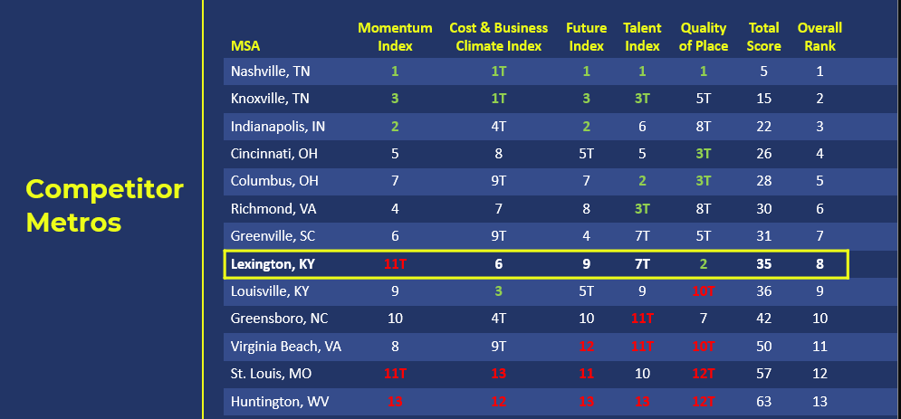
Notes:
But this isn’t all bad! I do think there is a lot of potential in Kentucky. Regional leaders analyzed how the Greater LEX region (9-county) ranked against some of our competitors cities or cities of a similar size based on competitiveness indexes, and you can see those results here. Two key takeaways are that the region has tremendous quality of life strengths that needs to be leveraged, ranking second in that regard, but we also have a momentum challenge, in a tie for 11th place out of 13. The momentum index refers to the “projected growth” of the region which measures the region’s growth in wages, GDP, and workforce, which is slowing and was below the national average in those categories.
Efforts from Commerce Lexington and the Governor’s “New Kentucky Home” campaign are working to change that trajectory. We just also need to make sure we are working on finding ways to make up the 206,000 unit shortfall in housing units as reported by the Kentucky Legislature’s Housing Task Force.

Slide 79
Notes:
Again, thank you all for your time and attention today, as well as this opportunity to present. I believe we will now be moving to the Q&A portion of the event.

