Slide 1

Kentucky’s Economic Outlook 2025
February 11, 2025
Michael W. Clark, Ph.D.
Associate Professor of Economics
Director, Center for Business and Economic Research
michael.clark@uky.edu

Slide 2
Overview
Economy appears to be on solid footing.
  Employment continues to grow but at slower pace
  Inflation has eased but is proving stubborn
  Output better than expected
Kentucky
  Employment growth in 2024 was slower
  Strong job growth in Education & Health Services and in Government
  Job losses in some sectors

Slide 3
Inflation: 12-Month Percent Change
Source: US Bureau of Labor Statistics. Consumer Price Index. US Bureau of Economic Analysis. PCE.

Slide 4
Real Gross Domestic Product
Kentucky & U.S.
Source: US Bureau of Economic Analysis.

Slide 5
Unemployment Rates
Kentucky & U.S.
Source: US Bureau of Labor Statistics. Local Area Unemployment Statistics. Kentucky and US are seasonally adjusted. Lexington/Fayette MSA not seasonally adjusted.

Slide 6
Number of People in the Labor Force (Employed or Looking for Work)
Source: US Bureau of Labor Statistics. Local Area Unemployment Statistics. Seasonally Adjusted.

Slide 7
Labor Market
Source: US Bureau of Labor Statistics. Local Area Unemployment Statistics. Seasonally Adjusted.
Source: US Department of Labor. Employment & Training Administration.
Notes:
There were nearly 38,000 more people employed in Dec 2024 than in Dec 2023.

Slide 8
Kentucky’s Nonfarm Employment (Jobs)
Source: US Bureau of Labor Statistics. Current Employment Statistics.

Slide 9
Percent Change in Annual Total Nonfarm Employment (Jobs)
Source: US Bureau of Labor Statistics. Current Employment Statistics.
Notes:
Average employment in KY for 2024 was up 23,300 jobs compared to 2023.

Slide 10
Percent Change in Annual Manufacturing Employment (Jobs)
Source: US Bureau of Labor Statistics. Current Employment Statistics.

Slide 11
Percent Change in Annual Construction Employment (Jobs)
Source: US Bureau of Labor Statistics. Current Employment Statistics.

Slide 12
Percent Change in Annual Education & Health Care Employment (Jobs)
Source: US Bureau of Labor Statistics. Current Employment Statistics.

Slide 13
Change in Average Annual Employment, Kentucky
2023 to 2024
Source: US Bureau of Labor Statistics. Current Employment Statistics.

Slide 14
Change in Average Annual Employment, Lexington-Fayette MSA
2023 to 2024
Source: US Bureau of Labor Statistics. Current Employment Statistics.

Slide 15
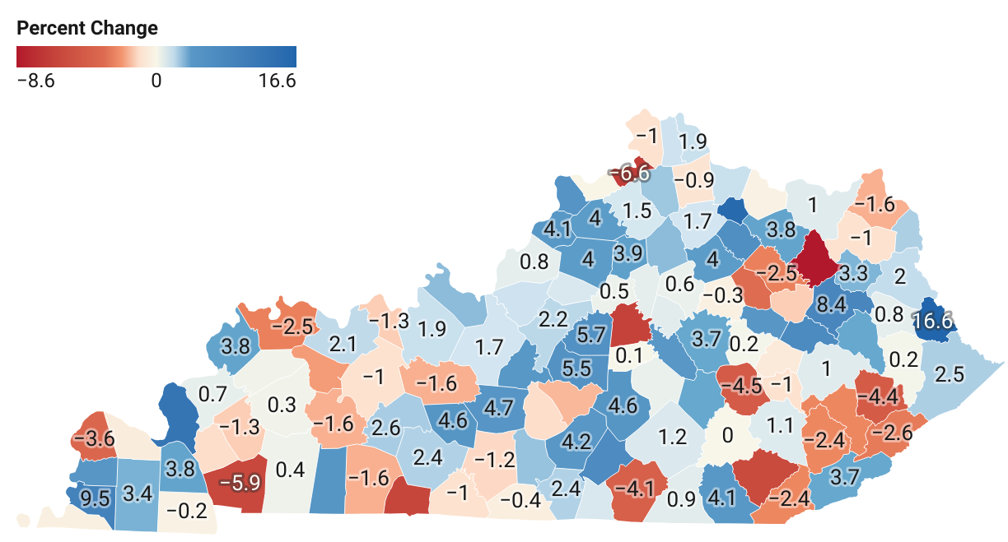
Change in County Employment June 2023 to June 2024

Slide 16
U.S. Employment Cost Index for Private Workers
Wages and Salaries and Benefits
Source: US Bureau of Labor Statistics.

Slide 17
Housing Market
Demand
Employment & Income
Population Growth/Migration
Financing Costs
Supply
Construction Input Costs
Lock-in Effects
New Construction

Slide 18
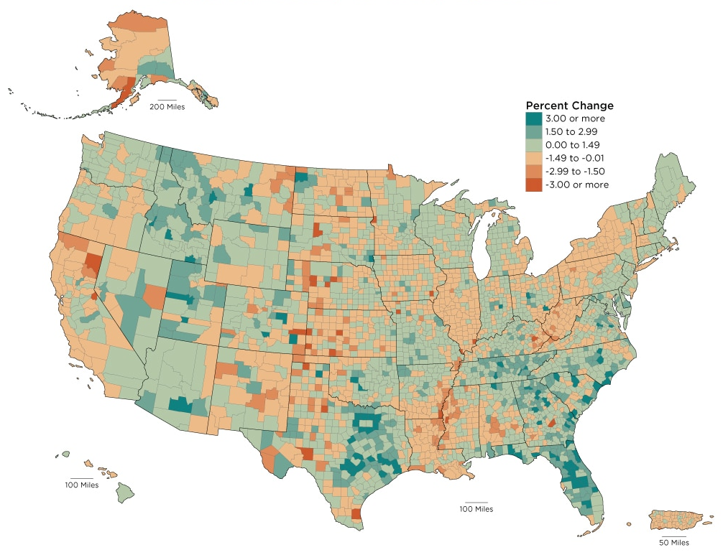
US Population & Household Growth
Percent Change in Population: 2022 to 2023
Change 2013 to 2023
 | Annual Average Growth Rate | Annual Average Change
Population | 0.5% | 1.9 mil
Households | 0.7% | 897,500
Family Households | 0.4% | 343,200
Nonfamily Households | 1.3% | 554,100
Sources: US Census Bureau.

Slide 19
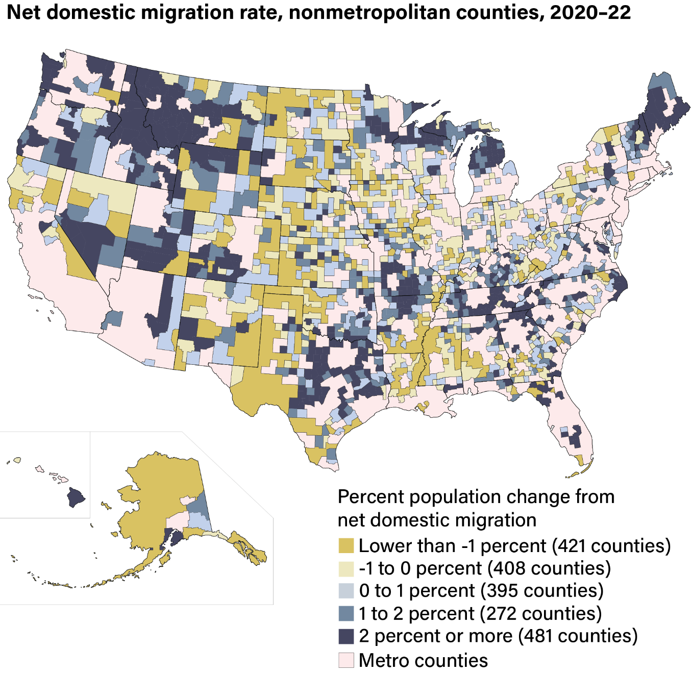
Net Migration to Rural Areas Have Increased
Sources: Cromartie, John. Rural America at a Glance, 2023 Edition. United States Department of Agriculture. Economic Research Service.

Slide 20
Mortgage Rates Have Increased Despite the Fed’s Actions Last Year
Sources: Board of Governors of the Federal Reserve System (US); Federal Reserve Bank of New York; Freddie Mac; fred.stlouisfed.org.
Notes:
10-year yield has increased, so prices for these bonds decreased. So, did demand for these notes decrease? Investors must think these notes are a bad investment. Why might the think this? Could be that they think rates on longer term notes will be higher in the future. Could be they think inflation might increase.

Slide 21
US Construction Costs Have Stabilized
Source: US Census Bureau, Construction Price Indexes.
Source: US Bureau of Labor Statistics. Producer Price Index.

Slide 22
US Housing Units (000s)
Source: US Census Bureau and US Department of Housing and Urban Development

Slide 23
KY Housing Units Authorized by Permits
Source: US Census Bureau.

Slide 24
High Interest Rates on Outstanding Mortgages Limit Housing Mobility
Roughly, 83% have rates that are below the current average 15-year rate of 6%.
Source: FHFA National Mortgage Database.

Slide 25
Housing Market
Source: Realtor.com. https://www.realtor.com/research/data/

Slide 26
FHFA Housing Price Index, Percent Change Over Same Quarter Last Year
Source: Federal Housing Finance Agency. Seasonally Adjusted.

Slide 27
Outlook
Economy will continue to grow but at slower pace
Unemployment rate increases gradually
Inflation pressures will continue to slowly ease
Recession risk still seems low

Slide 28
Economic Outlook
 | 2025
Real GDP—US | 2.1%
Real GDP—Kentucky | 1.9%
Inflation—US | 2.3%
Unemployment Rate—US | 4.3%
Unemployment Rate—Kentucky | 5.3%
Nonfarm Employment—US | 1.1%
Nonfarm Employment—Kentucky | 0.9%
Manufacturing Employment—Kentucky | -0.5%

Slide 29
Risk to Outlook
Tariffs & Trade Policy
  Period of higher inflation
  Slower long-term economic growth
Immigration Policy
  Reduce labor supply
  Upward pressure on wages and inflation
Notes:
Exports from KY are equivalent to 14% of KY’s GDP. 12% for US.
KY Imports a lot of
3363 Motor Vehicle Parts
3336 Engines, Turbines & Power Transmission Equip motor vehicle parts
3313 Alumina & Aluminum & Processing
Ky Exports a lot of
88 Aircraft, Spacecraft, And Parts Thereof 83,539,740,262 36.11%
87 Vehicles, Except Railway Or Tramway, And Parts Etc 33,342,401,640 14.41%
84 Nuclear Reactors, Boilers, Machinery Etc.; Parts 29,480,636,275 12.74%
30 Pharmaceutical Products 15,129,498,090 6.54%

Slide 30

http://cber.uky.edu/

Slide 31
Percent Change in Employment Since January 2014
US
KY
Ky’s Bordering States
Percent

Slide 32
Total Nonfarm Employment, Percent Change from January 2020
Source: US Bureau of Labor Statistics. Current Employment Statistics. Seasonally Adjusted.
Notes:
Ky emp decrease over the past 3 months (-7,800 jobs)

Slide 33
Manufacturing Employment, Percent Change from January 2020
Source: US Bureau of Labor Statistics. Current Employment Statistics. Seasonally Adjusted.
Notes:
Ky emp decrease over the past 3 months (-7,800 jobs)

Slide 34
Construction Employment, Percent Change from January 2020
Source: US Bureau of Labor Statistics. Current Employment Statistics. Seasonally Adjusted.
Notes:
Ky emp decrease over the past 3 months (-7,800 jobs)

Slide 35
Education & Health Care Services Employment,
Percent Change from January 2020
Source: US Bureau of Labor Statistics. Current Employment Statistics. Seasonally Adjusted.
Notes:
Ky emp decrease over the past 3 months (-7,800 jobs)

Slide 36
Job Opening and Turnover
KY
US
Source: US Bureau of Labor Statistics. Job Openings and Labor Turnover Survey.

Slide 37
Consumer Sentiment (1996=100)
Source: University of Michigan.

Slide 38
Pandemic Excess Savings
Source: Federal Reserve Bank of San Francisco. Pandemic-Era Excess Savings.

